Slide 1
Wednesday Morning Wellness Walks
Julie Cullings
Assistant Director of Student Services
jlc707@psu.edu

Slide 2
Why Walking?
Health Benefits
Logistics
Physical movement
Low impact
Outside activity
Social connection
No equipment necessary
Organized quickly
Minimal staff or volunteers

Slide 3
Goals and Challenges
Goals
Promote physical activity and social connection among students, faculty and staff
Engage all constituencies of the Dickinson Law community
Keep it easy to organize
Low cost
Challenges
Busy schedules and timing
Less folks on campus
Social distancing
Make walks exciting

Slide 4
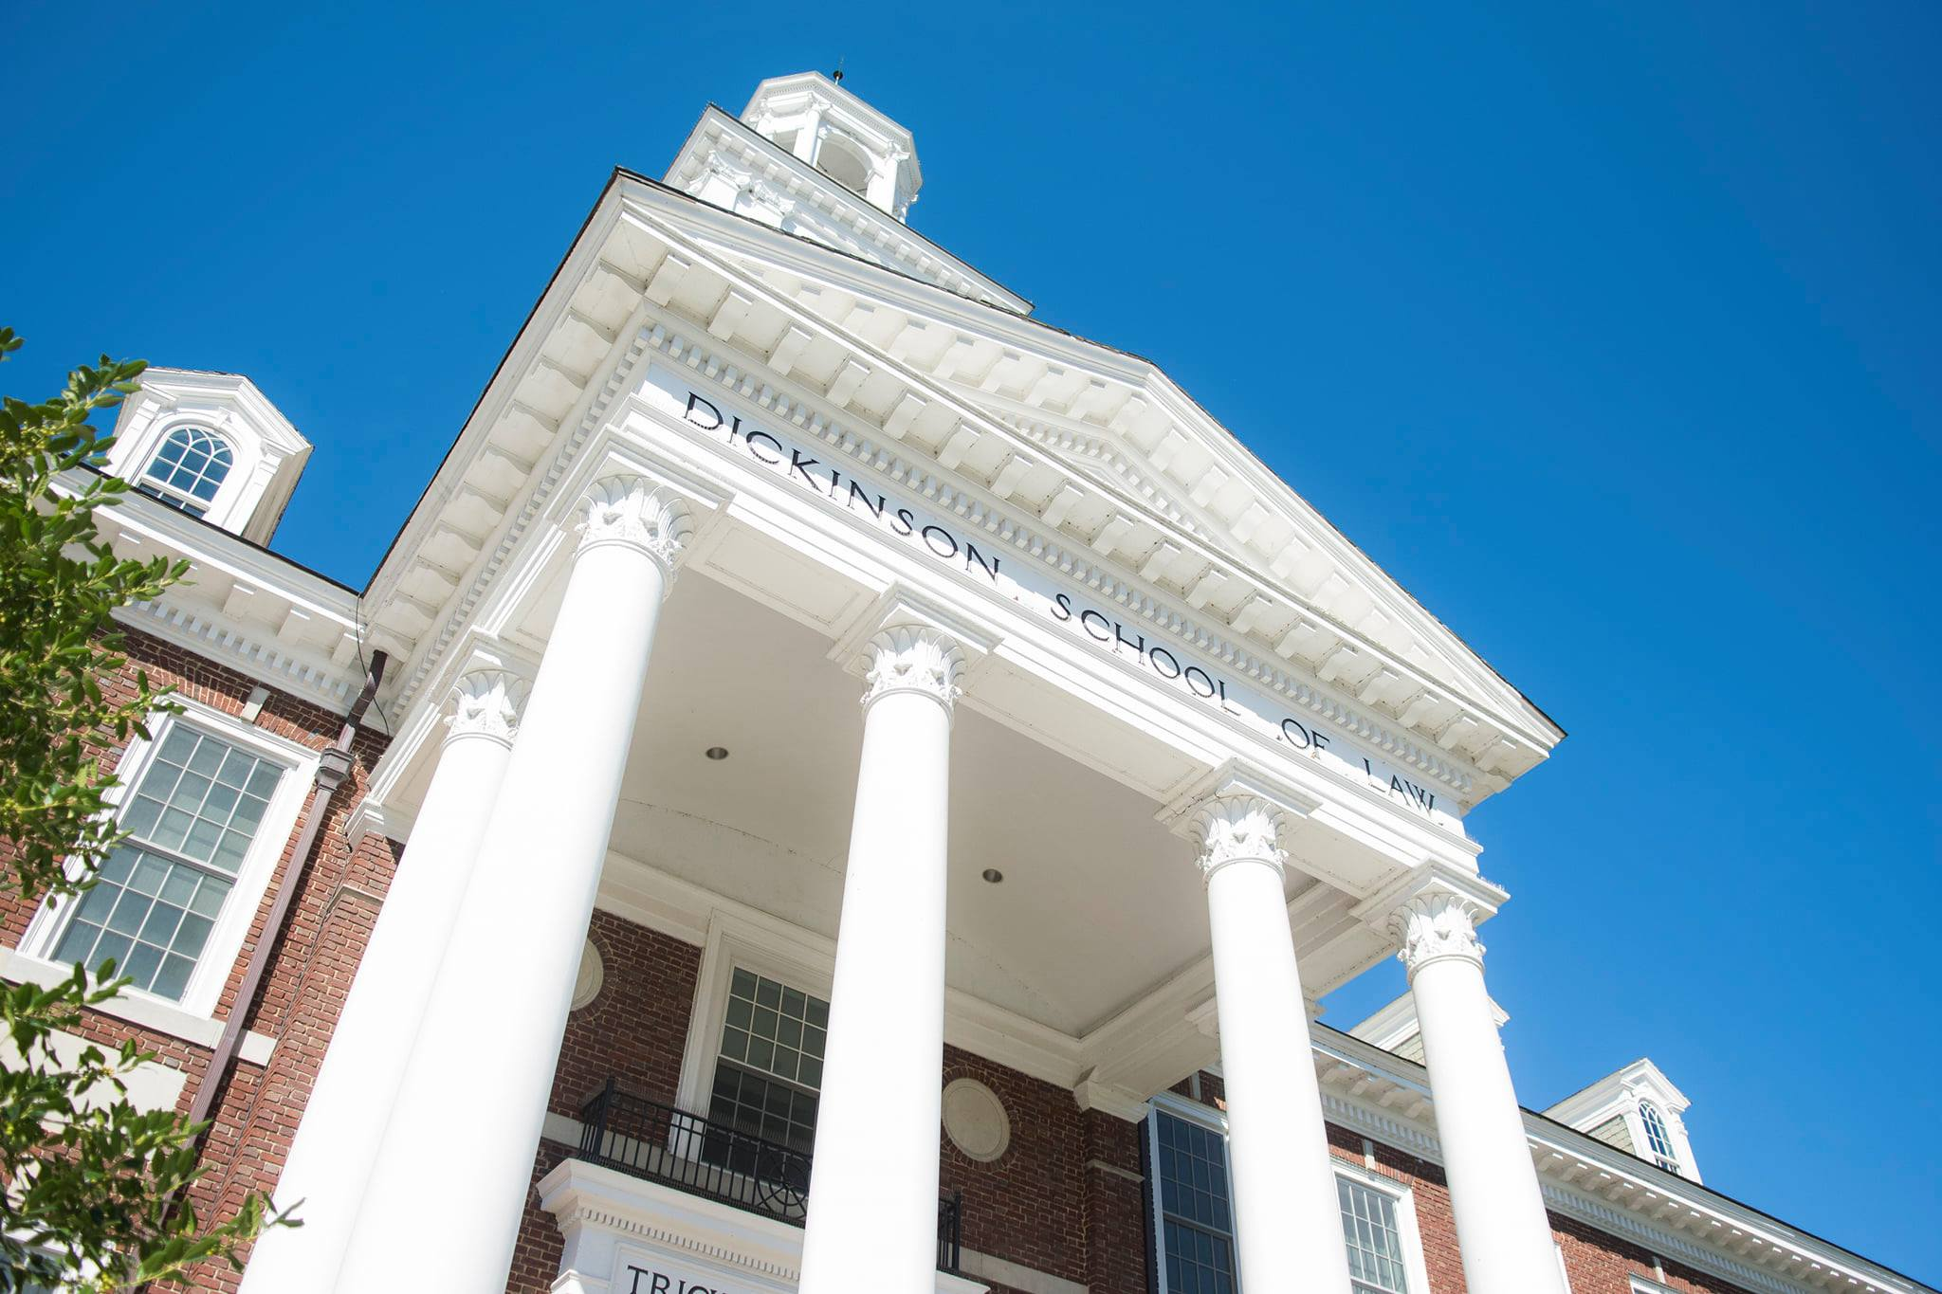
Formula for Success
Keep it short – 30 minutes
Class-free window
8:30-9:00am on Wednesdays
10 or less participants
Practice 6-foot distancing
Masked while not eating/drinking
3 in fall and 3 in spring

Slide 5
Formula for Success
Secret Sauce
Offer refreshments (coffee and prepackaged snacks)
Faculty or staff walk leader
Encourage connection outside the classroom
Keep it simple – recommended walking path with map
Student leader
Encourage peer participation
Serve as support to walk leader

Slide 6
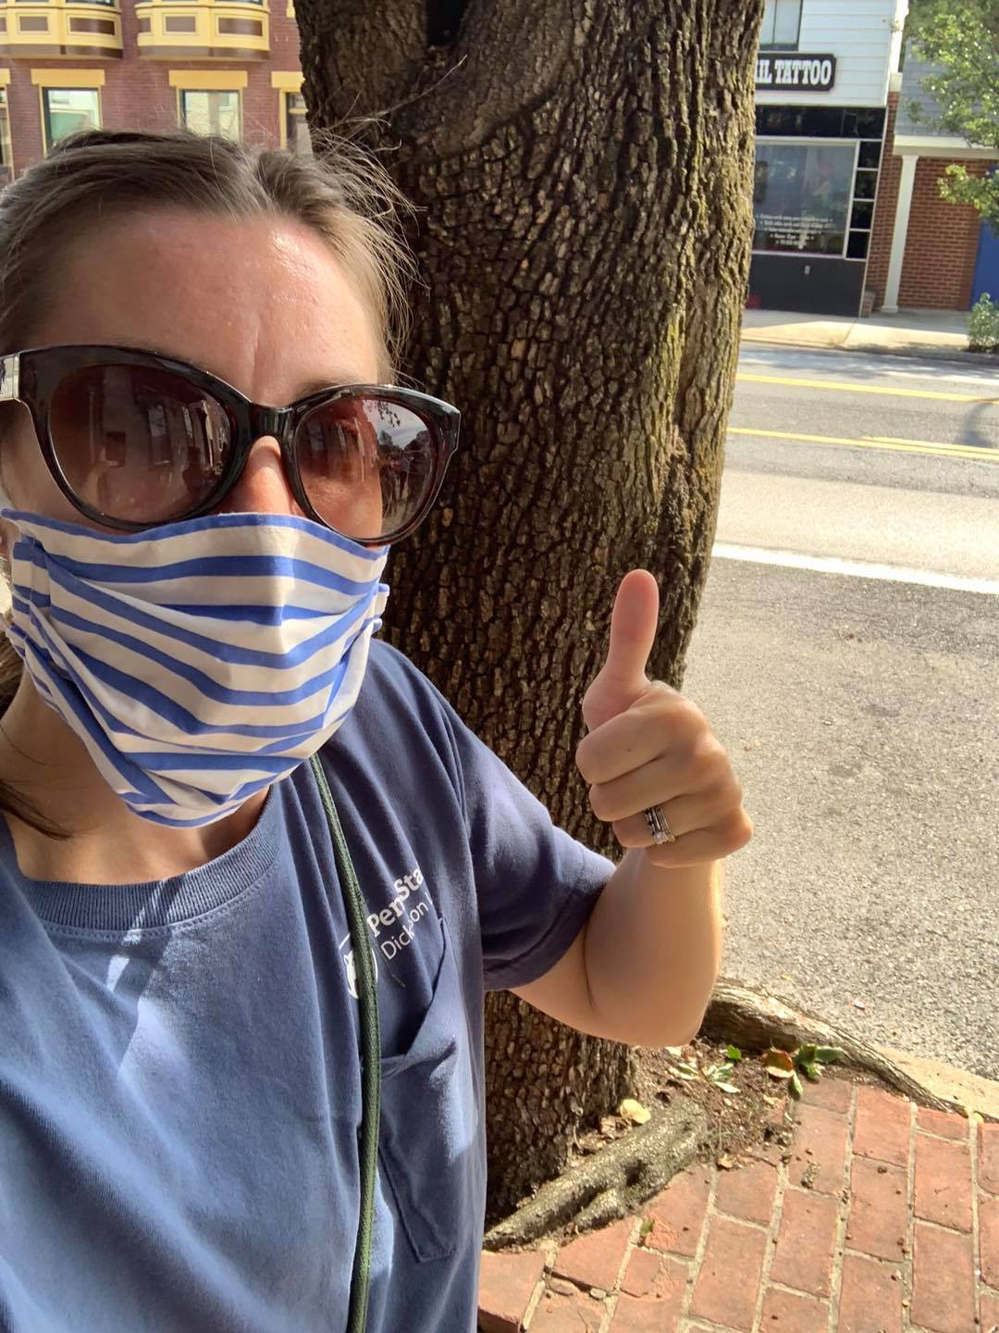
Outcomes
Walk participation at or around capacity
Positive student feedback – enjoyed opportunity to connect with faculty
Recognition of walking wellness benefits
Faculty and staff seeking to lead future walks
Plan to continue next academic year

