Slide 1



America Polarized: What Drives Us Apart?
What Brings Us Together?
AALS Conference on Clinical Legal Education
May 5th, 2019
Daniel Yudkin
Associate Director of Research, More in Common
Postdoctoral Researcher, Yale University

Slide 2
An international initiative founded in 2017 with the goal of building societies and communities that are stronger, more united, and more resilient to threats of polarization, social division, and authoritarian populism.

Slide 3

Agenda
Emotion – How are Americans feeling today?
Research – The Hidden Tribes of America
Lessons – What it means for you
Notes:
Overview

Slide 4
How are Americans feeling today?

Slide 5
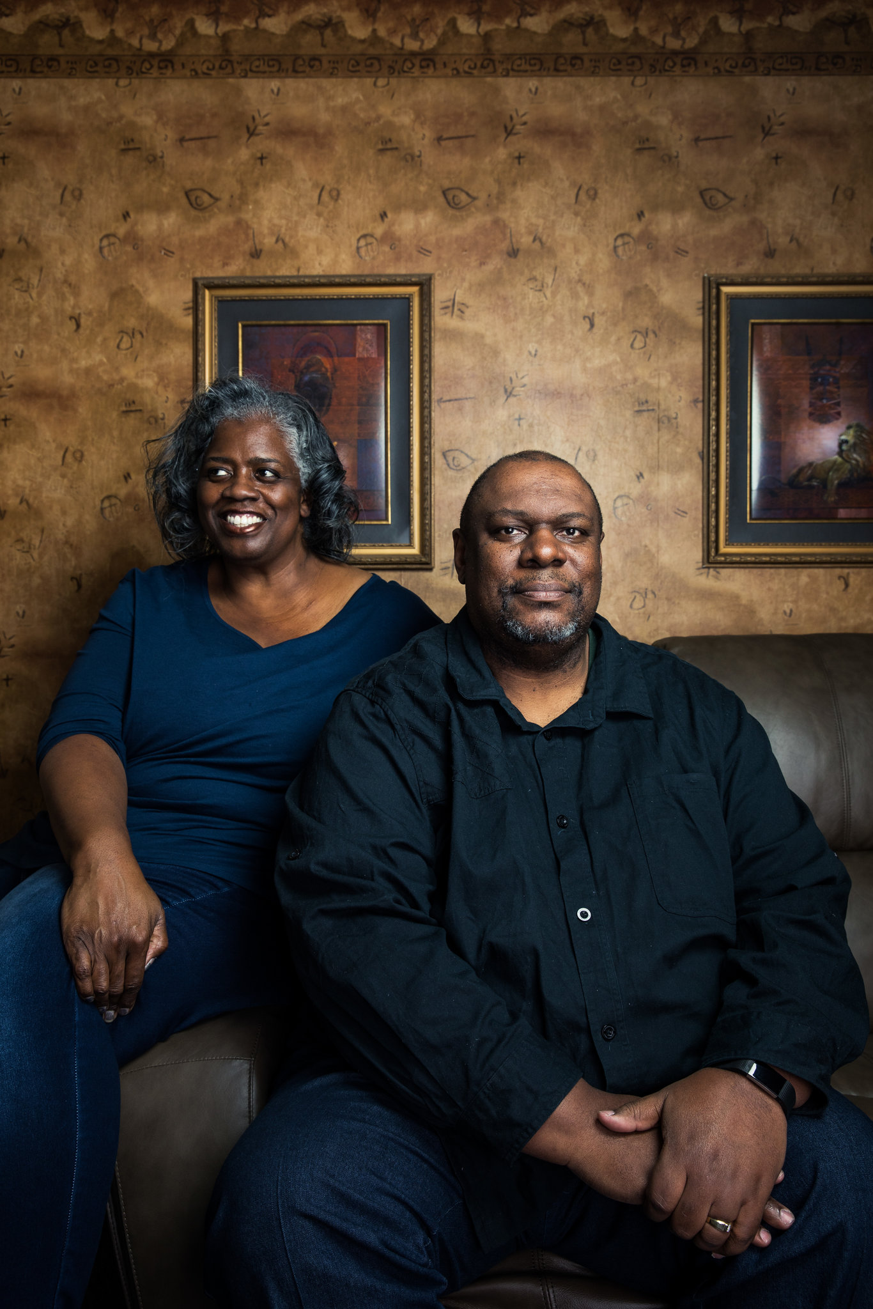
Disillusioned.
  80% of Americans think that the government is rigged to serve the rich and powerful
William and Jeanette Baltimore
Photo: New York Times

Slide 6
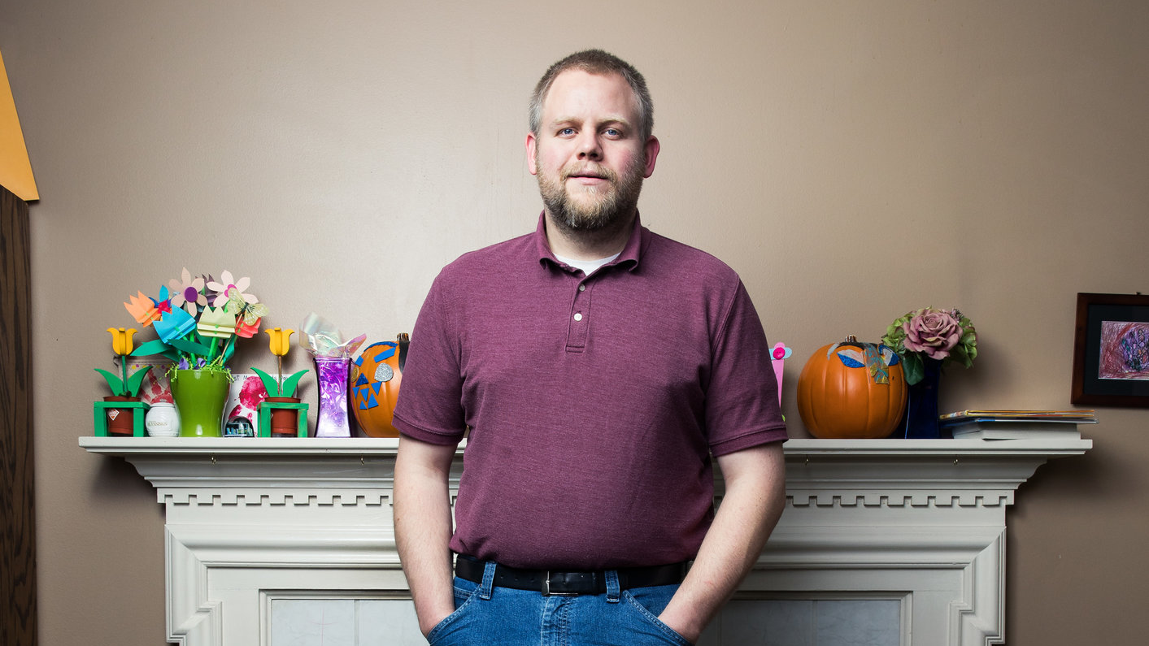
Frustrated.
Two thirds of Americans believe people should be more willing to listen to others and find compromise
​
“We are...at each other’s throats, calling each other evil.”
Bruce Bell, Michigan
Photo: New York Times

Slide 7
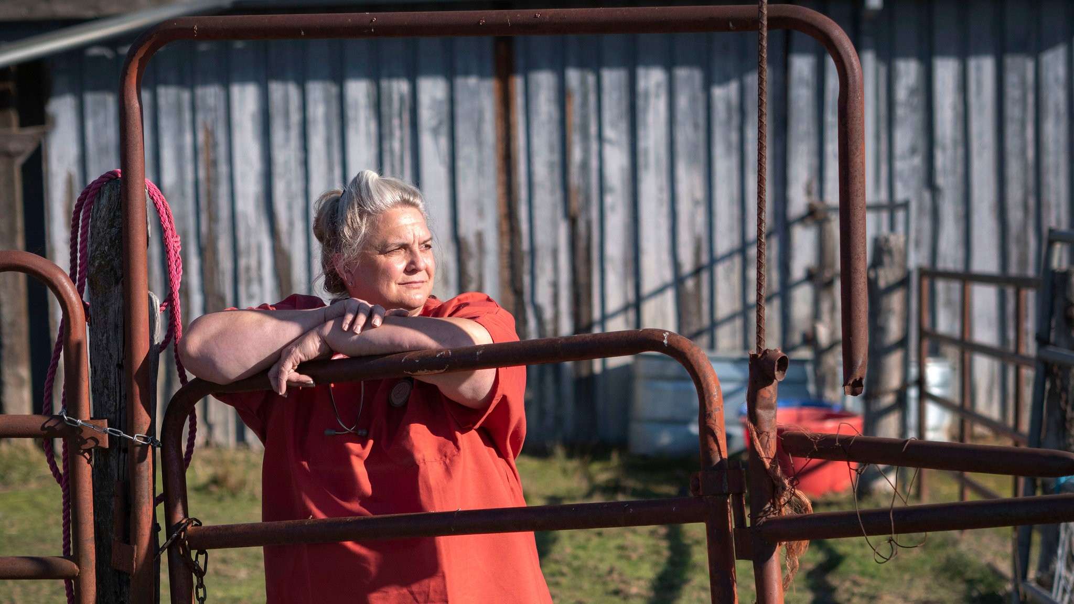
Exhausted.
“More than anything, [people] just want to pick fights.”
Two thirds of Americans say they are “exhausted” by politics today.
Elizabeth Damon, Oregon
Photo: New York Times

Slide 9
How do we navigate legal
and educational settings
in a polarized era?

Slide 10
Notes:
What this does is it identifies groups of people with similar responses.

Slide 11

Method
Survey of 8,000 Americans
Political Opinions
Core Beliefs
  Moral values
  Sense of threat
  Personal agency/responsibility
  Parenting philosophy
  Group identity
Hierarchical Cluster Analysis
Notes:
In the study, we surveyed 8,000 Americans. And we asked them a variety of questions not just about their political opinions, but also about their core beliefs. Core beliefs are views that research in social psychology suggests shape the way people see the world. These include things like moral values, the sense that the world is a dangerous place, their views on personal agency and responsibility, parenting style, and group identity.

Slide 12
Hierarchical Cluster Analysis
Notes:
What this does is it identifies groups of people with similar responses.

Slide 13
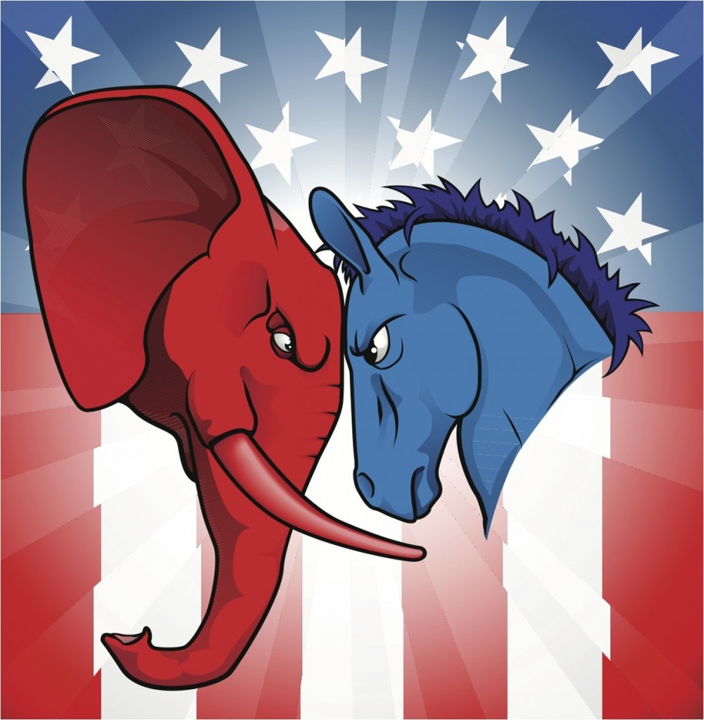
Notes:
Now, we’re often told that America is a 50:50 country with two main groups. But we found the story is far more nuanced.

Slide 14
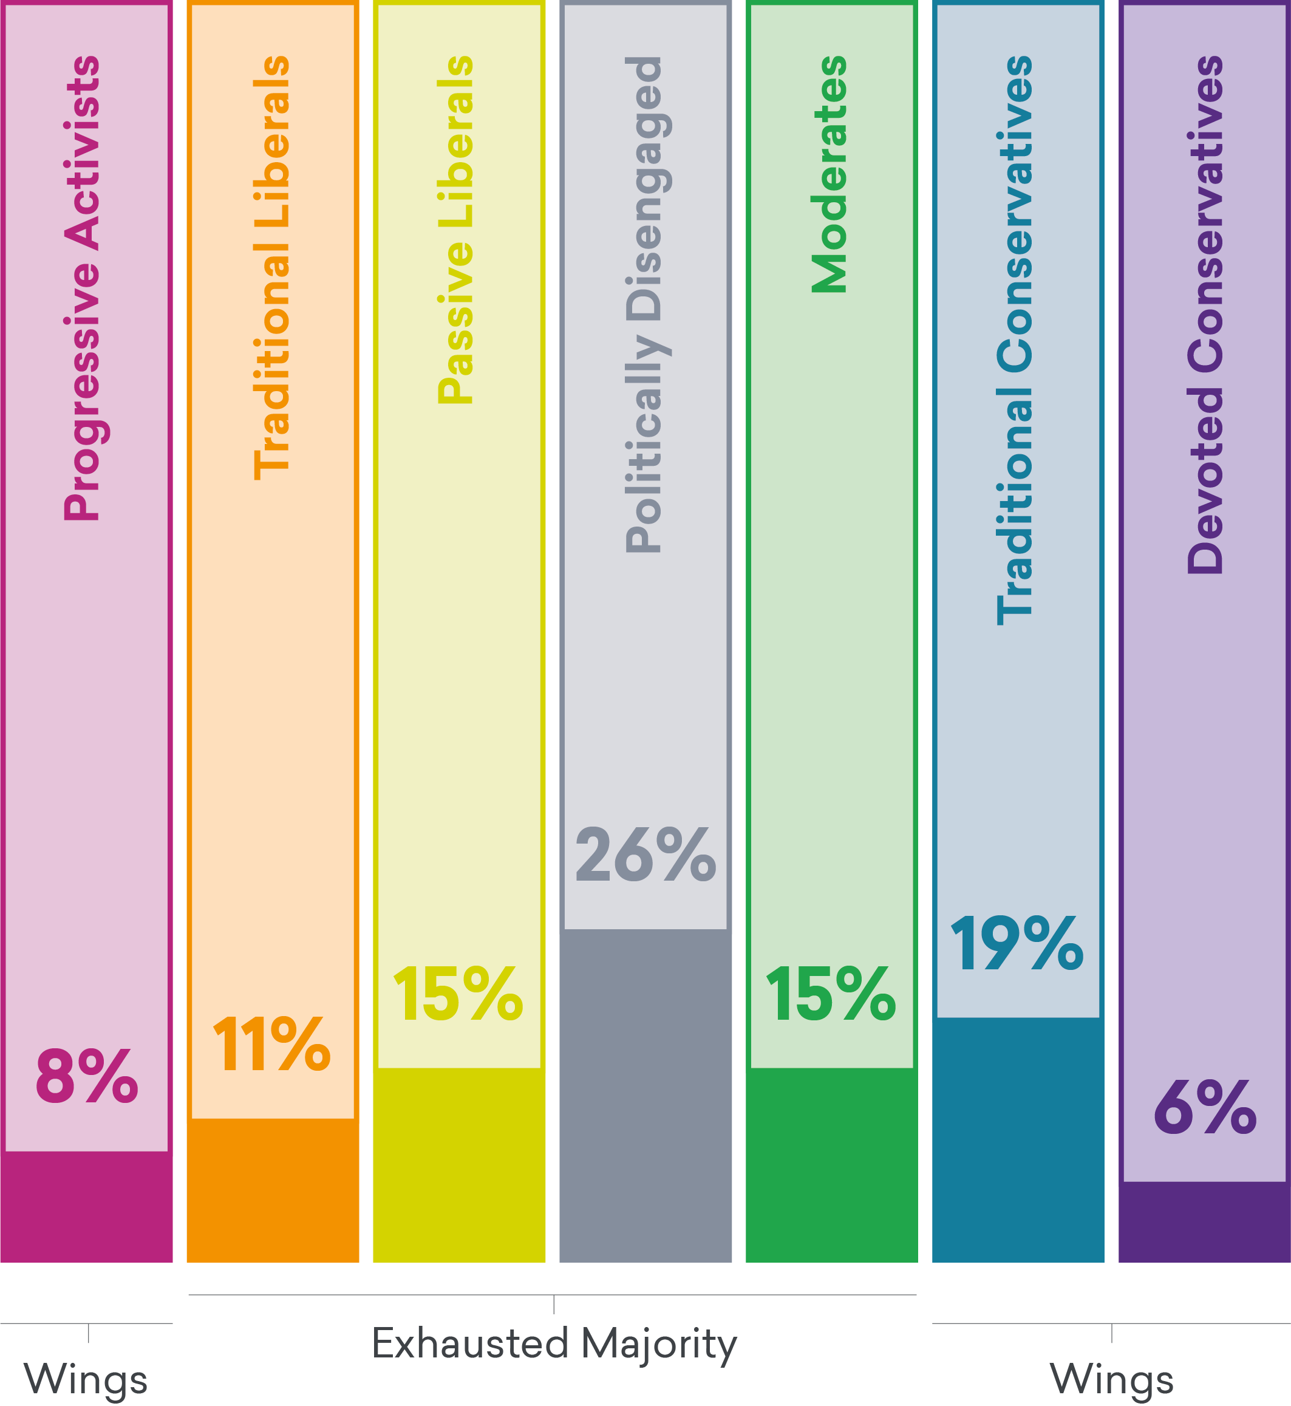
America’s Seven Tribes
Progressive Activists
younger, highly engaged, secular, cosmopolitan, angry
Traditional Liberals
older, open to compromise, rational
Passive Liberals
younger, unhappy, insecure, distrustful, disillusioned
Politically Disengaged
younger, lower income, distrustful, detached, patriotic, conspiratorial
Moderates
engaged, civic-minded, middle of the road, Pessimistic, Protestant
Traditional Conservatives
religious, middle class, patriotic, moralistic
Devoted Conservatives
white, retired, highly engaged, uncompromising, patriotic
Notes:
We actually found that America is divided into seven distinct tribes with very different core beliefs. We can group these from left to right on the ideological spectrum. On the far left are Progressive Activists, which tend to be younger, engaged, secular, cosmopolitan, and angry, all the way to Devoted Conservatives, who are more likely to be white, retired, uncompromising, and patriotic. And there are a variety of groups in between, including Traditional Liberals, Passive Liberals, Disengaged, Moderates, and Traditional Conservatives

Slide 15
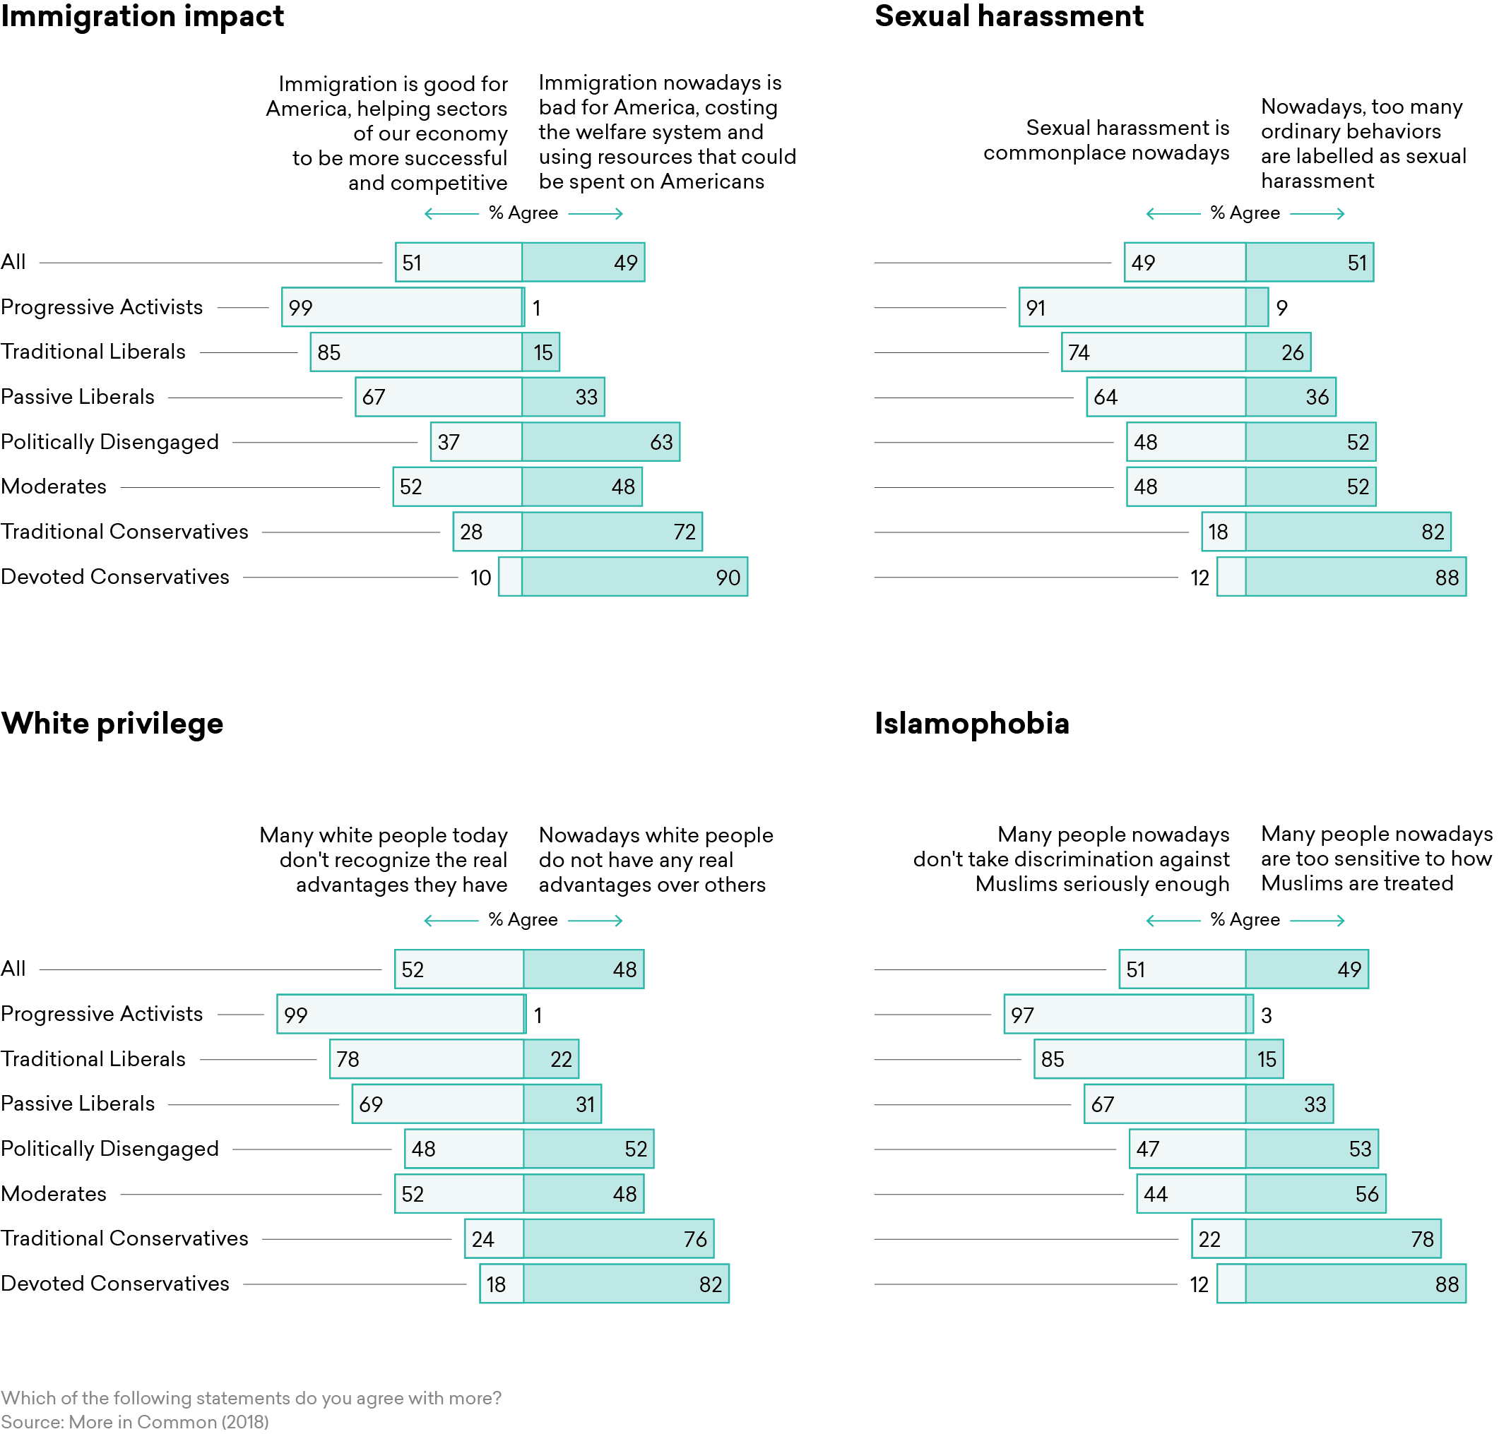
Notes:
And it turns out that these tribal groups are really helpful in predicting people’s views on political issues. So here we have a graph of people’s views on immigration. On the left is the proportion of people who believe that immigration is good for America, on the right the proportion of people who think immigration is bad for America. And if look at the question across all Americans, we see this familiar 50:50 split where people seem torn between two poles. But if you break it down by tribe you get a far more detailed understanding of how people view this issue. 99% of Progressive Activists think that immigration is good, ranging all the way to 90% of Devoted Conservatives answer the opposite.

Slide 16
Notes:
And you get similar patterns on a host of other issues.

Slide 17
Exhausted Majority: 67% of Americans
Exhausted Majority
Wings
Notes:
In addition, we examined each of the tribes according to their level of political activity. And we found that the outer groups, who we call the ”wings”, are far more likely to engage in a variety of political activities. And the less active group we call the “exhausted majority.”

Slide 18
Exhausted Majority experiences politics differently from Wings
Attribute | Wings | Exhausted Majority
1. [Frustrated] with America | 60% | 82%
2. [Forgotten] Government is rigged | 62% | 89%
3. [Flexible] Not strongly partisan | 57% | 71%
4. [Find Compromise] Want their side to listen | 51% | 65%

Slide 19
Core Beliefs

Slide 20
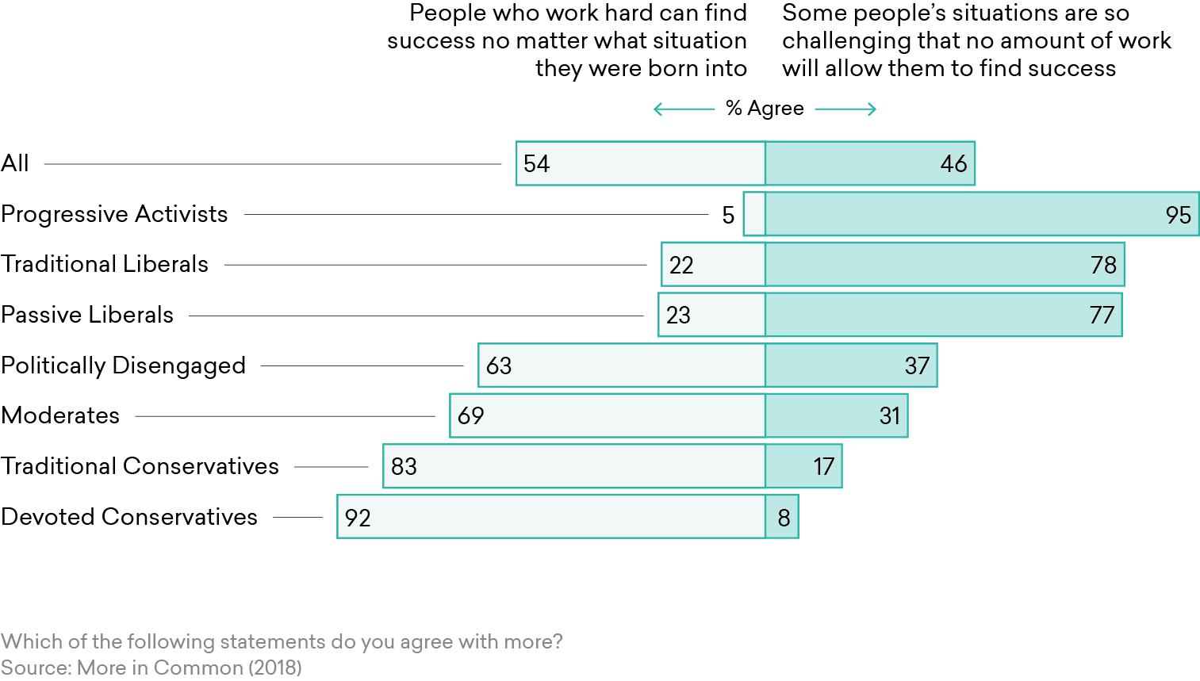
Personal Responsibility
People are responsible for their own outcomes in life
People’s outcomes in life are determined largely by forces outside their control
Notes:
And these groups are strongly divided according to their basic views. For example, we asked people whether they agree more that people who work hard can be successful, or that

Slide 21
Moral Values

Slide 22
Parenting Philosophy
87%
84%
Notes:
Parenting style?

Slide 23
What does it mean?

Slide 24
Implications
Understand the importance of core beliefs.
Notes:
Lenses that shape how people see the world
Progressives: Power, Privilege, and Oppression
Conservatives: Character, Loyalty, Tradition
Even if you don’t...

Slide 25
Implications
Understand the importance of core beliefs.
Recognize the Exhausted Majority.
Notes:
Members of the Exhausted Majority are in your classrooms. But they might not be as vocal because they’re not as convinced they have the answer. We should encourage this sort of thoughtfulness and flexibility.

Slide 26
Implications
Understand the importance of core beliefs.
Recognize the Exhausted Majority.
Adopt inclusive language.
Notes:
Finally, we should always be striving to inclusive language that doesn’t take justice as a zero-sum game. You can acknowledge systemic injustice while still encouraging individuals to reach their potential. You can help people recognize their advantages and invite them to fight for a fairer system. You can talk about the rights people should have in a democracy while also acknowledging the responsibilities that go along with it. That balance is hard to strike, but it’s what we need in this polarized time.

Slide 27
Thank you!
Hidden Tribes Report
Website: HiddenTribes.us
Quiz at HiddenTribes.us/quiz
@HiddenTribes.us
More in Common
MoreInCommon.org
@MiCGlobal
Daniel Yudkin
www.danielyudkin.com
dyudkin@gmail.com
@dyudkin
Thanks to
Stephen Hawkins
Miriam Juan-Torres
Tim Dixon
Carwina Weng
AALS

