Slide 1
Lawyering with Technology: Skills and Habits of Mind for Teaching How to Lawyer Effectively for Change
Conrad Johnson, Columbia
Ann Juergens, Mitchell Hamline
Joe Rosenberg, Cuny
Takao Yamada, Airportlawyer.org

Slide 2
Roadmap
Basic concepts
Examples of how technology can be used in clinics to facilitate progressive change and access to justice.
Exercise: how you might use technology to assist your clients and integrate contemporary practice.
How to make time for this

Slide 3
Basic Concepts: Law Runs on Information
Gather
Manage
Present

Slide 4
Why incorporate law practice technology?
Competence
Engagement
Expanded possibilities for access to justice, presentation, collaboration, empowering students and clients.
Employment
Social justice… Here are some examples.

Slide 5
Why does the shift from analog to digital matter to lawyers?
Communication options
Collaboration
Best practices, AI
Employment,
Confidentiality, security, privacy
Discovery
Virtual lawyering
Presentation, advocacy

Slide 6
Housing Justice Chatbot Building Clinic Prof. Ann Juergens, Mitchell Hamline
Lawyering with Technology: Skills and Habits of Mind for Teaching How to Lawyer for Change Effectively
AALS Clinical Conference, San Francisco, May 2019

Slide 7
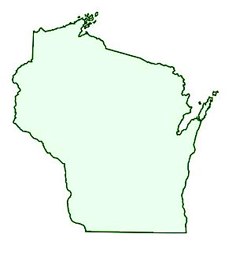
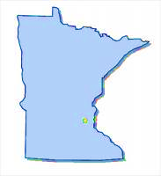
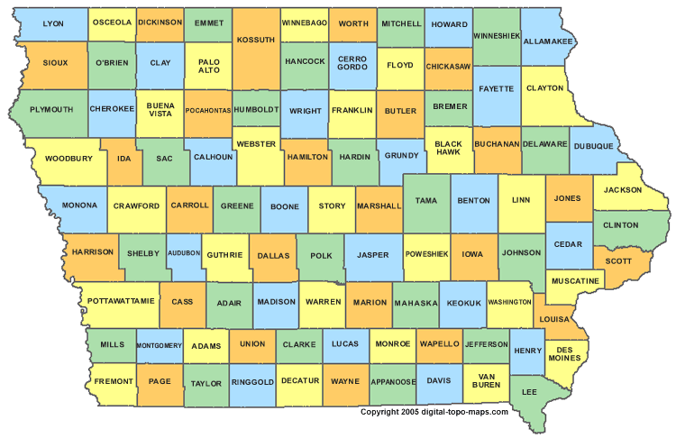
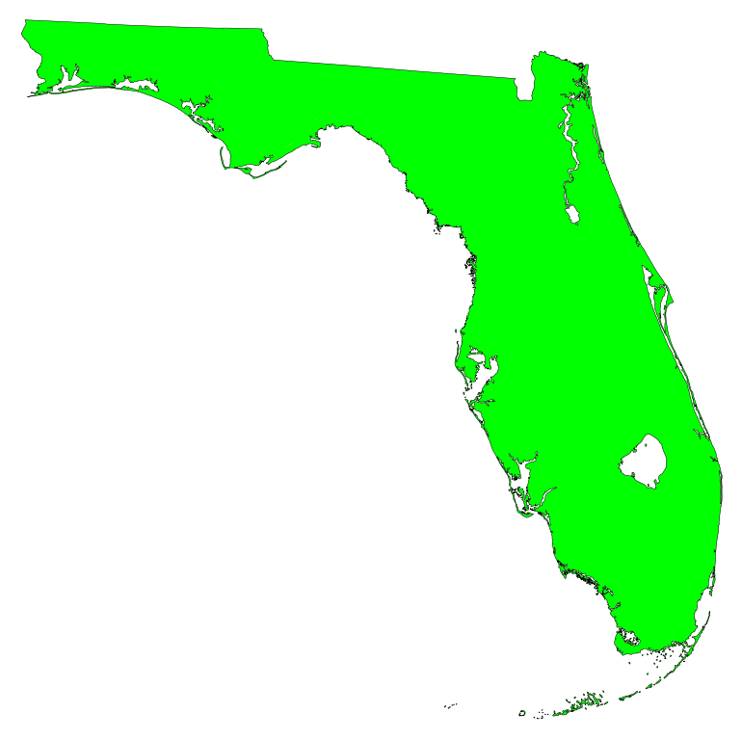
Clinic students:
live in 8 different states
are enrolled in MHSL’s “hybrid” program.

Slide 8
Process steps leading to connection with local housing activists & (hopefully) useful chatbot.
Connect with housing justice org. in your community
Build chatbot with community resources woven throughout
Research law & commun-ity resources & Outline answer to question
Work with the org. on a housing question amenable to answer with chatbot
Put answer into flowchart form & vet with org.

Slide 10
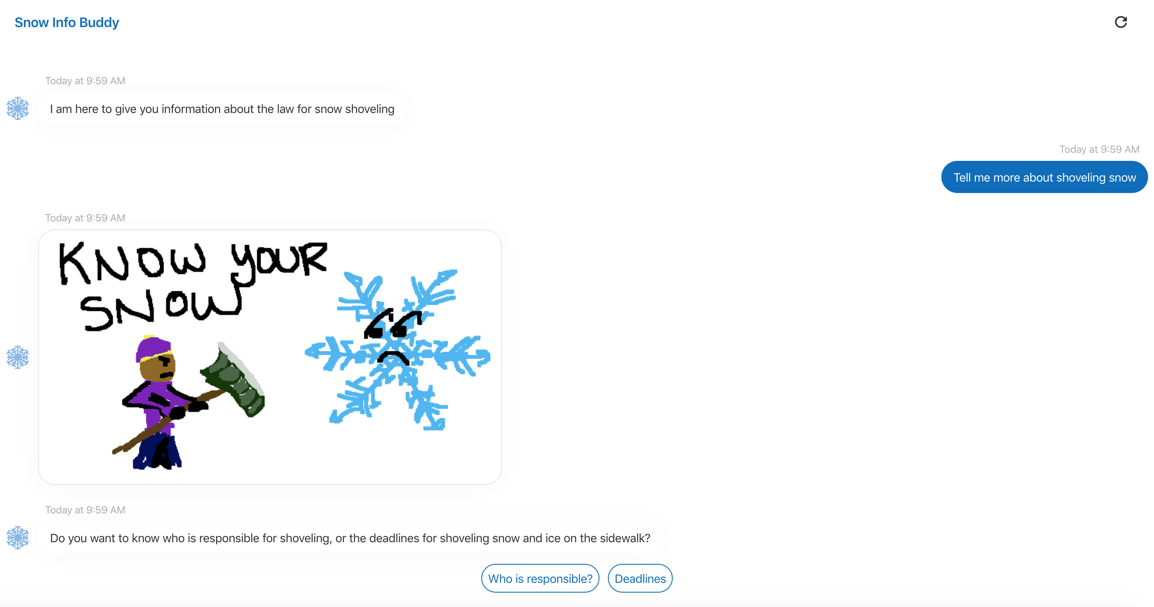
Notes:
Fun snippet as example.

Slide 11
CUNY Law Planning With Parents Project Emergency Advance Planning for Parents at Risk of Deportation Evolution of a Guided Interview App Prof. Joe Rosenberg, CUNY Law School

Slide 12
Advance Planning=Power & Control Legal Clinics: Face to face interviews
Allowed us to develop and modify interview approach
Trial & error
Importance of language
What works, and what doesn’t

Slide 13
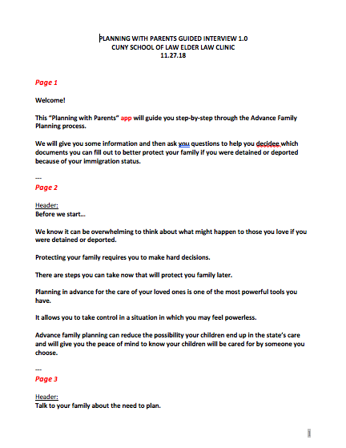
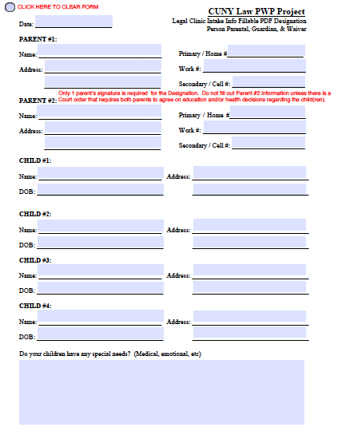

Slide 14
Planning with Undocumented Parents Guided Interview App
Collaboration with developer
Much wider reach & access
Advocates can assist with Advance Planning
Families can create & execute documents at “last minute in “emergencies” (e.g. ICE ”check-in”)
App can be customized/modified
https://community.lawyer/cl/scott/advanced-planning-with-parents

Slide 15
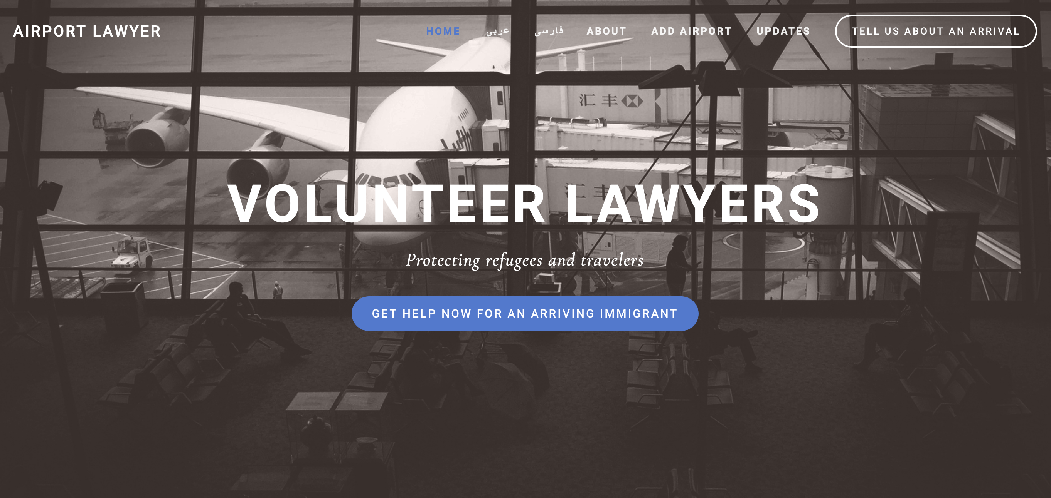

Slide 16
Your Ideas
WRC to reunite families
Defendants need to know to assert inability to pay court penalty fees
& alternatives
Cut off medical assistance; appeal adverse hearings within 10 days
Do I have a civil rights problem? Referrals to legal assistance
Referrals from health care providers to legal clinic instead of social
service providers
How to get info to clients about relative complexity of their case
& potential ease of solution
IP context, work flow, case mgmgt systems to link &
make efficient client needs & clinical students
Text reminder systems for clients to get to court

Slide 17
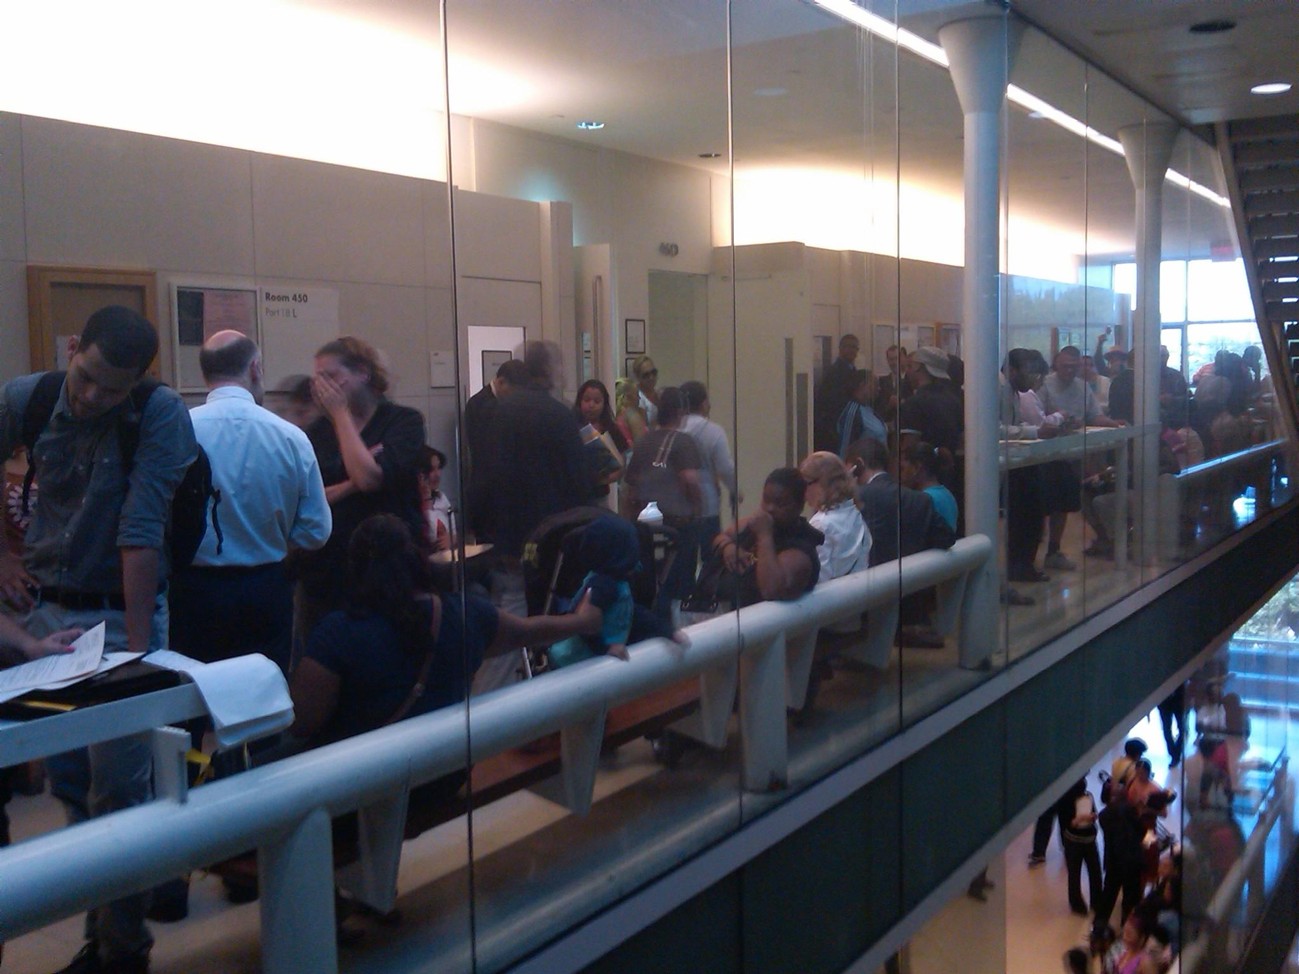
The Problem

Slide 18
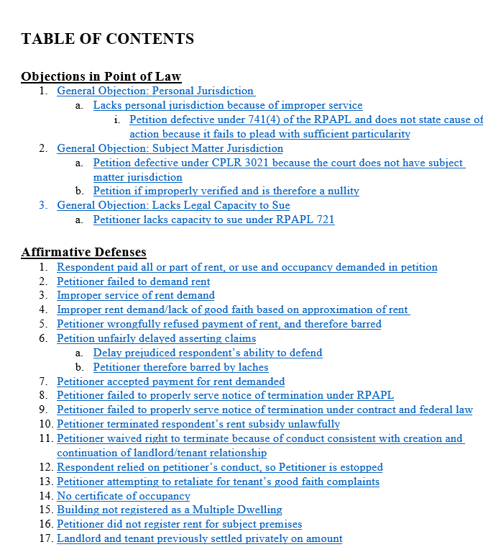
Sample Nonpayment Answer Template
Each clause of answer is annotated
Table of Contents hyperlinked
Digital format has increased functionality

Slide 19
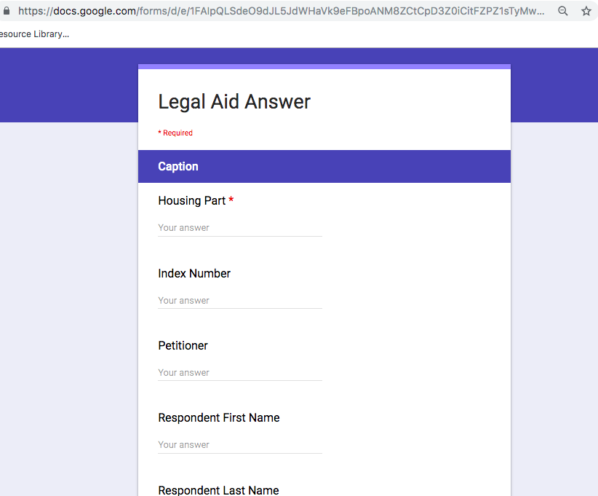
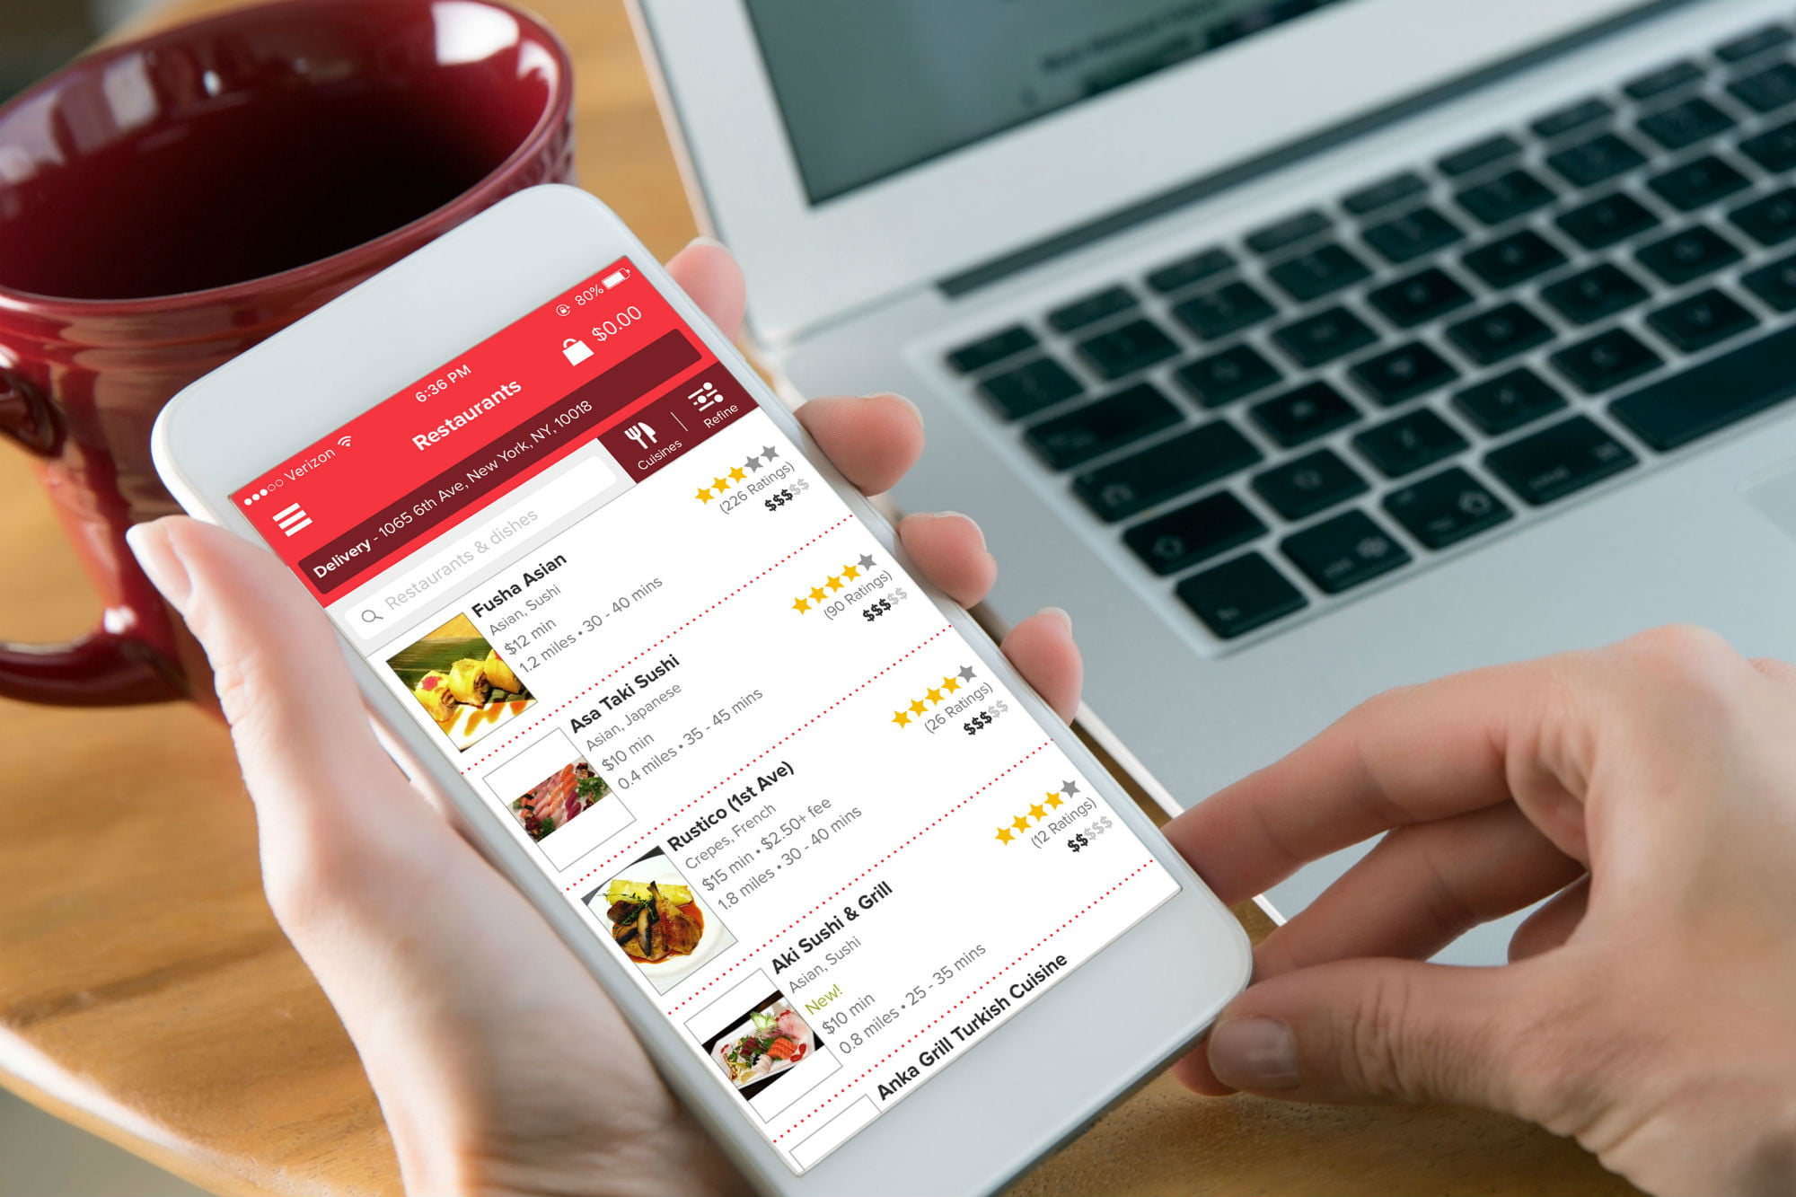
Free Document Assembly: Google Suite - Google Forms
Google Form: A master answer in google form. Attorneys input relevant clauses by simply checking the relevant boxes.
“It’s like ordering lunch--just less filling.”

Slide 20
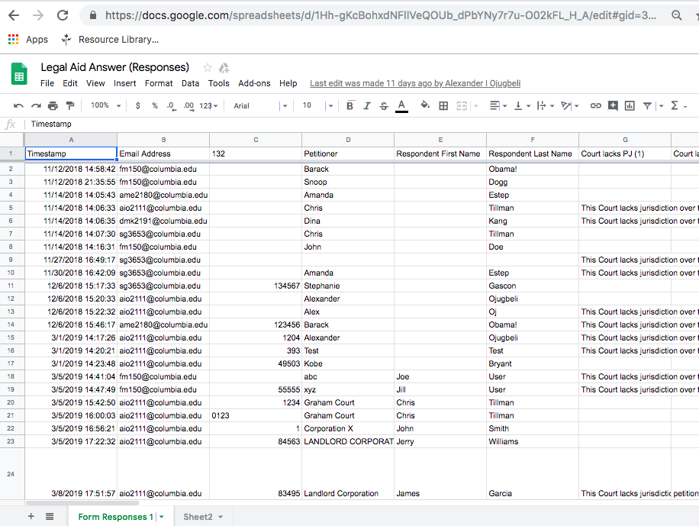
Free KM /Document Management
Google Sheet: Records and organizes the data inputs. Sort and search through extensive data entries.

Slide 21
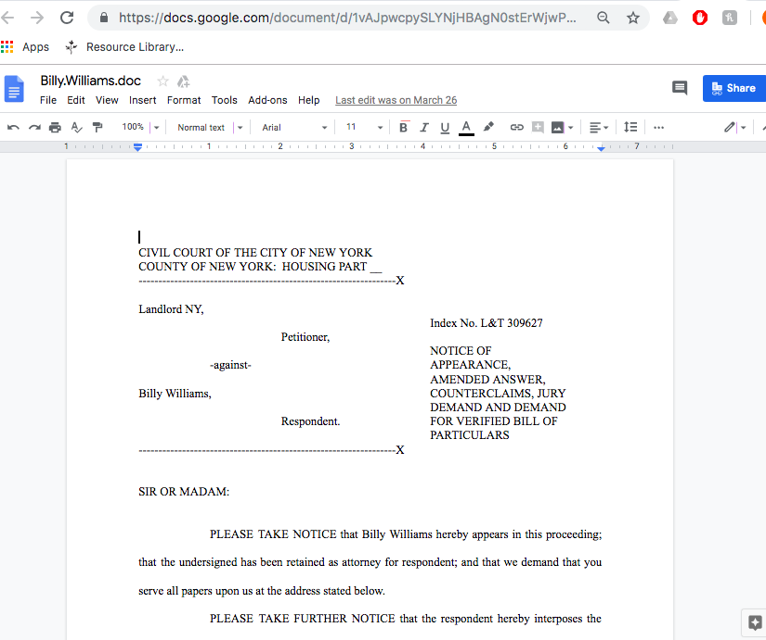
Efficiency, Quality, Convenience, Flexibility
Google Doc: Document Studio function converts the data from the google sheet into a complete and personalized court document.

Slide 22
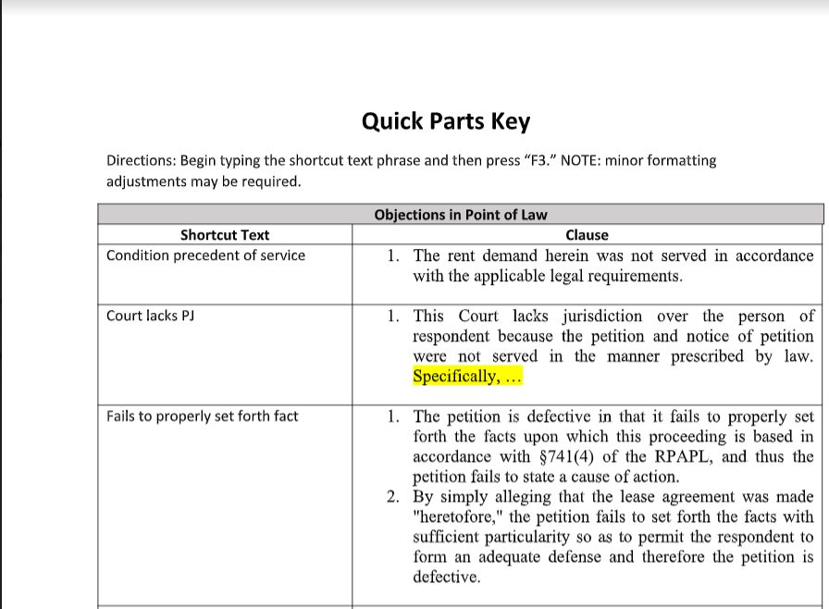
Even Lower Tech: Word Quick Parts
Quick Parts: Function in Microsoft Word that converts complete clauses into shortcut phrases.

