Slide 1
Applying the Benefits of
Reflection, Evaluation, and Assessment
to Develop Cultural Competence in Clinics and Externships with an International Learning Context
Briana Beltran - Cornell
Gillian Dutton - Seattle
Ron Hochbaum – Loyola Chicago
Anna Nicol - Michigan

Slide 2
Session Roadmap
Introductions
Definition of terms & session goals
Exercise 1: free write
Learning Outcomes – Gillian & Ron
Reflection & Assessment – Anna & Briana
Exercise 2: small group discussion

Slide 3
Briana Beltran, Cornell Law School
Clinical Teaching Fellow, Farmworker Legal Assistance Clinic (FLAC)
Semester-long, 4-credit clinic
Weekly two-hour skills seminar
Immigration & employment cases on behalf of farmworkers
Most clients are monolingual Spanish speakers, and from Mexico or Guatemala, mostly relatively recent arrivals to the United States
Clients generally live in isolated, rural settings
Past experience: Southern Migrant Legal Services
LSC organization (part of Texas RioGrande Legal Aid) based in Nashville, TN
Mostly employment litigation with mostly guestworker clients in the United States on temporary agricultural visas

Slide 4
Gillian Dutton, SeattlE University School of Law
Director of Externship Program, Assoc. Prof. of Lawyering Skills
Externship Program is Integrated with Clinical Program
Externship Seminars (Civil, Criminal, In House Counsel/Government Attorney, International, Judicial)
Students take weekly seminar while working in field placements around the United States and the globe
Earn part-time or full-time credit
Cultural competence and racial bias is topic in every seminar
Program is integrated with first year Legal Writing Course that introduces cultural competence as part of basic lawyering skills component and with clinics (e.g. International Human Rights Law Clinic) and other externships that teach intermediate/advanced skills
Korematsu Center Fellow
Faculty Advisor, International Refugee Assistance Project, International Law Society
Washington State Coalition for Language Access
Past Experience
Taught University of Washington Law School Refugee and Immigrant Advocacy Clinic for 15 years (immigration and public assistance cases, impact advocacy, language access issues, 28 different languages in first two years)
Represented migrant farmworkers at Evergreen Legal Services for 6 years, range of cases as only Spanish speaking attorney in legal services office

Slide 5
Ron hochbaum, Loyola Chicago school of law
Clinical Teaching Fellow, Health Justice Project
4-Credit, Semester-Long Clinic; Opportunity to take an Advanced Clinic for 2-4 Credits
Weekly Seminars for 2 Hours where we cover a range of topics including interviewing, counseling, and storytelling.
As well as Cross-Cultural Competency and Race, Implicit Bias, and Health Equity.
Interdisciplinary Advocacy.
Medical-Legal Partnership Clinic that engages in holistic advocacy – public benefits, housing, family and guardianship, education, disability, access to health care, immigration, etc.
Our Medical Partner’s patients are 70% Latinx.
Our Legal Partner accepts LSC funding, so we take on a number of cases for clients who are undocumented.
Previous Experience
Clinical Adjunct in the Farmworker Legal Assistance Clinic at Cornell Law School
Developed innovative clinical offering where students provided legal services to farm workers in California’s Central Valley.
Partnered with the United Farm Workers and Dolores Huerta Foundation.
Supervising Attorney at the Homeless Action Center in Oakland, California
Represented immigrants from Mexico, El Salvador, Nicaragua, Guatemala, Togo, Eritrea, Ethiopia, Afghanistan, Pakistan, India, China, Vietnam, Cambodia, and the united Kingdom in claims for public benefits.

Slide 6
ANNA W. NICOL, UNIVERSITY OF MICHIGAN LAW SCHOOL
Adjunct Clinical Faculty/Coordinator, Geneva Externship Program
Based in Geneva, Switzerland
Coordinate semester-long externships in Geneva at International Organizations and Civil Society Organizations (Winter Term)
Students receive 11 credits pass/fail for the work component
Students participate in a contemporaneous seminar for 2 credits, graded
Seminar includes a mix of Roundtable Discussions centered around particular themes and Guest Lectures
Reflective Essays submitted bi-weekly throughout the semester
International Law Advisor
Previous Experience
Director, Office of Career Services, Georgetown Univ. Law Center
Private Practice

Slide 7
key terms
Learning outcome: what a student is expected to be able to do as a result of an activity
Reflection: process of analyzing how a task was performed and how the task might be improved or changed for future performance
Assessment
Formative assessment: monitors student learning to provide ongoing feedback
Summative assessment: evaluates student learning by comparing it against a benchmark

Slide 8
Session goals: how to use these three tools...
To develop student awareness of cultural competence as a lifetime learning goal
To build the skill across different law school experiential learning contexts
To improve your own teaching of this topic

Slide 9
Exercise #1
Free Write
Write down an anecdote or example from a time when you worked with a client/student/ organization and became or had to become more culturally aware. Can you imagine how you would communicate this concept of continuing to develop the ability to see the world through others eyes to your students?

Slide 10
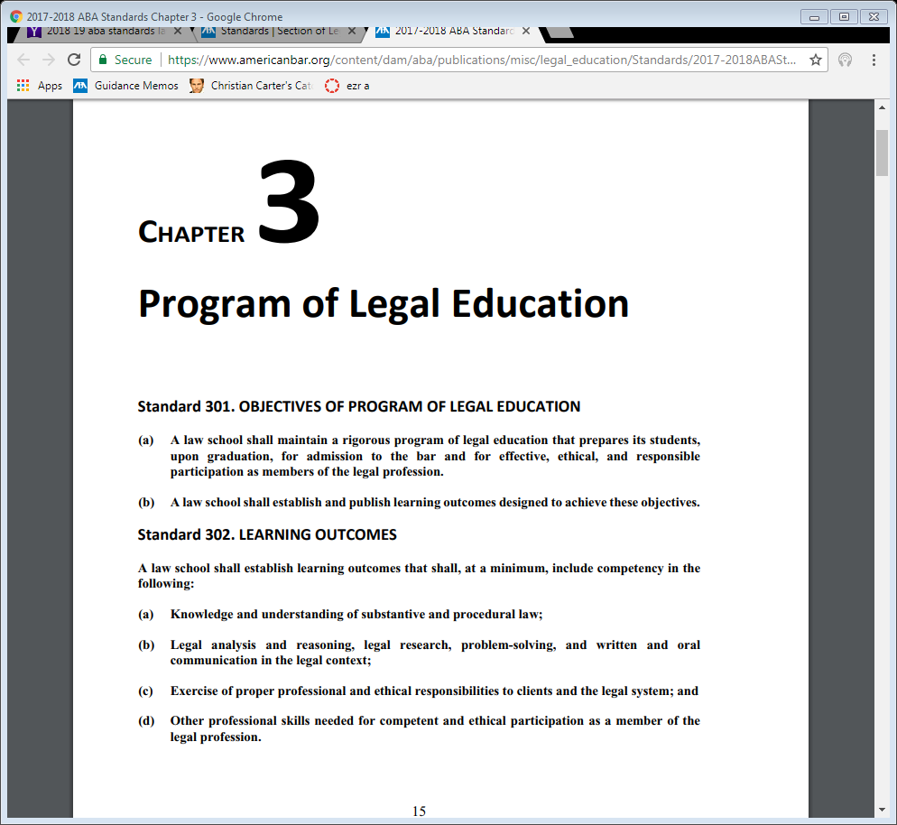
LEARNING OUTCOMES

Slide 11
Interpretation 302-1
LEARNING OUTCOMES
For the purposes of Standard 302(d), other professional skills are determined by the law school and may include skills such as, interviewing, counseling, negotiation, fact development and analysis, trial practice, document drafting, conflict resolution, organization and management of legal work, collaboration, cultural competency, and self-evaluation.

Slide 12
Learning Outcomes The Need – Part I
Future Lawyer (Provider of a Public Service)
Law Student (Who Must Engage with a Diverse Group of Peers, Professionals, Administrators, and Academics)
Public Citizen (Model Rules, Preamble)

Slide 13
Learning Outcomes The Need – Part II
Listen to Our Students
Racism Lives Here Too
Stanford
Harvard
Columbia
Not Just the Elite Law Schools
Loyola Chicago – Student Letter

Slide 14
Learning Outcome Being Resourceful and creative
Not Just Traditional Clinics and Externships
Orientation
1st Year Electives
Doctrinal and Podium Classes
Guest Lectures
Symposia
Student Group Activities
Other Extra-Curricular Opportunities
Centers, Institutes, etc.
Posters Around the Law School (Racism Lives Here Too)
Spring Break Trips

Slide 15
AALS Clinical Conference 2014 SMELLS LIKE TEAM SPIRIT : The Mid-Afternoon Show!
LEARNING OUTCOMES
How getting out of our silos helped us Develop build better learning outcomes AT SU LAW!
Seattle University Law School General Learning Outcome # 7
Graduates will be able to perform their lawyering tasks consistent with professional ethical requirements and with the cultural competence necessary for effective, respectful interaction with individuals from diverse backgrounds.
New Cultural Competence Learning Outcomes for 1st Year Legal Writing.
.

Slide 16
LEARNING OUTCOMES
Milton Bennett SIX stages of Cultural Competence: from ethno centric (first three stages) to ethno relative (last three stages)
Denial of difference - either do not notice differences or construct broad categories (e.g. Asian)
Defense against difference- recognize cultural differences but negatively evaluate them
Minimization of difference- recognize differences but assert that everyone is basically the same (due to a failure to recognize privilege) _______________________________________________________________
Acceptance of difference- learn about others without judgement
Adaptation to difference – aware of the role culture plays and has developed effective intercultural communication
Integration of difference – internalized multicultural frames of reference do not self-identify with any one particular culture, identity is a work in progress

Slide 17
Basic Level
LEARNING OUTCOMES
From Basic First Year Law School to intermediate/advanced Study ABROAD, Clinics and Externships
INTERMEDIATE/ADVANCED
Knowledge Learning Outcomes
Define race, ethnicity, and culture;
Recognize that bias and stereotyping (conscious and unconscious) affect your factual and legal analysis;
Attitude (Values) Learning Outcomes
Identify impediments that affect learning about your own cultural biases and stereotypes;
Explain why lawyers see the world through their own cultural lenses;
Knowledge Learning Outcomes
Describe how biases affect a lawyer’s interpretation of facts and application of legal rule;
Identify cultural experiences of the parties and the lawyers that may affect the legal and factual analysis;
Attitude (Values) Learning Outcomes
Reflect on how different values systems and communications styles may affect lawyers’ interpretations of client reactions and behaviors;
Recognize the need to suspend judgment when encountering unfamiliar conduct or views;
Demonstrate curiosity about the ways in which your cultural beliefs and practices influence your perceptions and interactions; about clients’ cultural beliefs and practices.
Classroom Live

Slide 18
LEARNING OUTCOMES Using these tools in First year Courses, International Human Rights Clinic, and
International Externships : Students Understand need to Learn skills
Basic Skills Learning Outcomes
Identify cultural factors affecting judge’s or jury’s decision-making process or how lawyer presented issues in a given case;
Identify methods to ensure awareness of your own cultural traditions, perspectives, and beliefs; others’ cultural traditions, perspectives, and beliefs; and how those may be the same or different than your own

Slide 19
Learning Outcomes INTERMEDIATE/ADVANCED Skills Assessment (Evaluation) and Reflection --- Keys to Improving Skills
Identify situations in which your cultural biases impeded successful representation; ​
Ask appropriate questions to elicit client information about cultural beliefs or practices that may affect representation; ​
Demonstrate strategies to assess, manage, and reduce bias in encounters with clients and witnesses; ​
Explain techniques and tools that can help identify red flags that there has been a cross-cultural miscommunication; ​
Use reflective practices when considering cultural contexts and cultural norms and whether particular cultural norms and practices create injustices which should be challenged.​

Slide 20
Learning Outcomes FLAC Alternative spring break
Considerations
1 Training → 1 Week
1Ls (Research and Writing but Not Interviewing)
Brief Services and Advice and Referral for Monolingual Spanish Speakers
“Modest” Objectives
Interviewing (and Issue Spotting)
Cross-Cultural Competency
Using Legal Interpreters
Legal Issues Faced by Farm Workers, Migrant Workers, and Immigrants
Interdisciplinary Approach to the Provision of Services
Accountants
Community-Based Organizations
Unions
Role of the Lawyer in Movement Building

Slide 21
Learning Outcomes What can be accomplished in a week

Slide 22
Reflection & Assessment
Will (attempt to) discuss them separately
However, you will see our approaches to these two skills often weave them together
Reflection: process of analyzing how a task was performed and how the task might be improved or changed for future performance

Slide 23
Reflection: 26 lawyering effectiveness factors
http://lawfaculty.utulsa.edu/wp-content/uploads/2016/01/26LawyeringEffectivenessFactors-worksheet.pdf

Slide 24
Reflection: MLS Geneva Program
Reflection is a central and recurrent component of the Program
Orientation in the Fall before the start of the Program
Throughout the semester
Schultz and Zedeck Lawyering Effectiveness Factors (Orientation)
Introduction
First draft of Professional Development Plan
Exercise to identify skills that students would like to improve or have not yet been addressed in their legal education
[Serves as own personal reflective/assessment exercise]
Schultz and Zedeck Lawyering Effectiveness Factors (Semester)
Regular referral back to particular goals identified in Orientation
Roundtables and Reflective Essays

Slide 25
Reflection: MLS Geneva Program
Cultural competence/humility are integral to all facets of experience and incorporate many (if not all) of the Factors
Potential avenues to explore (as identified by students)
Working with professionals from all over the world
Language
English as a second language
Drafting of legal documents
Exclusion/inclusion in settings
Lack of expertise where needed (value of learning other languages)
Impact of different systems (civil v. common law)
Issues of privilege for interns who can afford to work in Geneva at unpaid internships (unionizing interns)
Day-to-day cultural norms: eg, alcohol, length of work day, pace of work, physical space, etc.

Slide 26
Reflection: FLAC
At mid- and end-of-semester, students prepare a self-evaluation memo with prompts based on the effectiveness factors (do not have to answer all prompts)
Able to See the World Through the Eyes of Others:
In what ways has your clinic work been inter-cultural? What differences did you perceive between you and another person you interacted with? Did you feel prepared to work across these areas of difference? Were you able to balance acquiring cultural knowledge about the other person’s life experience with testing your own assumptions?

Slide 27
Reflection: FLAC
Responses vary depending on students and their natural level of self-reflection, but most generally have something to say on this skill
Common themes students identify:
Working with clients from different countries/nationalities
Clients with different goals than students, e.g. more practically focused
Students identifying commonalities in their own backgrounds, e.g. low-income family, immigrant parents
Traveling to meet with clients on farms, noticing the rural-urban cultural divide, and a newfound appreciation for presence of and isolation experienced by workers in rural areas
Interpreters as helping to navigate cultural differences

Slide 28
Assessment
Assessment
Formative assessment: monitors student learning to provide ongoing feedback
Summative assessment: evaluates student learning by comparing it against a benchmark
Formative Assessment = Reflecting upon Reflection
Summative Assessment >> Grading Challenges

Slide 29
Assessment: FLAC
Student self-evaluation memos are reviewed by supervisors and used as a starting point for discussions in one-on-one meetings
Role in grading?

Slide 30
Assessment: MLS Geneva Program
Reflective Essays throughout semester
Formative – provide feedback via written comments and by building off of individual topics in class for further development
Summative – did the student follow the prompt in the syllabus? Provide articles on reflective writing (J. Moon) to students.
Class Participation
Formative – mid-term meeting and perhaps commentary on reflective essays
Summative – did the student incorporate the material or process outlined in the syllabus? Provide students with a rubric.
Mid-Term Review/Meeting

Slide 31
Exercise #2
Working In groups of 3 (20 min. in group, 10 min. to Share Back )
Using the information you have just heard on learning outcomes, assessment and reflection
Share what you are doing in your clinic or externship or other setting
Discuss how you might use this session’s material or other ideas to improve student’s understanding of the concept of improving cultural competence over time and in multiple settings
Describe any other steps to improve the teaching of cultural competence at your institution

Slide 32
“If you have come here to help me, you are wasting your time. But if you have come because your liberation is bound up with mine, then let us work together.” – Lilla Watson

