Slide 1
How Does a Clinician Say Goodbye?
Jean Koh Peters
AALS Clinical Conference
Chicago, Illinois
May 1, 2018
OPENING PROMPT
Welcome! (You should have one 3 page handout)
Recall a goodbye or lack thereof that affected you deeply. Be prepared to discuss it with a neighbor.

Slide 2
Opening Exercise
Recall a goodbye or lack thereof that affected you deeply.
Discuss it with a neighbor—2 mins for each of you.
Immediately after, I will ask you to complete this sentence with ONE WORD:
Goodbyes can be _________________________.

Slide 3
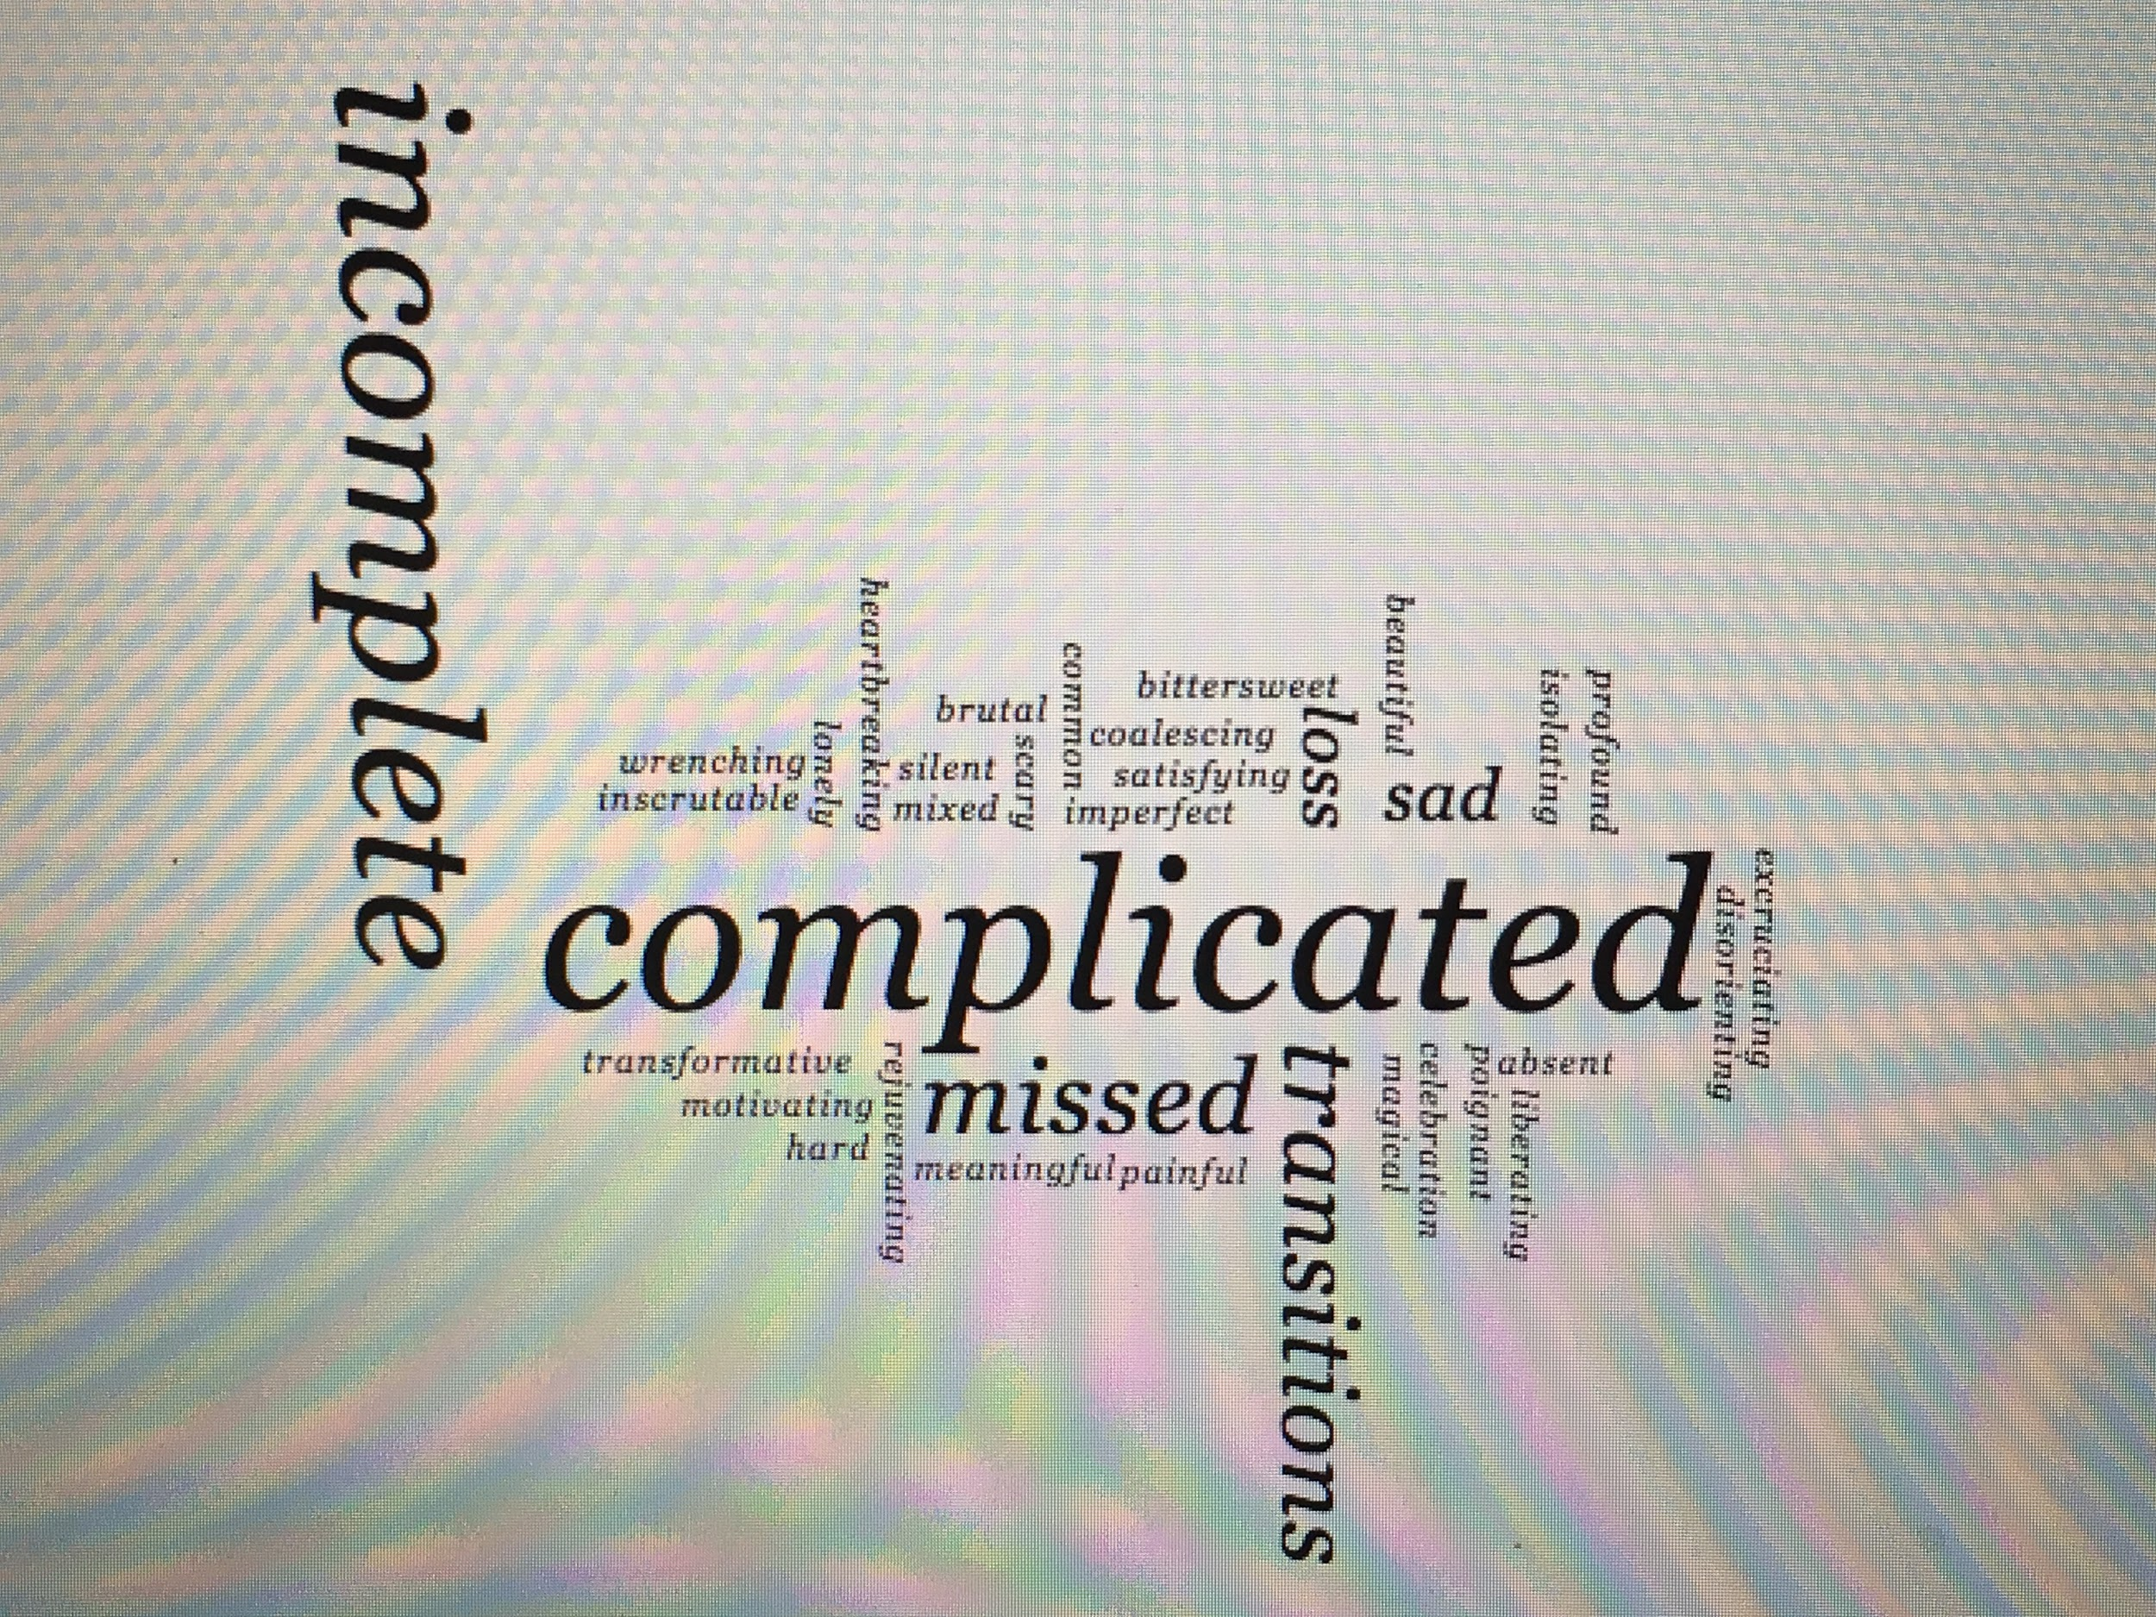
Wordmap http://www.richardwheeler.net/interactive/wordmap.php

Slide 4
Roadmap
I. From my writing and practice:
The Dynamics of Goodbye
Four Principles
Ten Skills and Strategies for Saying Goodbye
II. Leaving the Client’s World
III. Leaving the Student’s World
IV. Personal thoughts on Leaving the Work World--Thing of Beauty

Slide 5
Legal Sources
Gail E. Silverstein, All’s Well that Ends Well: The Importance of Full and Effective Closure in Lawyer-Client Relationships, 19 Clin. L. Rev. 555 (2013).
Jean Koh Peters & Mark Weisberg, How Does a Teacher Say Goodbye?, in A Teacher’s Reflection Book: Exercises, Stories, Invitations, 171-187 (2011).
Jean Koh Peters, Leaving the Child’s World, in Representing Children in Child Protective Proceedings: Ethical and Practical Dimensions, 507- 543 (1996/2007).
Naomi R. Cahn and Norman G. Schneider, The Next Best Thing: Transferred Clients in a Legal Clinic, 36 Cath. U. L. Rev. 367 (1986)
Model Rules of Prof’l Conduct R. 1.4, 1.5, 1.16.

Slide 6
Useful Sources: Other Disciplines
Caroline Rosenthal Gelman et al., Challenging Endings: First Year MSW Interns’ Experiences with Forced Termination and Discussion Points for Supervisory Guidance, 35 Clin. Soc. Work J. 79 (2007).
Lawrence Shulman, Ending and Transitions, in The Skills of Helping Individuals and Groups (1984).
Elisabeth Kubler-Ross, On Death and Dying; What the Dying Have to Teach Doctors, Nurses, Clergy, and Their Own Families (1969) .
Nat’l Assoc. of Soc. Workers, Code of Ethics of the Nat’l Assoc. of Soc. Workers § 1.16.

Slide 7
My Assumptions
As in all things, we perform a message by how we handle or don’t handle goodbyes.
Goodbyes creep up on students but clinical teachers see them coming; we can plan thoughtfully and creatively to include them in our teaching.
We say these goodbyes regularly, and have the privilege of guiding our students in this.
As with everything we teach, doing this constructively offers the students a professional framework that they can replace, tweak or evolve over their careers.

Slide 8
My Goals Today
Offer you a model: principles and skills/strategies from my writing—1996, 2011
Have you apply them to two contexts that recur in our teaching
concerns—what will you tweak or replace?
insights—what might you add to your practice?
Reflect together on Goodbye
Say Goodbye myself

Slide 9
The Dynamics of Goodbye Theories on Termination of Professional Relationships
In no set order, Elisabeth Kübler-Ross’s stages, On Death and Dying (1969): successful intense relationships end with echoes of the more ultimate goodbye:
Denial
Anger
Bargaining
Depression
Acceptance

Slide 10
Four Principles for Leaving the Other’s World
The termination should match the relationship.
A fitting boundary that echoes the experience.
Complete the story/land the plane
Be honest both with them and with yourself as you end.
Consider carefully what termination means to them in this context.
Keep straight what they are experiencing from what you are experiencing and deal with them both.

Slide 11
Ten Skills and Strategies for the Professional Goodbye—1-5
Let the Hello Contain the Goodbye: Think about termination from Day 1.
Think carefully about timing and sequencing.
Start early and divide into parts
Integrate Petit Partings
Wherever possible, involve your partner in the Design
As termination approaches, address the impending goodbye head on.
Set goals for termination.
And map a path through the last steps
Look Back.—retrace your steps

Slide 12
Ten Skills and Strategies for the Professional Goodbye—6-10
6. Provide and Seek Honest Feedback.
When you are both ready, Look Forward.
Make only promises you can keep
8. Work with others important to them, where needed.
Be creative.
verbally—write out your last sentences?
nonverbally—a time to put words aside?
BUT—gifts can be tricky—nonreciprocal/disproportionate
Ask yourself, do we feel finished?
or perhaps am I stuck in denial, anger, bargaining, depression instead?
Am I sad but satisfied?

Slide 13
The Dynamics of Goodbye— My Assumptions and Observations over a Career
We have been taught little about goodbye and generally resist facing and acknowledging loss. In contrast, we focus heavily on saying hello and starting new ventures.
We therefore cannot rely on our instincts to improvise healthy goodbyes. We must plan them carefully.
Even as our competence grows, goodbyes are rarely easy.
There are always new, unfamiliar goodbyes to say.

Slide 14
Leaving the Client’s World: Reflective Writing Exercise
Consider a recent or impending moment when a student did/will say a complicated goodbye to a client. How did/will you suggest that they end this relationship?

Slide 15
Retainers: The Hello Contains the Goodbye
Model Rule 1.2. Scope of Representation and Allocation of Authority between Client and Lawyer
(a) … a lawyer shall abide by a client’s decisions concerning the objectives of representation and, as required by Rule 1.4, shall consult with the client as to the means by which they are to be pursued.
Model Rule 1.5. Fees
(b) The scope of the representation and the basis or rate of the fee and expenses for which the client will be responsible, shall be communicated to the client, preferably in writing, before or within a reasonable time after commencing the representation…

Slide 16
Rule 1.16 Declining or Terminating Representation, Model Rules of Professional Conduct
(d) Upon termination of representation, a lawyer shall take steps to the extent reasonably practicable to protect a client's interests, such as giving reasonable notice to the client, allowing time for employment of other counsel…

Slide 17
Leaving the Client’s World--Concerns
Leaving a person in danger
Referrals to other organizations
Not enough focus on the student’s experience of the good-bye

Slide 18
Leaving the Client’s World--Concerns
How to help the student draw parameters for her goodbye to a client. What’s professional? What’s appropriate? What’s authentic?
Timing the goodbye with the student and the client with notice to both
How about goodbyes when the student might still be involved with the client? (Transactional clinic example—future donor, etc) JKP suggestion: cleanly if formalistically end one relationship; start the next—watch for the nonmutuality of the Lawyer/client relationship leaking into the next
As clinical professors are we making it OK but not honest for the client, my students, myself? How do we figure out how to say hard things?

Slide 19
Leaving the Client’s World—Insights
Be in solidarity with the incompleteness; the supervisor may be able to help with closure even in a failed client goodbye
Work through with the students what will give them a sense of completeness/closure
Leave a relationship with no remainders/as few as possible
Letter prefacing the goodbye meeting with the client
You end the lawyer-client relationship but may begin a new relationship like as a donor or board member
Goodbye doesn’t always have to be the end

Slide 20
Leaving the Client’s World—Insights
Are you better off ending the relationship while it’s still good? While ethical boundaries are still in place?
Figure out a way to talk about/revisit hard events or conversations. Can you put it in proportion? What percentage of the students’s work was problematic? Pick a number and match the goodbye to the number. (e.g., a student whose work was 70% good still deserves a rousing thank you and a lot of affirmation, while the 30% concerns are noted for the future)
Does the client really want to be in touch with you? JKP example of a client whom she wanted a deep goodbye with, when the client was done!

Slide 21
Leaving the Client’s World— Prominent Traps
Goodbyes are “not lawyering”
Failing to complete the story—saying hello but not goodbye
Overdoing or Underdoing
Focusing what happens repetitively to us (having the client leave our world) but not what happens a single time to her (leaving our world)

Slide 22
Leaving the Client’s World: Remember
Make way and lay the groundwork for healthy constructive professional relationships in the future.
Encourage the client wherever possible.
Be honest and don’t sugarcoat.
Acknowledge the privilege of working with them.
Silverstein: While the relationship is indeed over, it had meaning.
Respect dignity, voice and story as you part.

Slide 23
Leaving the Student’s World: Hypothetical
A beloved student is graduating. You have worked closely with Sam for a client who has had both a very emotional time and whose case, which you are continuing, has uncertain prospects for success. You and Sam have also spent many hours talking about her professional plans, which are currently on a good footing.
The semester is ending and graduation is three weeks from now. How will you say goodbye?
Discuss with the same neighbor.

Slide 24
Leaving the Student’s World--Concerns
In a transition for the client, how does student #1 decrease so that student #2 can increase?
Navigating the end of a particular group of students; noting the end of an era
Last class of the semester rituals? We all seem to have them.
But are we avoiding saying goodbye? E.g. Brothers and sisters of the State Bar
Differential planning for students with different working relationships
What do we say to students that we aren’t sure are going to be great lawyers?

Slide 25
Leaving the Student’s World--Insights
Mark the end of an era for the students
Signal that you will always remember the student as a 2L
Students can teach us to say goodbye
End one relationship and start the next one
“I remember your first oral argument, and I can’t wait for us to be brothers and sisters in the bar.”—But—still end the Teacher/Student relationships
Students are overwhelmed. We are too, but we are repeat players. We can give them a parting gift by teaching them how to do this.

Slide 26
Leaving the Student’s World--Insights
Avoid the “goodbye party syndrome” where everything was great all the time. A roast as well as a celebration.
Say something authentic about the student’s work. Why not acknowledge the bumps or difficulties in the student’s work. “I’m pulling for you. I’m really excited that the place where you’re working will help you with….”
Show the student that you aren’t chickening out.
Be honest.
Be wary of gifts.

Slide 27
Leaving the Student’s World: Prominent Traps
Farewell Party Syndrome—the good without the bad; sugarcoating
Assuming we have infinite time—example: fabric tying exercise
Focusing what happens repetitively to us (having students graduate year after year) but not what happens a single time to her (law school graduation)

Slide 28
Leaving the Student’s World: Concrete Ideas
Structure the clinic: the hello contains the goodbye.--rituals
Invite reflection together; take time to honor the depth of relationship.
Acknowledge the end of an era.
Convey your confidence in and excitement for the future.
Acknowledge that you will not be able to stay current the same way.
Make a plan for the future (e.g. jkp coupon and rec letter policy).

Slide 29
Leaving the Work World—A Reflection and A Goodbye
I. FAQ
II. Three Parting Thoughts
and one Thing of Beauty

Slide 30
Leaving the Work World—A Reflection and A Goodbye--FAQ
Why are you retiring? The Purse
Who will take over? The Box
Why now? The Dance

Slide 31
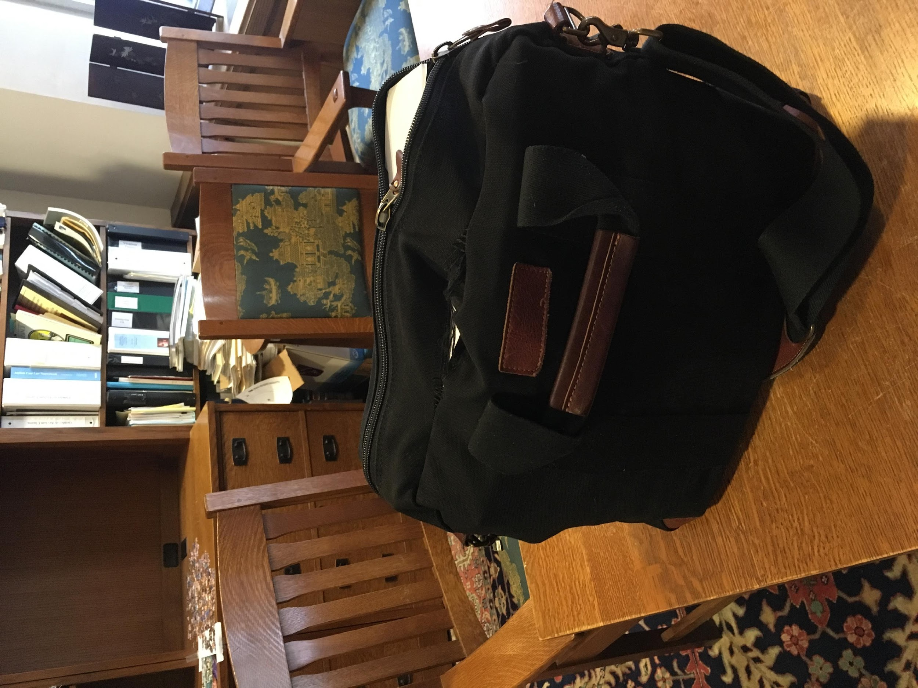
Leaving the Work World— Why are you retiring?

Slide 32
Why are you retiring? The Purse

Slide 33
B. Who will take over? The Box

Slide 34
C. Why now? The Dance

Slide 35
Leaving the Work World—Three thoughts for you and me
Let’s continue to perform our messages.
Nonjudgment is the way.
Let’s notice our lives as they happen.

Slide 36
Leaving the Work World—A Reflection and A Goodbye—Noticing My Life
A Life That's Good [feat. Lennon & Maisy] by Nashville Cast

