Slide 1
Working Around Federal Marijuana Law Professor Robert A. Mikos

Slide 2
State Reforms Are Proliferating
CBD only
Medical only
Recreational

Slide 3
Physicians as Gatekeepers
“No person shall be prosecuted . . . for the possession of marijuana or tetrahydrocannabinol when that possession occurs pursuant to a valid prescription issued by a medical doctor in the course of his professional practice for treatment of cancer or glaucoma.”
(Virginia 1979)
“[The ban on possession and cultivation of marijuana] shall not apply to a patient . . . who possesses or cultivates marijuana for the personal medical purposes of the patient upon the written or oral recommendation or approval of a physician.”
(California 1996)

Slide 4
Supply Models
Personal cultivation only – grow it yourself (or with the assistance of a caregiver).
Commercial cultivation only – buy it from a state-licensed shop.
Mixed supply – grow it yourself or buy it from a state-licensed shop.
Commercial cultivation preferred – buy it from a state-licensed shop unless one is not reasonably available, in which case, you may grow it yourself.

Slide 5
Supply Models Have Shifted
Commercial only
Commercial preferred
Mixed
Personal only

Slide 6
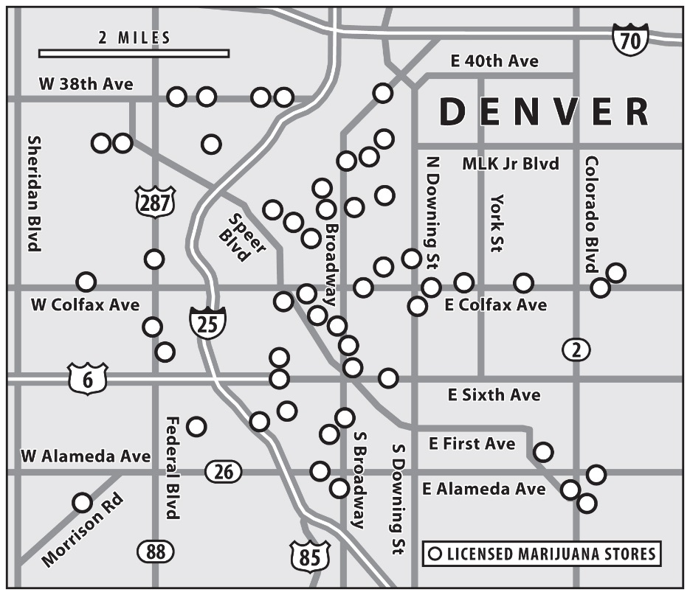
State Licensed Stores Have Proliferated

Slide 7
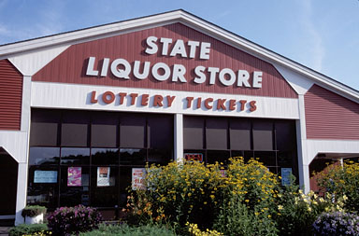
But Where Are the State Run Stores?

Slide 8
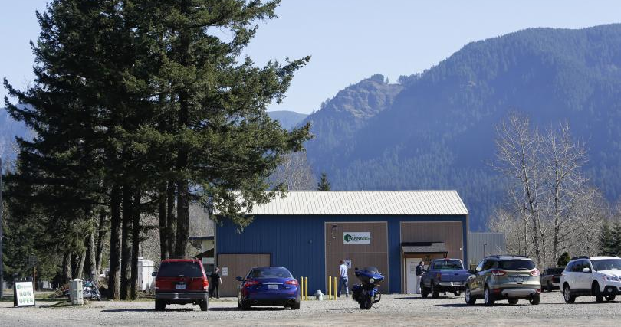
North Bonneville, Washington

Slide 9
Working Around Federal Marijuana Law Professor Robert A. Mikos

