Slide 1
The Anticompetitive Potential of Cross-Market Mergers in Health Care
Jaime S. King, JD, PhD
Erin C. Fuse Brown, JD, MPH
AALS Annual Meeting: January 7, 2017

Slide 2
Overview
Traditional enforcement focus on horizontal mergers only
Vertical mergers: theory and evidence
Cross-market mergers: theory and evidence
Implications for antitrust enforcement

Slide 3
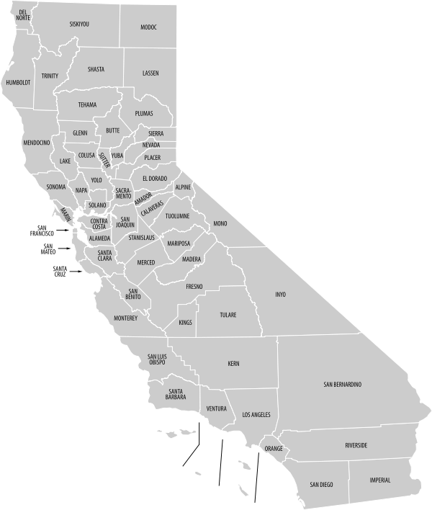
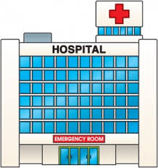
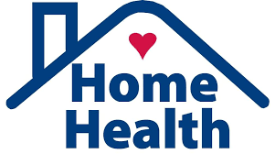

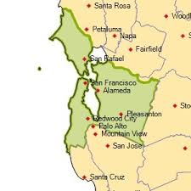


Horizontal vs. Vertical vs. Cross-Market
Horizontal
Cross-Market
Vertical

Slide 4

Traditional View
Horizontal vs. non-horizontal: Only horizontal mergers can be anticompetitive
  Vertical integration in health care may enhance efficiency by improving care coordination, reducing fragmentation.
  Cross-market mergers do not affect competition because merging firms do not directly compete in the same geographic or product markets.

Slide 5
Data: Horizontal Hospital Consolidation
Hospital consolidation leads to significantly higher prices in concentrated markets.
Estimated price increases: 20-40%
Author/Year | Result
Dafny (2009) | Merging hospitals had 40% higher prices than non-merging
Haas-Wilson, Garmon (2011) | Post-merger, Evanston NW hospital had 20% higher prices than controls
Tenn (2011) | Summit/Sutter prices increased 28% - 44% compared to controls
Source: Gaynor M, Town R, The impact of hospital consolidation – update, Robert Wood Johnson Foundation, The Synthesis Project, ISSN 2155-3718 (June 2012).

Slide 6
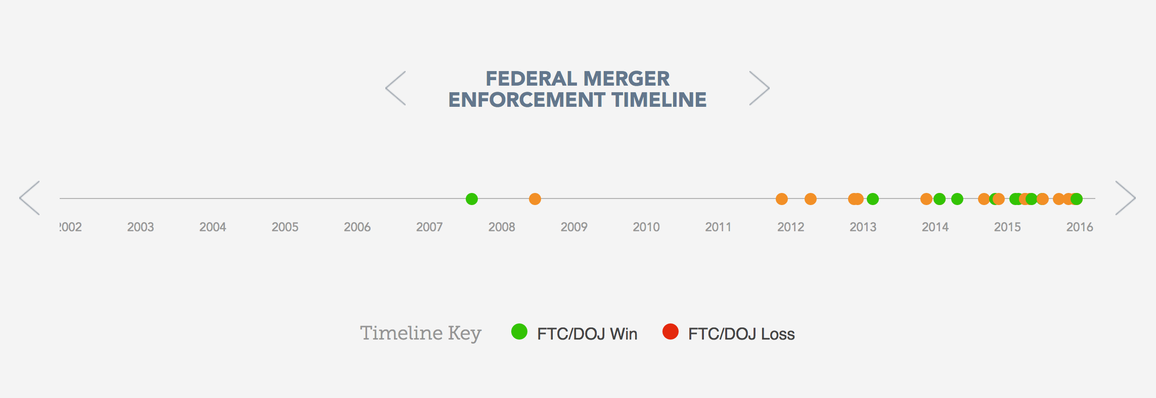
Horizontal merger enforcement
© Source on Healthcare Price and Competition 2017

Slide 7
Emerging View
Non-horizontal mergers are widespread, and they can be anticompetitive.
    Vertical mergers among hospitals and physicians increase prices, per-patient spending, and utilization without improving quality or efficiency.
  Cross-market mergers among entities with common customers or insurers increase market power and prices.
Notes:
[From Dafny, Ho, Lee) “Less than half of the 871 hospital mergers between 2000-2012 involved hospitals located within the same CSBA.” (CSBA = metropolitan statistical area for cities, micropolitan statistical area for smaller towns).
See similar trend for other types of health care services, e.g., rehab, home-health, LTC, even physician practices.
Roughly 1/3 of hospital mergers between 2000—2010 were in entirely different geographic markets. (Lewis and Pflum 2015).

Slide 8
Vertical Integration: Theory (1)
Vertical integration increases market power through:
  Tying: Vertically integrated firm can bundle hospital & physician services when negotiating with health plans, including all-or-nothing or exclusive arrangements
  Foreclosure: Competing hospitals can lose access to integrated physicians’ referrals and services
Notes:
As noted on prior slide, one anticompetitive effect of vertical integration is increased prices.
Mechanism is that the vertically integrated entity increases its market power, not just the horizontal market power.

Slide 9
Vertical Integration: Theory (2)
Hospital ownership of physicians can increase referrals and reimbursement:
Referrals: Increase utilization by incentivizing referrals within the bounds of Stark and Anti-Kickback Laws → more volume, use of high-priced services
Reimbursement: Exploit the “site-of-service differential,” which allows hospital outpatient dep’t to charge extra facility fee for physician services
Notes:
When explaining why hospital owner­ship of physician organizations led to higher total expenditures per patient, Robinson and Miller reasoned that higher expenditures could be driven by increased use of higher-priced services, but it could also be due to higher volume of services, or both.
Hospital acquisition of physicians allows the merged entity to charge higher prices for certain outpatient services by exploiting the fact that hospital-based services are typically reimbursed at higher rates than identical ser­vices provided in physician-based locations. This pricing practice is called the site-of-service differential and is cited as one of the financial incentives driving hospital-physician integration. In Capps, Dranove, and Ody’s research finding that vertical integration between hospitals and physicians increased physician prices, they estimate that about a quarter of the 14% price in­crease resulted from exploitation of reimbursement methodologies that allow hospi­tals to charge facility fees for employed physicians. In the study by Neprash et al., the site-of-service differential explained part of the increase in prices for outpatient services experienced by those areas experiencing the highest increase in hospital-physician integration.
Although BBA of 2015 instituted site-neutral payment for Medicare for all new hospital outpatient departments, HOPDs still charge higher prices for grandfathered (pre-Nov 2015) entities and private payers still pay site of service differential/

Slide 10
Vertical Integration: Data
Hospital ownership of physician organizations correlates with higher prices and spending.
The greater the hospital market share, the greater the price increases.
Author/Year | Result
Baker, Bundorf, Kessler (2014) | Hospital ownership of physicians is associated with higher hospital prices and spending
Robinson, Miller (2014) | Hospital-owned physician orgs had 10-20% higher total expenditures/patient than physician-owned orgs
Capps, Dranove, Ody (2015) | Vertical integration associated with 13.7% increase in physician prices
Neprash, et al. (2015) | MSAs with increases physician-hospital integration experienced median price increases of $75

Slide 11
Conglomerate Cross-Market Mergers
“Protect competition, not competitors.” – Charles James, Assistant A.G. for the Antitrust Division

Slide 12
Cross-Market Mergers: Theory
Portfolio Effects
Modern American Approach
  Vistnes & Sarafidis
    Health Plan Pricing Model
    Employer Choice Model
  Dafny, Ho, & Lee
    Common Insurer/Common Consumer

Slide 13
Common Consumer Example
Ideal Plan | Network A (independent) | Network B (TP + ES) | Network C (TP+ES+MHS)
Tamalpais Pediatrics | yes | x no | x no
Eric Smith, Pediatric Pulmonologist | X no | x no | x no
Marin Hospital System | yes | yes | x no
Cardiology Associates | yes | yes | yes

Slide 14
Common Employer Example
Ideal Plan | Network A (independent) | Network B (Unity + LA) | Network C (Unity+LA+BAP)
Unity Hospital System | x no | X no | x no
UC Hospitals and Providers | yes | yes | yes
LA Cardiology | yes | no | x no
Bay Area Pediatrics | yes | yes | x no

Slide 15
Cross-Market Mergers: Data
Healthcare consumers now consider multiple product and geographic markets when selecting a health network.
The network purchasing model creates the potential for price increases following cross-market mergers.
Author/Year | Result
Lewis & Pflum (2014) | Tested Vistnes & Sarafidis theory of competitive harm from cross-market mergers. Examined hospital mergers from 2000—2010. Cross-market mergers resulted in 14-18% increases in price, comparable to in-market mergers.
Dafny, Ho, & Lee (2016) | Examined acute care hospital acquisitions 1996-2010. Hospital system acquisitions in an adjacent geographic market saw price increases of 6-9% when there were common insurers.

Slide 16
Potential New Conditions for Conglomerate Merger Analysis
Products in closely related markets
  Common Purchaser/Insurer/Consumer
  Same state or regulatory boundary
Significant barriers to entry in one or both of the markets
Existing market leverage of one or both of the merging entities.

Slide 17
Conglomerate Mergers in Health Care
Medical service and products markets are closely related.
  Health plan networks require bundling of medical services across markets for sale as a whole.
  All or nothing contract terms have become ubiquitous.
Highly concentrated provider and insurer markets.
Significant barriers to entry for providers, especially in already concentrated markets.

Slide 18
Limitations and Considerations
Limitations in the data
  Differences in differences approach used by Lewis & Pflum depends on a good control group match.
Other factors that could lead to price increases
  Negotiating ability of the larger firm
  Greater ability to bear risk
  Better information

Slide 19
Implications for Enforcement
Antitrust analysis does, and should, evolve with economic data.
Antitrust enforcers should examine vertical and cross-market mergers for anticompetitive effects.
Must have limiting principles.
Post merger conduct remedies should be avoided because the mergers are happening at a rapid rate, the provider market is already highly consolidated, conduct remedies have proven inadequate, and it is difficult to unscramble a consummated merger.

Slide 20





Thank you!
Jaime S. King, JD PhD | Erin C. Fuse Brown, JD, MPH
kingja@uchastings.edu | efusebrown@gsu.edu
@profjaimeking | @efusebrown

