Slide 1
AALS Annual Meeting Animal Law Section Co-Sponsored by Disability Law and Law and Mental Disability Sections January 6, 2017 ANIMALS AS LIVING ACCOMMODATIONS
Issues Relating to Service Animals in Schools: What Happens After the Decision in Fry v. Napoleon Community Schools
Rebecca J. Huss
Professor of Law and Phyllis and Richard Duesenberg Chair in Law
Valparaiso University Law School
POSTED VERSION – DOES NOT INCLUDE ALL PHOTOS

Slide 2
Roadmap
Intro to Service Animals in Schools
Fry v. Napoleon Community
Schools
Other Cases of Interest
Impact of State Laws

Slide 3
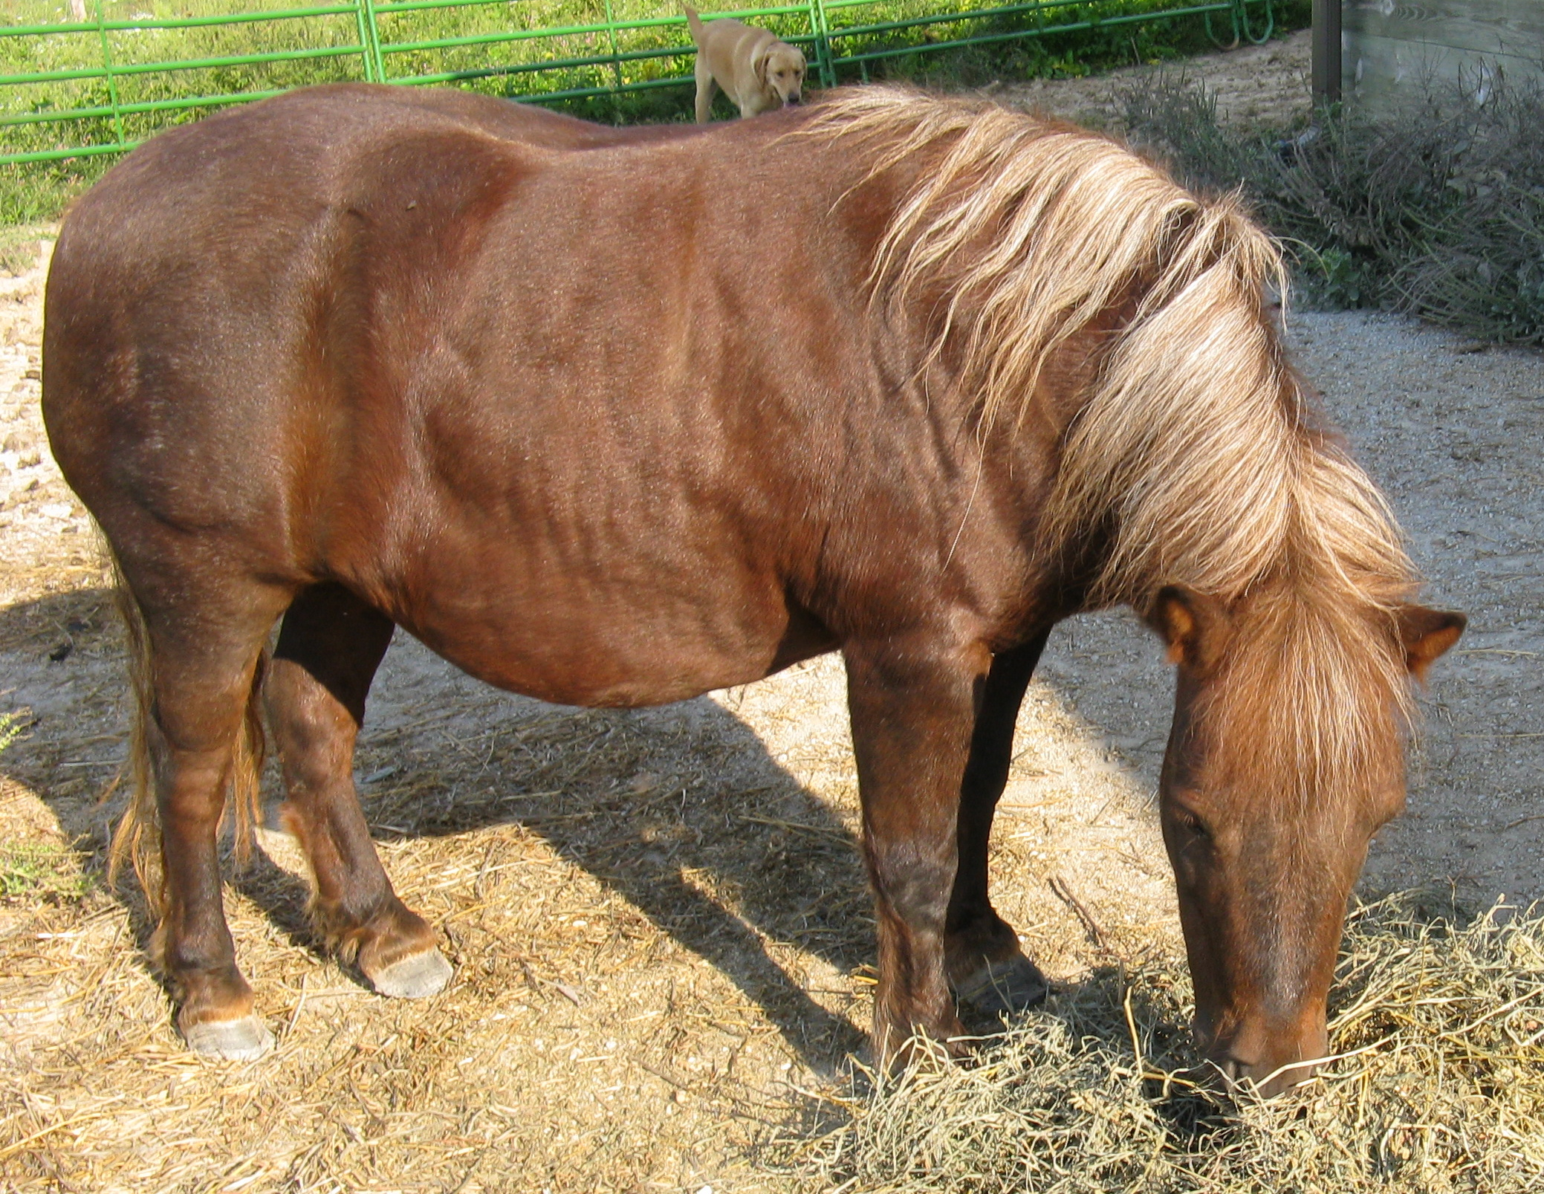
Americans with Disabilities Act Service Animal Regulations
Individually Trained
Do Work or Perform Tasks
Includes Psychiatric Service Animals

Slide 4
Regulations – ADA Exclusion of “Emotional Support Animals”
“[a]nimals whose sole function is to provide emotional support, comfort, therapy, companionship, therapeutic benefits, or promote emotional well-being are not service animals”

Slide 5
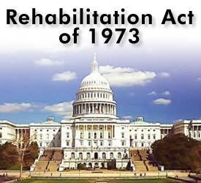
Section 504 of the Rehabilitation Act
“no otherwise qualified individual with a disability . . . shall solely by reason of her or his disability . . . be denied the benefits of . . . any program or activity receiving Federal financial assistance.”

Slide 6
Advice for Advocates of Students
Check Your Applicable State Law
Focus on Access Pursuant to the ADA and Section 504 of the Rehabilitation Act
Individualized Determination
If Unsuccessful, Utilize Individuals with Disabilities Education Act’s (IDEA) IEP Process

Slide 7
Issues in Recent Education
Cases
Exhaustion of Administrative Remedies Under IDEA
Under Control of Handler
Liability Insurance
Vaccinations
Care and Supervision

Slide 8
Ehlena Fry and Wonder, Photo Credit: ACLU of Michigan
Fry v. Napoleon Comm. Schools,
788 F.3d 622
(6th Cir. 2015),
cert. granted,
136 S.Ct. 2540
(June 29, 2016)
(No. 15-497)
Oral Arguments
October 31, 2016
20 U.S.C. § 1415(l)

Slide 9
Amici Curiae Briefs
Former Senator and Former DOE Officials

Slide 10
Other Cases of Interest
Alboniga v. Sch. Dist. Broward Co. Fla
(S.D. Fla. 2015)
U.S. v. Gates-Chili Cent. Sch. Dist.
(W.D.N.Y. 2016)
Anthony Merchante and Stevie
Photo Credit: Miami Herald Feb. 2015
Berardelli/Bardelli v. Allied Serv. Inst. of
Rehabilitative Med. (M.D. Pa. Apr. 2014) Riley v. Sch. Admin. Unit #23 (D.N.H. Apr. 2015)
Child with Disability v. Sachem Cent. Sch. Dist.
Bd. of Ed. (E.D.N.Y. May 2015)
Devyn Pereira and Hannah Photo Credit: WHEC.com Aug. 2016

Slide 11
State Laws of Interest
Alabama Georgia Illinois Mississippi
New Jersey
Washington
“Autism Service Dog”
Indiana
Louisiana
Alaska
Hawaii

Slide 12
Applying General Access Provisions Example: Va. Code § 51.5-44
Virginia Department of Education Guidelines (Revised 2011)
“afforded each student a near absolute right to be accompanied by a service dog in a Virginia public school”
“provide a separate statutory right of the student to be accompanied by a service dog, thereby making IEP/504 team determinations unnecessary”
“still must be qualified and carefully weighed against the rights of other students who are equally entitled to receive educational benefits at the school”

Slide 13
Illinois Law
Photo Credit: Daily Herald
Photo Credit: Illinois Times
Carter Kalbfleisch and Corbin
Kaleb Drew and Chewey
Ill. Comp. Stat. 5/14-6.02
“service animals . . . shall be permitted to accompany that student at all school functions, whether in or outside the classroom.”
Ill. Comp. Stat. 5/48-8 “autism service animal”

Slide 14
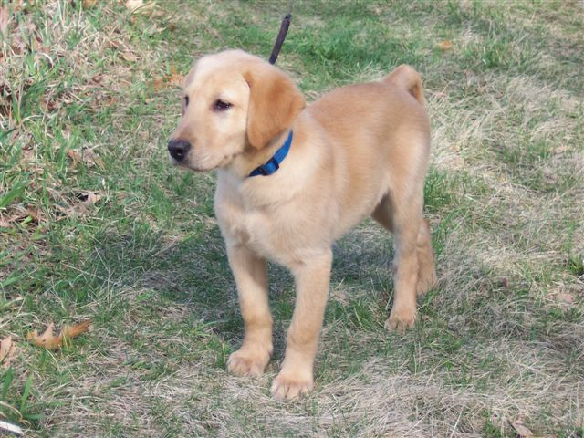
Policy and Ethical Issues

Slide 15
Canines in the Classroom Revisited: Recent Developments Relating to Students’ Utilization of Service Animals at Primary and Secondary Educational Institutions, 9 Albany Gov’t L. Rev. 1 (2016) Canines in the Classroom: Service Animals in Primary and Secondary Educational Institutions, 4 J. of Animal L. & Ethics 11 (2011) Articles can be downloaded from SSRN.com
THANK YOU

Slide 16
Recent Education Cases
Alboniga v. School Board of Broward Cnty. Fla., 87 F.Supp.3d 1319 (S.D. Fla. 2015)
U.S. v. Gates-Chili Central Sch. Dist., 2016 WL 4036601 (W.D.N.Y. 2016)
Bardelli/Berardlli v. Allied Services Inst. of Rehabilitative Medicine, 3:14-cv-00691 (M.D. Penn. 2014)
Riley v. School Admin Unit #23, No. 1:15-cv-00152 (D.N.H. Apr. 2015)
Child with Disability v. Sachem Cent. Sch. Dist. Board of Ed.,
No. 2:15-cv-02903 (E.D.N.Y. May 2015)

Slide 17
Citations to State Laws of Interest Relating to Service Animals in Schools
Alabama § 21-7-4
Georgia § 30-4-2(b)
Mississippi § 37-70342
New Jersey § 18A:46-13.2 et. seq.
Washington § 28A-642.010
California Education Code § 39839
Indiana § 16-32-3-1.5
Louisiana § 46:1952

Slide 18
Illinois Education Cases
K.D. v. Villa Grove Cmty. Unit School District, 936 N.E.2d 690 (Ill. App. 2010) (trial court order in favor of student affirmed)
Kalbfleich v. Columbia Cmty. Unit School District, 920 N.E.2d 651 (Ill. App. 2009) (trial court’s preliminary injunction in favor of student affirmed)

