Slide 1
Defining a Disability Assistance Animal in Disability Discrimination Laws in Australia and the US:
Two Jurisdictions with Similar Approaches and Similar Confusions
Dr Paul Harpur, Dr Martie-Louise, Professor Simon Bronitt, Professor Nancy Pachana and Dr Peter Billings

Slide 2
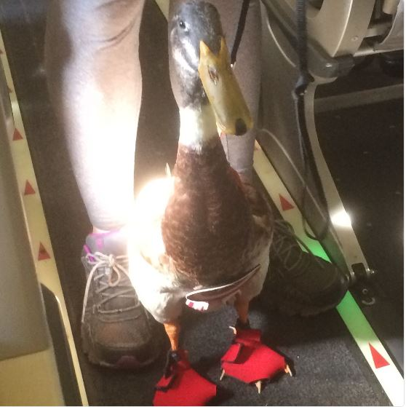
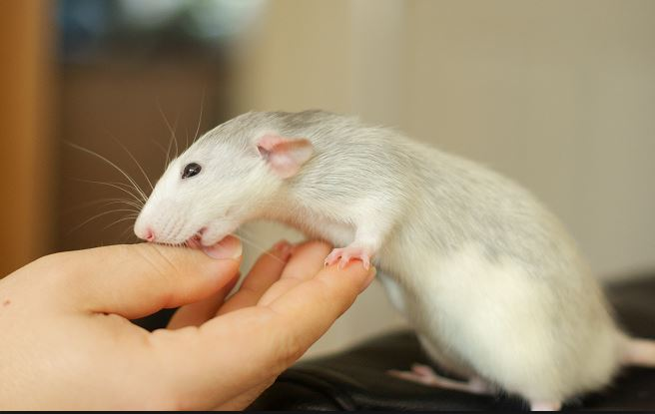
Distinguishing between a pet and a disability assistance animal:
Types of animals protected and training standards

Slide 3
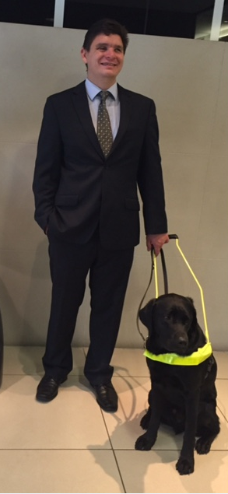
How the public can
distinguish between a
disability assistance animal
and a pet.
Identification cards, jackets
and harnesses

Slide 4
Fake and fraudulent disability assistance animals
a. Where the handler has no disability and the animal is just a pet.
b. Where the handler has a disability but the animal does not have appropriate training and they are aware of the lack of training or should reasonably be expected to be so aware.

Slide 5
c. Where the person with a disability reasonably believes the animal has appropriate training but the animal does not have appropriate training. Here the handler might have been negligent in the way they acquired their animal, however the problem is that they may have owner trained the animal to a poor standard or acquired it from a dubious organization.
d. Where a training institute fraudulently holds out animals as assistance animals.

Slide 6
Prohibiting and sanctioning fake and fraudulent disability assistance animals.
Regulating, ignoring and under enforcing

Slide 7
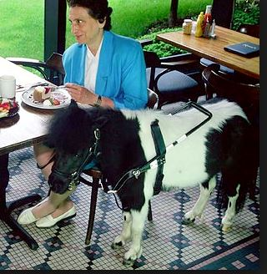
Moving forward
Definition of disability assistance animal requires clarification
Identification cards should be required to obtain protection

