Slide 1
How to Complete Your Service Requirements, Keep Your Sanity, Make New Friends, Influence People, and Earn Tenure, Too: 6 Lessons Plenary Session-Service: Challenge, Opportunity and Passion
Phoebe A. Haddon
Chancellor

Slide 2
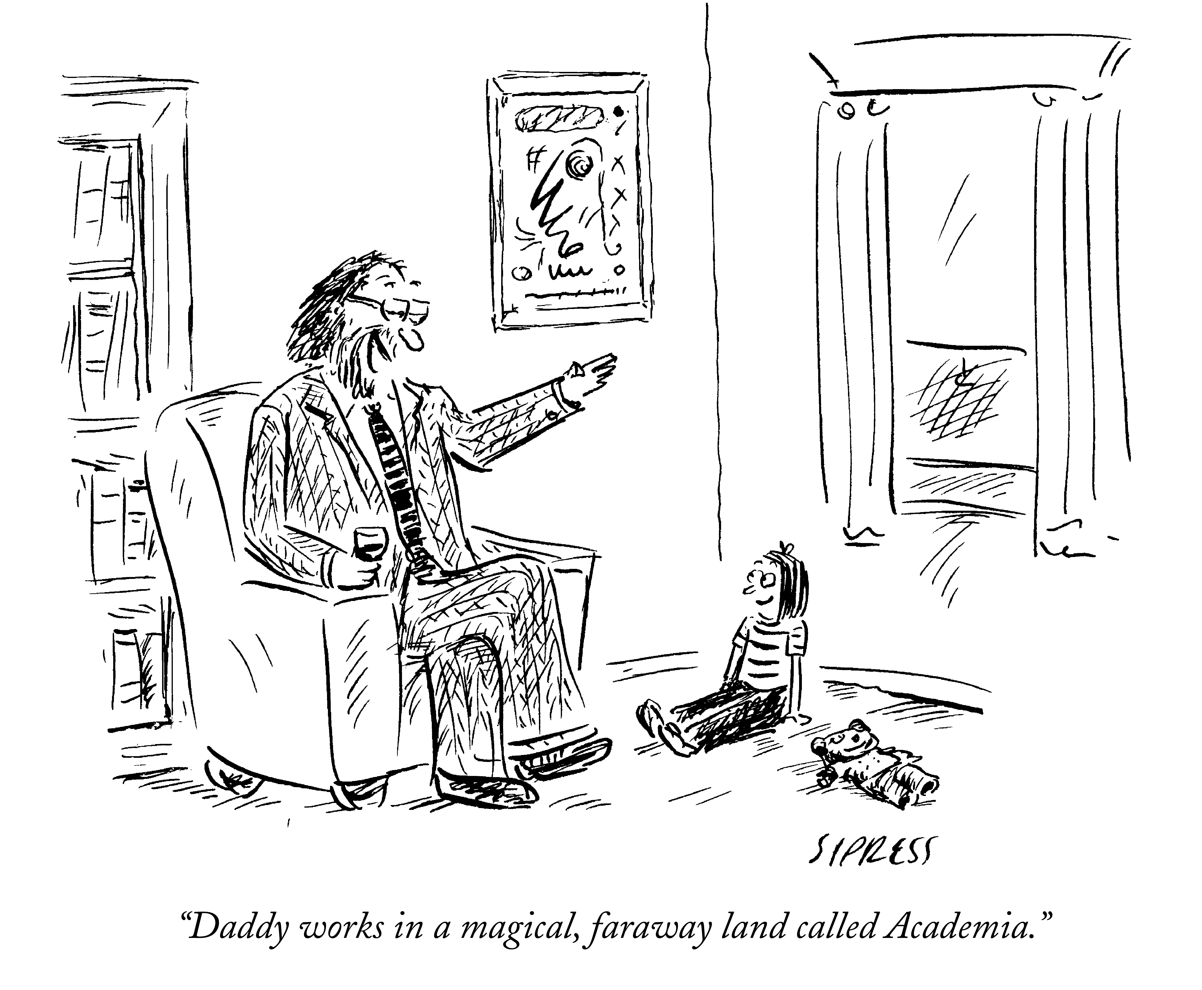

Slide 3
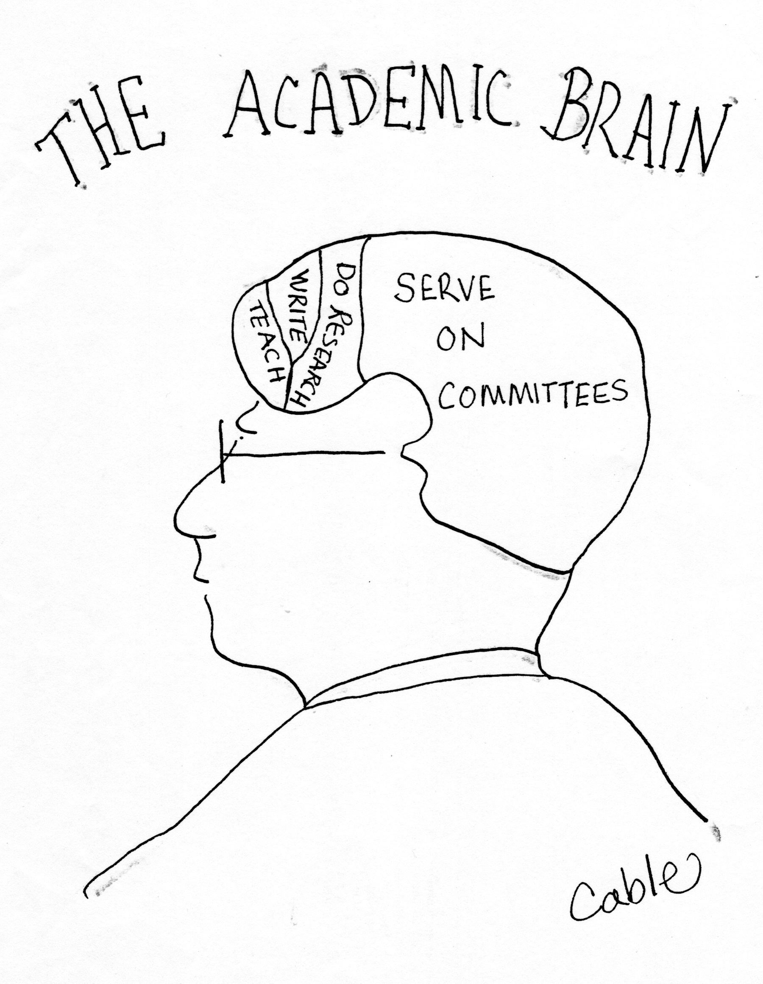

Slide 4
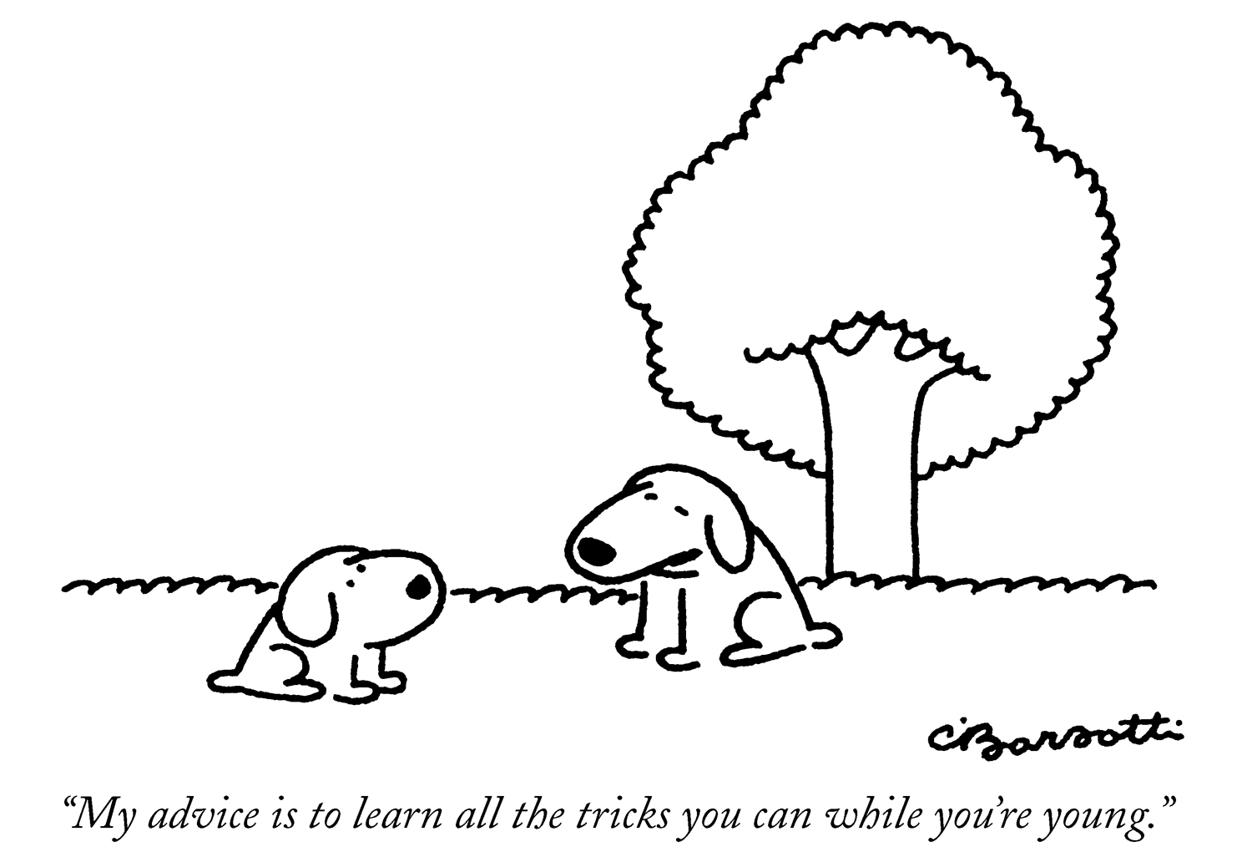

Slide 6
Lesson #1:
Find your focus and your passion, and avoid spreading yourself too thin.

Slide 7
Lesson #2:
Find creative ways to do service that can
promote or support
other aspects of your work.

Slide 8
Lesson #3:
Have the courage to say “no” when you are too busy or simply don’t have the passion for the area.

Slide 9
Lesson #4:
If “no” is not an option, negotiate.

Slide 10
Lesson #5:
Know your law school’s culture.

Slide 11
Lesson #6:
Keep good records of actual service, compliments, and other indications of the richness of your contributions and share them with your peers and the tenure committee.

Slide 12
Summarized Lessons:
Focus
Be creative
Say “no”
Negotiate
Be a good “citizen”
Keep good records

