Slide 1
Navigating the Path to Tenure and Promotion (Things I Wish I Had Known When I Started)
Leo P. Martinez
Albert Abramson Professor of Law
University of California, Hastings College of the Law
AALS Workshop for Pretenured Law School Teachers of Color
Washington, D.C.
June 6, 2015

Slide 2
The Elephant in the Room
Leo P. Martinez
Albert Abramson Professor of Law
University of California, Hastings College of the Law
Past President Association of American Law Schools
AALS Workshop for Pretenured Law School Teachers of Color
Washington, D.C.
June 6, 2015

Slide 3
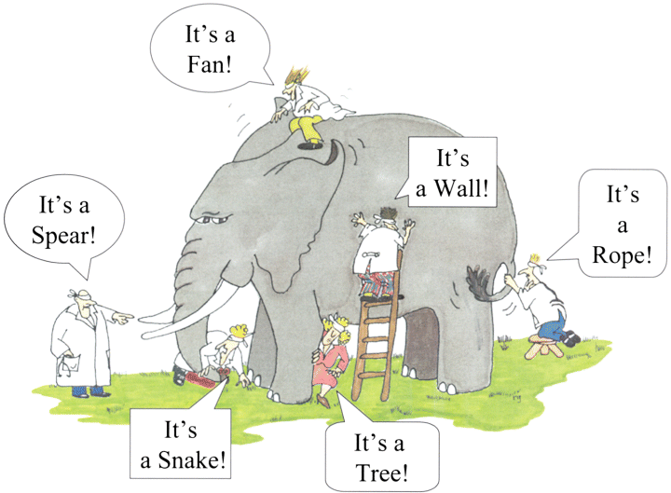

Slide 4
Scholarship and Writing
Teaching
Student Advising and Office Hours
Committee Work
Time
Work-Life
Balance
University Service

Slide 5
Martinez’s law:
The number of tasks to be done is inversely proportional to the amount of time available to do them

Slide 6
Martinez’s law on the relationship between number of tasks and the time available to do them
Available
Time
Increasing number of tasks

Slide 7
The Elephant in the Room
Reality
Saying No
Coping

Slide 8
Reality
Doing it all
24 hours/day
Isolation

Slide 9
Saying No
Know what’s on your plate
Be aware of what others are doing
Grace and coolness under fire matter
No is not never
Say yes when it’s right for you

Slide 10
Coping
Chop the wood in front of you
You are not alone 2
You are not alone 1

Slide 11
Coping
Chop the wood in front of you

Slide 12
The Elephant in the Room
Leo P. Martinez
Albert Abramson Professor of Law
University of California, Hastings College of the Law
Past President Association of American Law Schools
AALS Workshop for Pretenured Law School Teachers of Color
Washington, D.C.
June 6, 2015

