Slide 1
Ten Keys to
Successful Implementation
2015 AALS Midyear Meeting
Steve Bahls, President
Augustana College

Slide 2
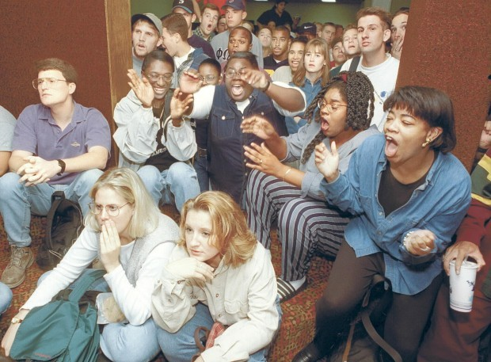
Photo by Larry Fisher, Quad-City Times, Oct. 3, 1995

Slide 3
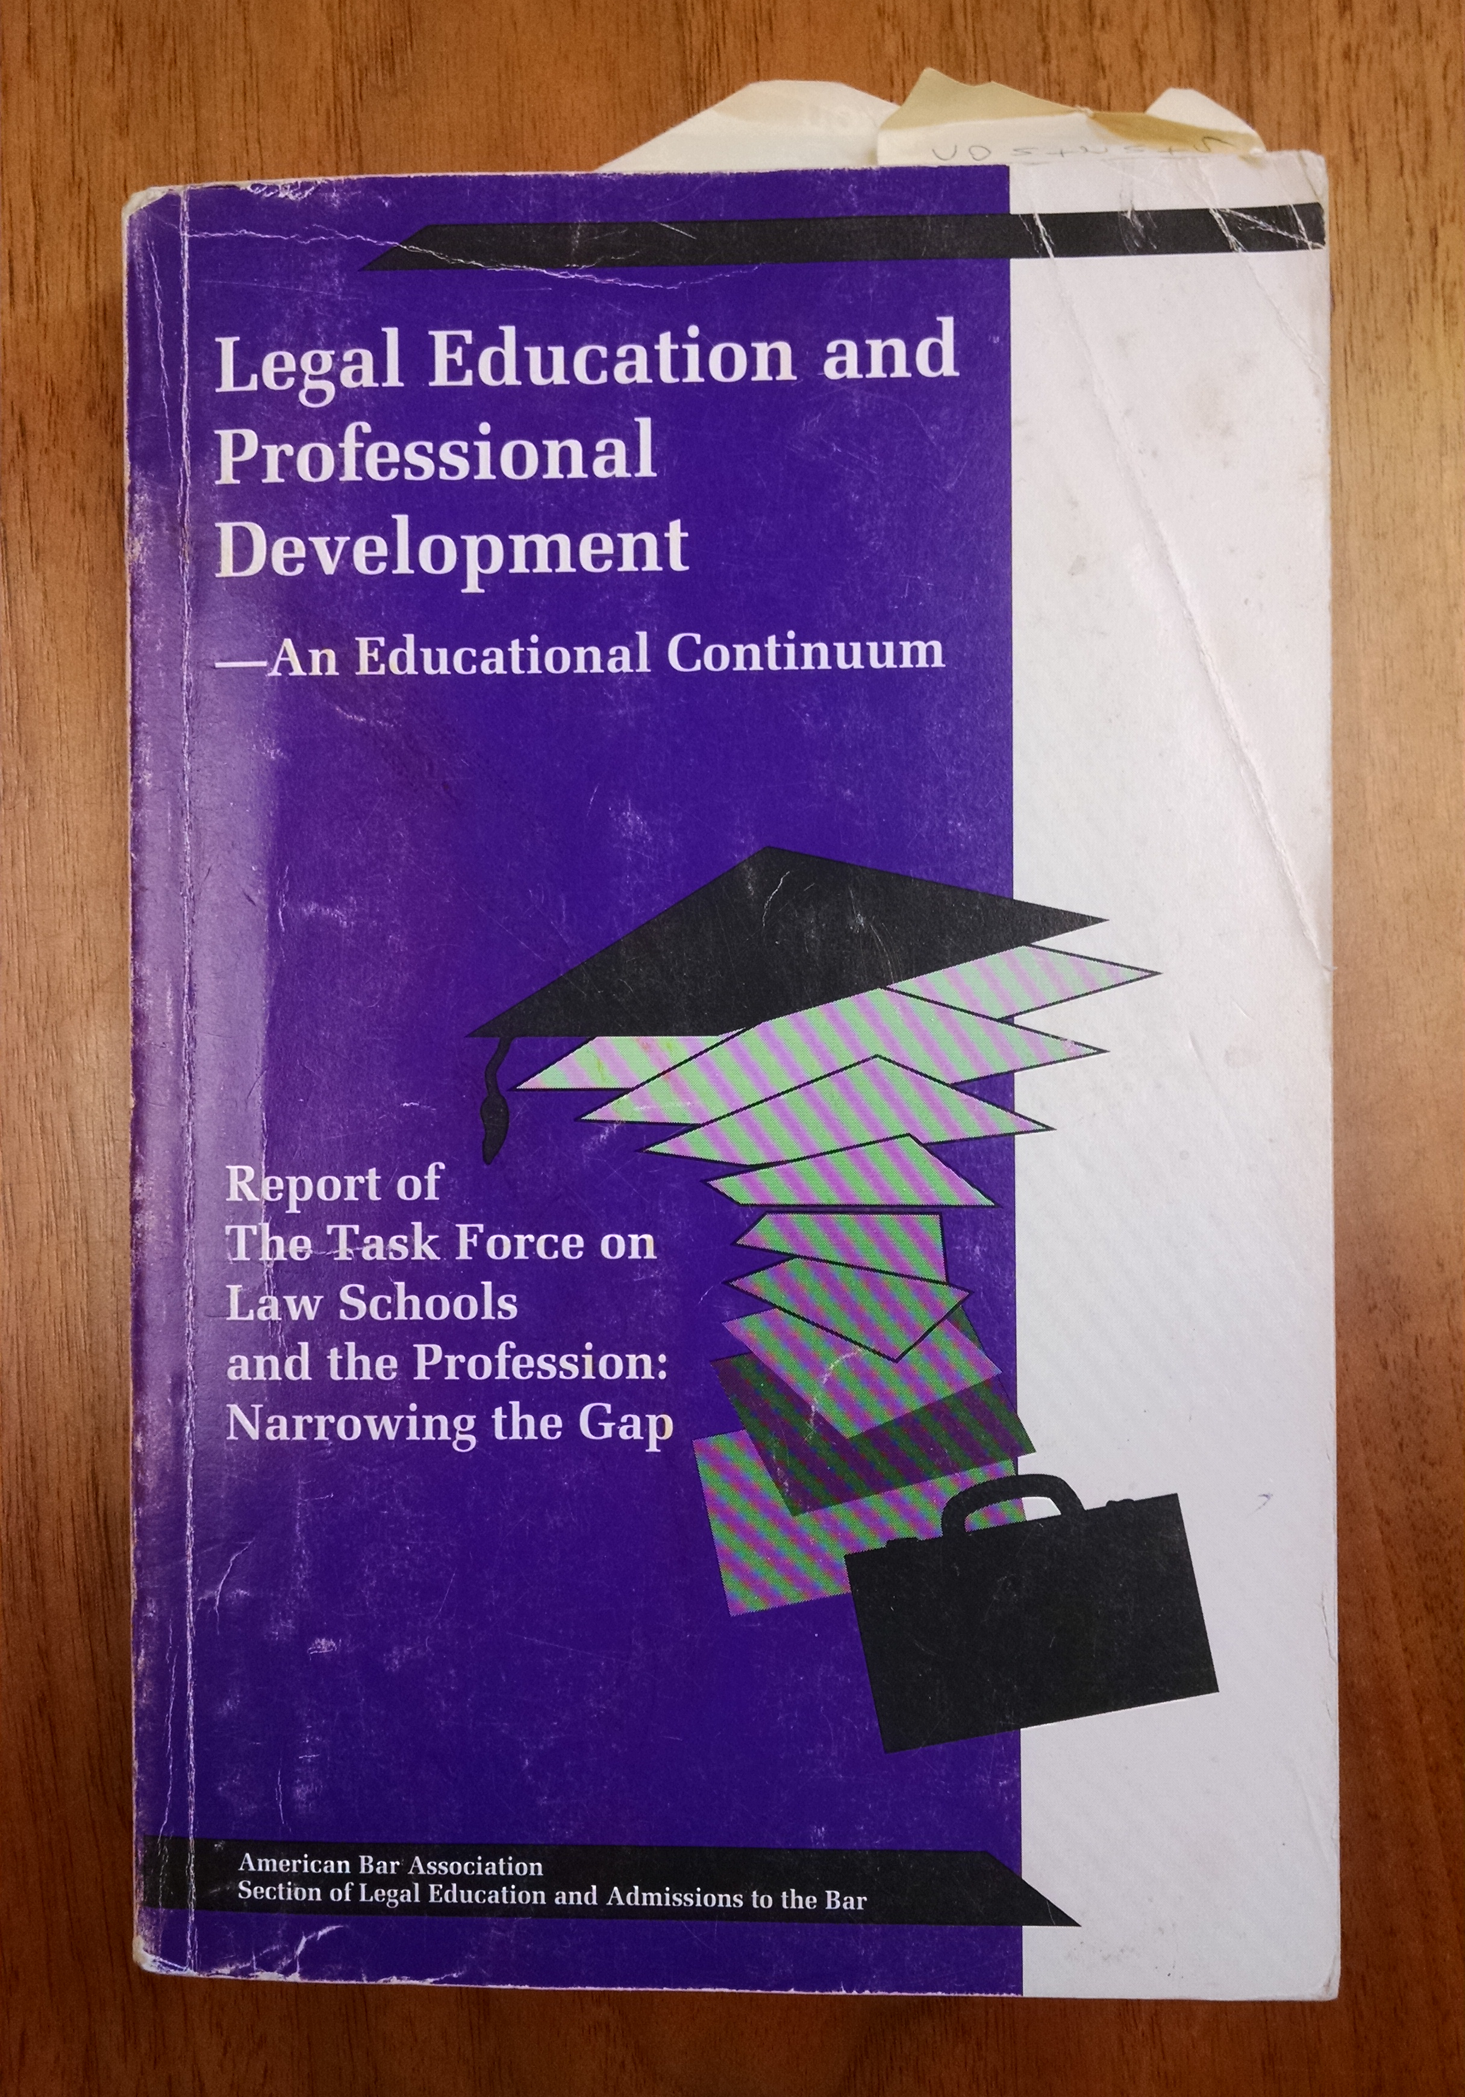

Slide 4
Ten Keys to Successful Implementation of SLO Standards:

Slide 5
1. Understand what the standards require

Slide 7
2. Understand what the standards don’t require:
Blizzard of paperwork
Practice-ready lawyers
One size fits all
Considerable cost

Slide 8
3. Be cautious about promising too much; connect to mission

Slide 9
4. Leverage your phase-in period, and don’t be afraid to innovate

Slide 10
5. The rules of shared governance should apply

Slide 11
6. Embrace all faculty members, both those teaching skills and those teaching doctrine

Slide 12
7. Look for a diverse group of advocates for SLOs

Slide 13
8. Curriculum mapping, the role of syllabi, and special SLO subcommittee of Academic Affairs

Slide 14
9. Invest in faculty development and the scholarship of teaching and learning

Slide 15
10. The bar asked for this and…
We should ask members of the bar to help fund it

Slide 16
Thank you!
Steve Bahls
stevenbahls@augustana.edu

