Slide 1

Competencies and Rubrics, What are they Good For?!
Law, Social Work and Psychology Standards in an Interprofessional Context
Virgil Wiebe, Patricia Stankovitch & George Baboila
University of St. Thomas Interprofessional Center

Slide 2

Rubrics! Huh! Yeah! What are they good for?!
Absolutely nothing?

Slide 3
“Rubrics, I despise, because they mean destruction to innocent lives. Rubrics leave tears in thousands of teacher’s eyes when their students go to practice and loose their minds. . .” paraphrasing the Temptations and the late Edwin Starr and the
PERSONAL KNOCK ON RUBRICS:
Time consuming
Reductionist
Bulky
Time consuming

Slide 4
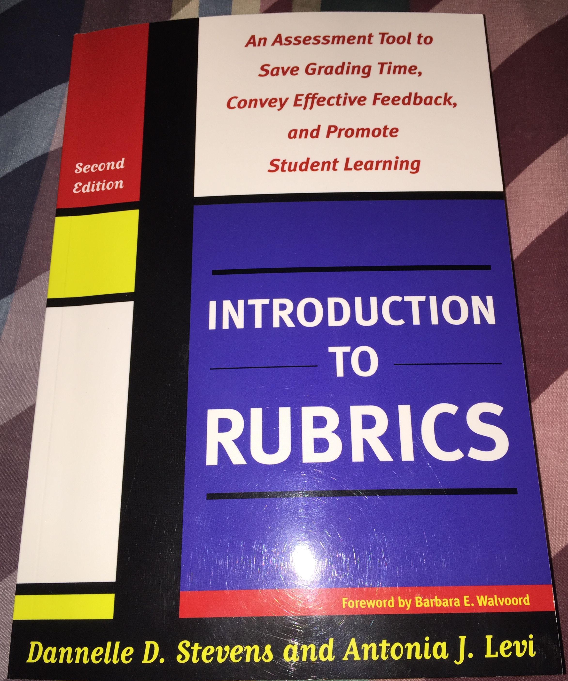
Rubrics: What are they good for?
Rubrics can help provide timely feedback
Rubrics prepare students to use detailed feedback
Rubrics encourage critical thinking
Rubrics facilitate communication with others
Rubrics help us refine our teaching methods
Rubrics can help level the playing field
Dannelle Stevens & Antonia Levi, Introduction to Rubrics (2d ed. 2012)

Slide 5
Outline
    ABA Standards – Learning Outcomes & Assessment
Competency Based Education in Social Work & Psych
Interprofessional Collaboration Competencies
  Training
  Implementation in practice – recent cases
Evaluation of Interprofessional collaboration
  Interactive exercise - [hidden curriculum]
Other methods of Interprofessional Collaboration Evaluation

Slide 6
The New ABA Standards –
Learning Outcomes and Competencies

Slide 7
ABA Standard 301. OBJECTIVES OF PROGRAM OF LEGAL EDUCATION
(a) A law school shall maintain a rigorous program of legal education that prepares its students, upon graduation, for admission to the bar and for effective, ethical, and responsible participation as members of the legal profession.
(b) A law school shall establish and publish learning outcomes designed to achieve these objectives.

Slide 8
NEW Standard 302. LEARNING OUTCOMES
A law school shall establish learning outcomes that shall, at a minimum, include competency in the following:
(a) Knowledge and understanding of substantive and procedural law;
(b) Legal analysis and reasoning, legal research, problem-solving, and written and oral communication in the legal context;
(c) Exercise of proper professional and ethical responsibilities to clients and the legal system; and
(d) Other professional skills needed for competent and ethical participation as a member of the legal profession.

Slide 9
Interpretation 302-1
For the purposes of Standard 302(d), other professional skills are determined by the law school and may include skills such as, interviewing, counseling, negotiation, fact development and analysis, trial practice, document drafting, conflict resolution, organization and management of legal work, collaboration, cultural competency, and self-evaluation.
Interpretation 302-2
A law school may also identify any additional learning outcomes pertinent to its program of legal education.

Slide 10

Learning Outcomes
Professional Formation and Ethical Responsibilities
Knowledge of Substantive and Procedural Law
Legal Analysis, Reasoning, and Problem Solving
Written and Oral Communication Skills
Legal Research and Factual Investigation
Teamwork and Relationship Skills
Faculty approved March 2015
Notes:
C. Statement of Learning Outcomes
In the course syllabus, the instructor shall state course specific learning outcomes and indicate how those learning outcomes connect with the “General Learning Outcomes” for the law school as stated in section III.1.a.
D. Statement of Assessment
The instructor shall offer students opportunities for formative assessment with instructor feedback. Instructors teaching subjects that are included on the Multistate Bar Examination shall include multiple choice questions in formative assessment.
For summative assessment, the instructor shall notify students in the course syllabus how the grade for the course will be determined or, where the course is ungraded, how passing performance will be determined. The faculty favors multiple modes of assessment, including written papers and/or presentations, evaluation of experiential learning, and written examinations which may be composed of essay questions, short answer questions, and multiple choice questions. The faculty also favors written modes of assessment, which may be comprised of more than multiple choice questions.

Slide 11

The New ABA Standards –
Assessment Methods

Slide 12
Standard 314. ASSESSMENT OF STUDENT LEARNING
A law school shall utilize both formative and summative assessment methods in its curriculum to measure and improve student learning and provide meaningful feedback to students.

Slide 13
Standard 315. LEARNING OUTCOMES, AND ASSESSMENT METHODS
The dean and the faculty of a law school shall conduct ongoing evaluation of the law school’s program of legal education, learning outcomes, and assessment methods; and shall use the results of this evaluation to determine the degree of student attainment of competency in the learning outcomes and to make appropriate changes to improve the curriculum.
Interp. 315-2 “The methods used to measure the degree of student achievement of learning outcomes are likely to differ from school to school and law schools are not required by this standard to use any particular methods.”

Slide 14
Professional Competencies and Evaluative Tools
Social Work

Slide 15
Educational Policy and Accreditation Standards (EPAS) 2008
The Council on Social Work Education (CSWE) uses the Educational Policy and Accreditation Standards (EPAS) to accredit social work programs.
Competency-based education is an outcome performance approach to curriculum design.
Competencies are measurable practice behaviors that are comprised of knowledge, values, and skills.
The goal of the outcome approach is to demonstrate the integration and application of the competencies in practice with individuals, families, groups, organizations, and communities.

Slide 16

A2.1.10 (a)-(d) – Engage, assess, intervene, and evaluate with individuals, families, groups, organizations, and communities.
A2.1.10 (b)—Assessment. Advanced practitioners in clinical social work
  1. use multidimensional bio-psycho-social-spiritual assessment tools;
  2. assess clients’ readiness for change;
  3. assess client coping strategies to reinforce and improve adaptation to life situations, circumstances, and events;
  4. select and modify appropriate intervention strategies based on continuous clinical assessment; and
  5. use differential and multiaxial diagnoses.

Slide 17
In the Field Setting (Internship)
IV. CLINICAL PRACTICE METHODS
Objectives: To apply the knowledge and skills of the clinical social work perspective to practice with individuals, families and groups. To differentially apply clinical knowledge, analytic, and practice skills that are sensitive to client systems that differ in social, cultural, racial, religious, spiritual and class backgrounds, gender, sexual orientation, ability, and age.

Slide 18
Rubric for evaluating Clinical Assessment competency

Slide 19
Rating system
RATING SCALE: This is a summative evaluation. We are asking you to evaluate behaviors; i.e., the degree to which each practice behavior is demonstrated by the student.
5) Skillfully and Consistently demonstrates
4) Consistently Demonstrates
3) Generally Demonstrates
2) Inconsistently Demonstrates
1) Rarely Demonstrates
N/A Not applicable to the internship setting (note – clinical social work skills are transferable to a wide range of practice settings. Please use N/A only when there is no opportunity to apply a certain practice behavior or skill.)

Slide 20
Social Work & Interprofessional Assessment

Slide 21

End of year evaluation with questions on Interprofessionalism.
I. AGENCY & COMMUNITY
b. Communicate professional judgments to other social workers and to professionals from other disciplines, in both verbal and written format.
e. Work collaboratively with others to effect systemic change that is sustainable.
III. SELF AWARENESS & COMMUNICATION
h. Collaborate with other professionals to coordinate treatment interventions.
IV. CLINICAL PRACTICE METHODS
n. Consult with other professionals, as needed, to facilitate the assessment, diagnosis and treatment processes.

Slide 22
Professional Competencies and Evaluative Tools
Psychology

Slide 23

  Practitioner-Scholar Training Model; APA Accredited
  Prepares students for practice in professional psychology & to base practice on science
  National Council of Schools and Programs of Professional Psychology (NCSPP) Model of Training: good fit for our teaching & evaluation of students

Slide 24
NCSPP Model of Training
Core Competency Areas
Relationship
Intervention
Diversity
Research & Evaluation
Management & Supervision
Assessment
Consultation & Education

Slide 25
Intervention Competency = Activities that promote, restore, sustain, &/or enhance positive client functioning
Ability to collaborate with clients on treatment plans, orient clients to treatment process & plan as necessary.
Ability to clearly articulate & consistently follow through with theory and its connection to the case
Ability to manage sessions, facilitate interventions & follow through on recommendations/previous sessions
Ability to be reflective & mindful of one’s abilities and limits & how they affect interventions & outcomes
Ability to terminate appropriately, with sensitivity to the issues at hand.
Appreciation of client strengths, resiliency and effectiveness

Slide 26
Rating Scales
Below Minimum Competence
  Needs considerable improvement; remediation
Novice
  EXPECTED here at beginning Practicum I
Intermediate
  Novice less prominent; generalizability of skills to new clients/situations somewhat limited; support still needed to guide performance
Advanced
  EXPECTED @ end Practicum II; Internship ready

Slide 27
Pros & Cons of Competency-Based Education
Cons
Difficult to define uniform standards & expectations
The profession is more than simply a set of skills
Some knowledge/skills/ attitudes hard to measure; so evaluations may focus too much on those that are easily measured
Significant time & possibly financial cost

Slide 28
Pros & Cons of Competency-Based Education
Pros
Clearly communicates expectations for learning
Foundation for evaluating students’ progress
Assists in determining curriculum & course development
Provides way to view students’ growth over time

Slide 29

UST Interprofessional Collaboration Competencies

Slide 30
Interprofessional Competencies – drawn from health professions
Domain I. Values and Ethics: Work with individuals of other professions to maintain a climate of mutual respect and shared values.
Domain II. Roles and Responsibilities - Use the knowledge of one’s own role and those of other professions to appropriately assess and address the service needs of the clients and populations served.
Domain III. Interprofessional Communication - Communicate with clients, families, communities, and other professionals in a responsive and responsible manner that supports a team approach to the provision of services.
Domain IV. Collaboration and Teamwork - Build teams and relationships based on appropriate roles in order to plan and deliver services.
Domain V. Conflict Management: Build an environment of trust in which disagreements and conflict can be addressed directly and productively.

Slide 31
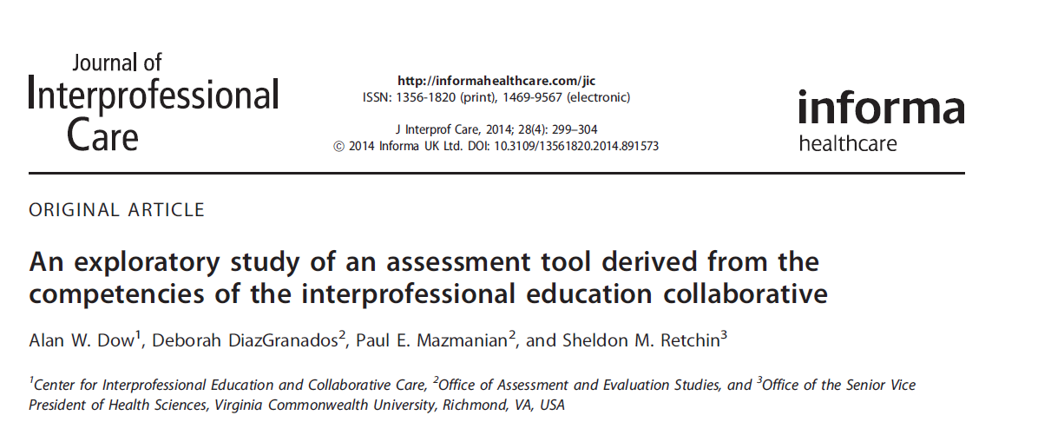

Slide 32
Implementation of the Interprofessional Competencies
Orientation exercise (see handout)
Interprofessional Ethics class and readings
Simulation – expert and lay professional witness class
Therapeutic Jurisprudence

Slide 33
Interprofessionalism in practice
Physical Setting
Recent cases

Slide 34
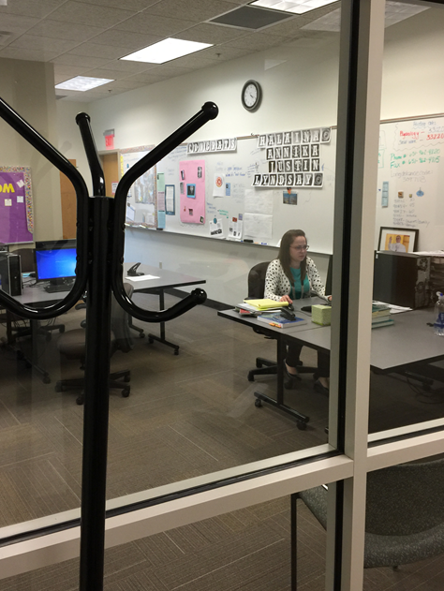

Slide 35
Evaluation - UST Law Clinic Skill Area Assessment
Modeled on Georgetown Center for Applied Legal Studies
Goal Identification by students of practice skill areas plus other goals
Ongoing informal formative assessments
Formal summative Midterm Evaluation - self-evaluation plus individual meeting with supervisor(s)
Formal summative Final Evaluation – self-evaluation plus individual meeting with supervisor(s)

Slide 36
Evaluation of Interprofessional Competencies
Case Team Meetings
Rubrics
    Breakout session
Rounds
Client Satisfaction Surveys

Slide 37
Small group instructions
After presentation of the case, each group will evaluate the performance on this case of Virgil (and his students) or Pat (and her student) or George (and his students) by using the IPC rubric created for our law students
Pick two or three of the domains to discuss with the presenters. One person from the group will report back.

Slide 38

Swing Out Sister – Breakout!
When explanations make no sense
When every answer's wrong
You're fighting with lost confidence
All expectations come
The time has come to make or break
Move on don't hesitate
Breakout
https://www.youtube.com/watch?v=-P67b07z7Qw

Slide 39

Independent & Collaborative Client Service
Social Work
faculty member
Expert witnesses
Child Advocate
Guardian ad Litem
Law
Asylum & Special Immigrant Juvenile Status
Psychological Testing
Case Management
Therapy
Social Work
Psychology

Slide 40
Other Methods of Interprofessional Collaboration Assessment
https://nexusipe.org/measurement-instruments
Examples from the health professions:
Videotaped simulations
Objective structured clinical examinations
Knowledge tests
Implicit association tests
Notes:
Go to https://nexusipe.org/measurement-instruments
Journal of Interprofessional Care

Slide 41
Questions? www.stthomas.edu/ipc
George Baboila GVBABOILA@stthomas.edu
Pat Stankovitch PASTANKOVITC@stthomas.edu
Virgil Wiebe vowiebe@stthomas.edu

