Slide 1
Use of Competencies at WilmerHale
AALS Workshop on Measuring Learning Gains: Institutional Effectiveness for the New Era
William F. Lee
June 23, 2015

Slide 2
Background
The law firm apprentice model
Development and use of practice specific benchmarks
Formal evaluations
“If you pick the right people and give them the opportunity to spread their wings and put compensation as a carrier behind it you almost don't have to manage them.”
- Jack Welch

Slide 3
Why Competencies?
Rethink career paths at the firm – associate to counsel to partner
Answer the question: What do I need to do to be successful at WilmerHale?
Create a common language to define success
Align our compensation system with performance and away from an hours based model

Slide 4
Competency Development
Outside research - PWC, McKinsey, Bain and others
Outside consulting firm - Hay Group
Interviews with over 100 partners
Input from over 200 associates and counsel in group sessions and through an anonymous survey
Asked the question: What does a successful associate, senior associate and counsel look like?

Slide 5
WilmerHale Competencies
Commitment
Confidence
Matter Management
Oral Communication
Problem Solving
Relationship Building
Teamwork
Writing
In business, the idea of measuring what you are doing, picking the measurements that count like customer satisfaction and performance…you thrive on that.
- Bill Gates

Slide 6
Attorney Competencies

Slide 7
Commitment - Associate
Takes the initiative to develop foundational knowledge by mastering relevant law, facts and details.
Delivers useful, timely work product that reflects appropriate thoroughness and attention to detail.
Learns the “life cycle” of the matter and begins to anticipate next steps.
Asks questions about the client, goals and strategy to better understand the matter.
Demonstrates the interest to learn and develop as an attorney. Incorporates feedback and learns from mistakes.
Seeks out new responsibilities on billable and pro bono work, viewing each assignment as an opportunity to learn new skills and/or broaden capabilities.
Begins to understand the client’s business, including its internal organization, its competition and its industry.

Slide 8
Commitment – Senior Associate
Seeks to develop new skills and knowledge. Demonstrates interest in a specific area of the law, industry or practice group.
Takes ownership for an entire project and/or matter. Proactively anticipates and plans for obstacles and last-minute changes and team needs.
Willingly gets involved in areas outside of what is directly assigned and ensures that matters are moving forward.
Demonstrates an in-depth understanding of the business of law and the client’s business and goals.
Takes decisive and appropriate action without waiting to be told what to do.

Slide 9
Commitment - Counsel
Deepens his/her expertise and skill set and can be relied upon as an expert in relevant practice areas.
Takes ownership of deepening client relationships through the mastery of the client’s business and needs.
Identifies improvements to processes and procedures within a client relationship.
Sets priorities that will benefit the team and the client, makes decisions, and acts with appropriate speed.
Willingly seeks out challenging matters, opportunities and clients to further grow and develop.

Slide 10
Use of Competencies
WilmerHale Career Advancement Program
Semi-annual evaluations – revised evaluation form
Overall competency assessment becomes a major lever in determining individual compensation
Refocused formal training programs around the competencies

Slide 11
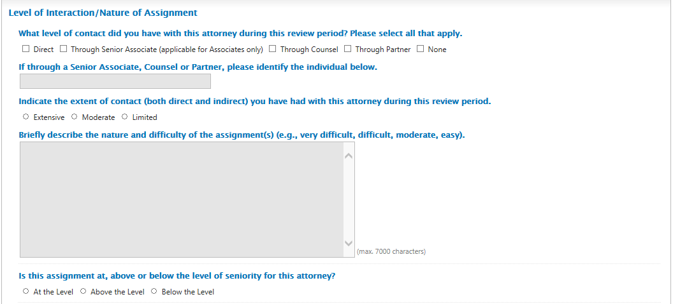

Slide 12
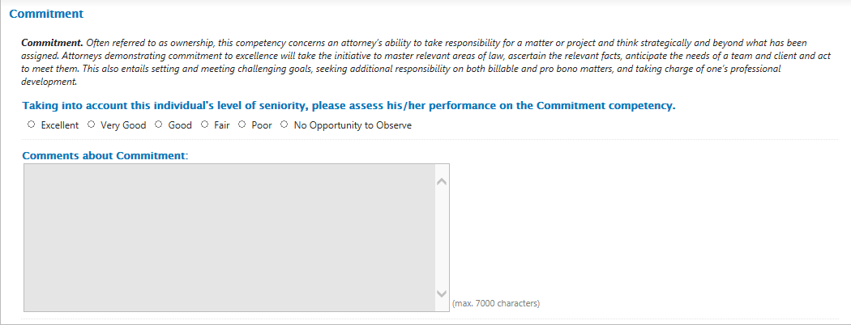

Slide 13
Competencies as a Reward
Promotions
Compensation

Slide 14
Challenges
Evaluation grade inflation
Consistency in overall assessment
Partner hours

Slide 15
Upward Evaluations
Matter management
Teamwork and collaboration
Training and development
Respect and recognition
Leaders get out in front and stay there by raising the standards by which they judge themselves—and by which they are willing to be judged.
– Frederick W. Smith, CEO of FedEx

Slide 16
Questions?

