Slide 1
Readying Students for Practice by Scaring them Senseless?:
Effective Uses of Fear
Appeals in the Classroom and Clinic
Carolyn Young Larmore
Abigail A. Patthoff

Slide 2
“Any Questions?”

Slide 3
“Fear Appeals” in Law School
Inadequate research
leads to malpractice
judgment
Supervisor gives poor
eval of student who
called him “dude”
Judges berates extern
for wearing flip flops
The “two-million-dollar comma”
Court orders attorney to
show cause why he should not
be disbarred for filing
“gibberish” brief
Judicial
“benchslaps”
Spell check changes
“sua sponte” to “sea
sponge”

Slide 4
Why We Use Them
To get “buy in”-- demonstrate the importance of taking a topic seriously
To teach ethics and professionalism, esp. important in clinics and externships
To enhance our own credibility
Image source: http://blogs.fit.edu/

Slide 5
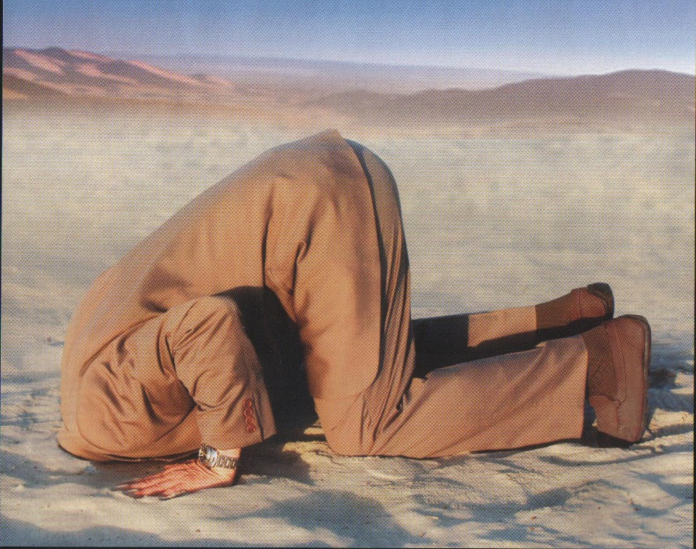
Potential Outcomes of Fear Appeals
Message acceptance
Defensive avoidance
Reactance
Source: www.123rf.com
Image source: http://optimisman.com
Image source: superstock.com

Slide 6
Components of Fear Appeals
Threat (the message)
Fear (the audience’s emotional reaction to the message)
and
3. Efficacy (the audience’s perception of their ability to avoid the threat)

Slide 7
Interaction of the Components
threat + efficacy = message acceptance
threat + efficacy = avoidance or reactance
threat + efficacy = indifference
threat + efficacy = mixed results

Slide 8
Fear Appeals Research Goes to Law School
Law student population – high in preexisting anxiety
High threat fear appeals are not effective in populations with high preexisting anxiety/fear
Image source: superstock.com

Slide 9
Threat
Perceived severity
If you violate ethical rules, you could be disbarred.
If you are inattentive to comma placement, you could lose your client millions of dollars.
Perceived susceptibility
You are studying to be a lawyer; lawyers are subject to ethical rules that you are at risk of violating if you are inattentive to those rules.

Slide 10
Efficacy
Perceived response efficacy
Does response work?
“I believe that knowing how to use commas prevents expensive ambiguities in contracts.”
Perceived self- efficacy
Can I do the response?
“I think that I can easily learn how to use commas to prevent expensive ambiguities in contracts.”

Slide 11
Ideas for Improving Efficacy
Limit the number of cautionary tales told
Deliver cautionary tales at lower-stress times in the semester
Pair cautionary tales with detailed instructions so that students have a clear roadmap for avoiding the threat

Slide 12
Clinic and Externship Application
Keep using them, but in moderation
Don’t front load in externship/clinic training
Give practical solutions
How do you proofread effectively?
How do you make sure you understand an assignment?

Slide 13
Conclusion
Cautionary tales with high efficacy/practical solutions are the most successful in changing student behavior
Questions / Comments?
Image source: clipartpal.com

