Slide 1
Where the Jobs Are Now and What They Require: Preparing Law Students for an Interprofessional World
AALS Clinical Conference May 2015

Slide 2
Roadmap for today
Where jobs are now, where they are headed
Types of interprofessional/interdisciplinary collaboration
Challenges & benefits of interprofessional/interdisciplinary collaboration
Small group discussion

Slide 3
What is interprofessional/interdisciplinary collaboration?
Involves members of different professions who work together to address multidimensional problems faced by clients

Slide 4
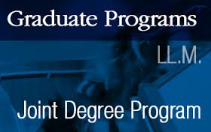
Trends in Law School Education
Notes:
Legal education and the job market seem to be trending in the direction of inteprofessional/interdisciplinary collaboration:
“Inteprofessional/interdisciplinary” is the new buzz-word among law schools:
for example, Stanford’s hire of their most recent law school and med school deans was apparently based on their joint commitment to interdisciplinary learning.
Other esteemed law schools, including my own, UC Hastings, and UWash have been vocal regarding the design of their programs and even strategic plans for this end
Anecdotal evidence regarding notable increase in joint law degrees across disciplines even as law school enrollment has dropped by more than 25%

Slide 5
Job Trends
Health Law
IP
Elder Law
Energy Law
Food & Drug
Immigration
Others….
Notes:
Seems to be growth in legal fields which tend to be interdisciplinary in nature:
Big one is Health Law: considered one of the most in-demand job markets, according to US News & World Report (and “Super Hot” by multiple surveys)
Over half of the fastest growing occupations are in health care, which means that health lawyers are in demand, and likely to only increase, in settings from government agencies to hospitals and law firms. The work covers everything from embryonic stem cell research to Medicare fraud and implementation of the Affordable Care Act [1/3 of projected fastest growing occupations through 2020 are in the health care field (US Bureau of Labor & Statistics)]
Health care field is already largely interdisciplinary in practice and there’s increasing emphasis on building out more interprofessional training in health professional education by the Institute of Medicine and other groups, so budding health law attorneys need to be trained to work across professions.
Other areas of law considered “hot” which also favor interprofessional/interdisciplinary collaboration:
IP: explosive growth of patent work: needing lawyers trained in business, science (i.e. expected growth of patenting in synthetic DNA)
Elder Law: poised to grow; closely related to health law due to rapid aging of our population, field where attys likely to deal with doctors frequently and deal with crossover medical-legal issues like mental capacity, end-of-life wishes, and more
Energy Law, etc.

Slide 6
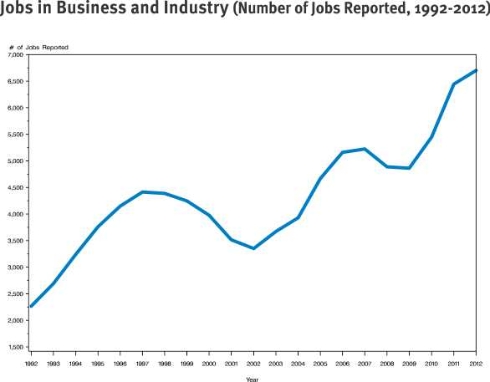
Source: National Association of Law Placement, Inc. (NALP)
“Jobs in Business and Industry - Two Decades of Change,” NALP Bulletin, November 2013
http://www.nalp.org/1113research, last accessed 5/3/15
Notes:
Nature of the practice is changing, with more law grads then ever taking jobs directly in business and industry instead of law offices- so law students need to know how to work together with other disciplines!
[According to Assoc for Legal Career Professionals (NALP) 2012 study: % of employed law school grads taking jobs in business and industry has doubled to nearly 20%; half of these come predominantly from banking & finance and technology/e-commerce; other half untracked, but include health care, manufacturing, others]

Slide 7
Why interprofessional/interdisciplinary?
Notes:
Why these changes?
Some people posit that it’s due to the growth of the global economy which leads to greater complexity in the legal landscape
Growing recognition that legal problems arise in larger contexts where it’s difficult to separate out the legal aspect from other disciplines
New idea of efficiency through collaboration and keeping professions less silo’ed, considered a way to leverage limited resources and address problems and help clients more effectively.
This seems to be the clear trend, so now is a good time to jump on the bandwagon!
A lot of lawyering now takes place in field of regulatory compliance, and statutes, so it’s not what we’ve traditionally thought of as litigation or even transactional, but really compliance, statutory interpretation: IP, environmental, health, pharm, so need that rigor and training across the company
Systemic change work by its nature implicates multiple perspectives.

Slide 8
Mapping Interprofessional in Our Lawyering and Teaching

Slide 9
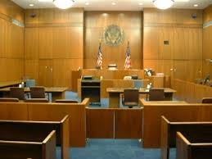
Client Representation
Training to issue spot among potential clients
Referrals for intake and/or participation in intake process
Working with expert witnesses
Writing affidavits or other reports
Consulting with law students/lawyers on
relevant substantive issues
Observations in court
Participation on advocacy team

Slide 10
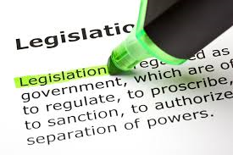
Legislative/Policy Advocacy
Issues in interprofessional direct service informs need for legislation
Draft legislation with interprofessional partner
Prepare testimony for legislative hearings
Collaborate on fact sheets, white papers, etc.
Create coalitions and organize community groups
Collaborative research in support of policy/legislative advocacy
Meetings with individual legislators (i.e., “lobbying”)

Slide 11
Research
Collaborate with students/faculty from other disciplines on research
Research issues related to cases and/or systemic issues informed by other disciplines
Interprofessional empirical research
Clinic as research “site”

Slide 12
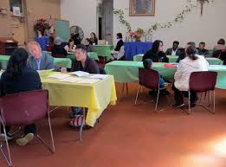
Lawyering in the Community
Conduct intakes at community partner sites
Hold office hours and/or meet with clients at community partner locations
Community education presentations with community organizations or in collaboration with interprofessional partners

Slide 13
Outreach/Education
Present on legal issues to students/professionals from other disciplines
Train professionals from other disciplines to spot legal issues and refer cases
Train other professionals on legal issues to inform the work of those professionals and help them advocate in their own roles
Provide consultation on legal issues to professionals from other disciplines
Participate in team meetings of other professionals

Slide 14
The Clinical Seminar
Law students and students from other disciplines take joint seminar
Simulations
Case rounds
Students from other disciplines rotate in law clinic
Faculty/professionals from other disciplines teach clinic seminar sessions

Slide 15
Interprofessional Collaboration Competencies

Slide 16
Interprofessional Competency Domains
Interprofessional Values and Ethics
Roles and Responsibilities
Interprofessional Communication
Collaboration and Teamwork
Conflict Management

Slide 17
The Case of Edgar

Slide 18
Benefits of Interprofessional Clinics
Broadening of perspectives- move away from narrow approach
Learn about roles, boundaries, limits of each profession of the collaboration
Familiarity with knowledge base of partner profession
Appreciate shared professional values
Build trust, understanding and respect among members of collaboration
Build skills to collaborate effectively and engage in shared decision-making
Models real experience of interdisciplinary collaboration in law
Better service for clients; better problem-solving for systemic issues
Increased reflection: students reconsider their own roles as lawyers and advocates
Source: Galowitz, Paula. The Opportunities and Challenges of an Interdisciplinary Clinic, International Journal of Clinical Legal Education. 2012. 18: 163-178.

Slide 19
Thank you!
AALS Clinical Conference May 2015

