Slide 1
AALS National Security Law Section: Mike Lewis Prize for Scholarship

Slide 2
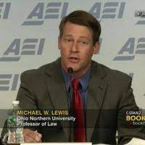
Professor Michael Lewis, Ohio Northern Petit College of Law,
Mike graduated from Johns Hopkins; became a Navy “Top Gun” flying F-14s in Desert Storm
After Harvard Law, Mike worked at McKinsey & Co. and McGuire Woods LLP
Became a professor of law at Ohio Northern Law, writing on the law of armed conflict, including targeting and drone warfare
Other subjects: international criminal law, including war crimes; use of force, including aggression (so timely today)
Before his untimely death at age 50 in 2015, Mike wrote many law review articles and book chapters, including one that I co-authored on military commissions

Slide 3
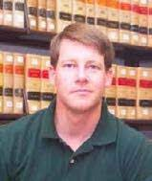
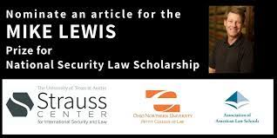
Mike Lewis as Scholar & Teacher
-Mike blogged regularly for Opinio Juris
-His perspective was practical and informed by his experience, but always balanced military necessity & humanity
-Conferences in US & abroad including Penn State & the Naval War College in Newport, Rhode Island (I remember a spirited session at a bar in The Hague with Laurie Blank of Emory Law, now at DoD)
-Mike was a devoted teacher; he often brought students along and encouraged their work
-Recognizing Mike’s work: The Mike Lewis Prize for National Security Law Scholarship, sponsored by Ohio Northern Law, the Robert Strauss Center for International Security and Law at UT-Austin, and the AALS Nat’l Security Law Section

