Slide 1
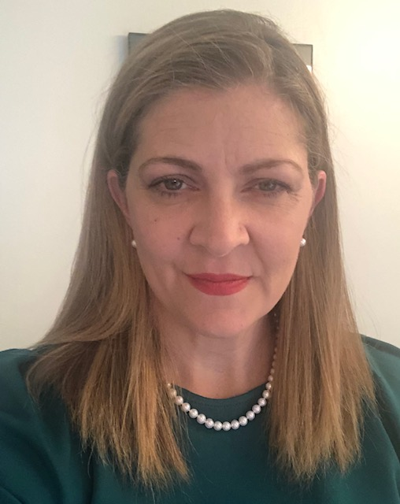
ASSESSMENT AND EVALUATION: TOOLS FOR STUDENT IMPROVEMENT
Presented by:
JENNIFER S. MARTIN, J.D.
PROFESSOR OF LAW
jmart@albanylaw.edu

Slide 2
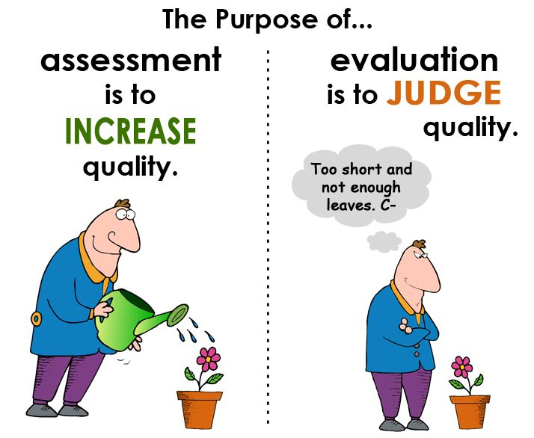
Assessment v. Evaluation
How do you use assessment or evaluation in your work?
How COULD you use assessment or evaluation in your work?

Slide 3
Let’s back up…
Measure: You first need a measurement to collect data; an example is a test or survey; “Charles got 5 out of 10”
Assessment: Based upon the data collected in the measurement, you can make an assessment; “Charles’ grade is poor”
Evaluation: Using data collected from the assessments, you can evaluate and determine a plan/change/needs; “Charles needs to work on these 2 things to improve”

Slide 4
First Step: Develop Course Outcomes/The syllabus What are you measuring and why?
By the end of this course, students should be able to:
identify, describe, compare and contrast the attributes of the essential elements of contract formation at common law (offer, acceptance and consideration) and defenses to formation, including mistake, misrepresentation, incapacity, duress, unconscionability, undue influence and statute of frauds; contract performance, breach and excuse; remedies; and third party rights
appreciate the challenge of balancing several important and, at times, competing values within a coherent legal framework know how to extract rules and policy from judicial opinions
identify issues and holdings in judicial opinions
recognize the various sides of a given legal issue, and effectively articulate the strengths and weaknesses of each
distinguish or harmonize, as appropriate, cases on the basis of law and/or fact
summarize and apply the applicable rules to problem

Slide 5
Second Step: Assessment of Student Learning Examples/Ideas of Assessments What are you trying to measure in the assessment?
Cali.org tutorials
West Academic Casebook Plus Question Banks
Aspen Connected Casebooks
NCBE past exams
Problems from your casebook that you’ve not used
Law Professor Blogs (often has current events and oldies but goodies)
Recent cases
Problems from other casebooks

Slide 6
Once you have an assessment in mind . .
Find/Create a measurement
Make sure the assessment measures what you are trying to find
What are your expectations in terms of student performance?
Excel spreadsheets can be helpful to provide student feedback and determine class averages
Collecting Data/ The scores
Data is essential for assessment and evaluation
Interpret the data
How did the students do individually and as a group?

Slide 7
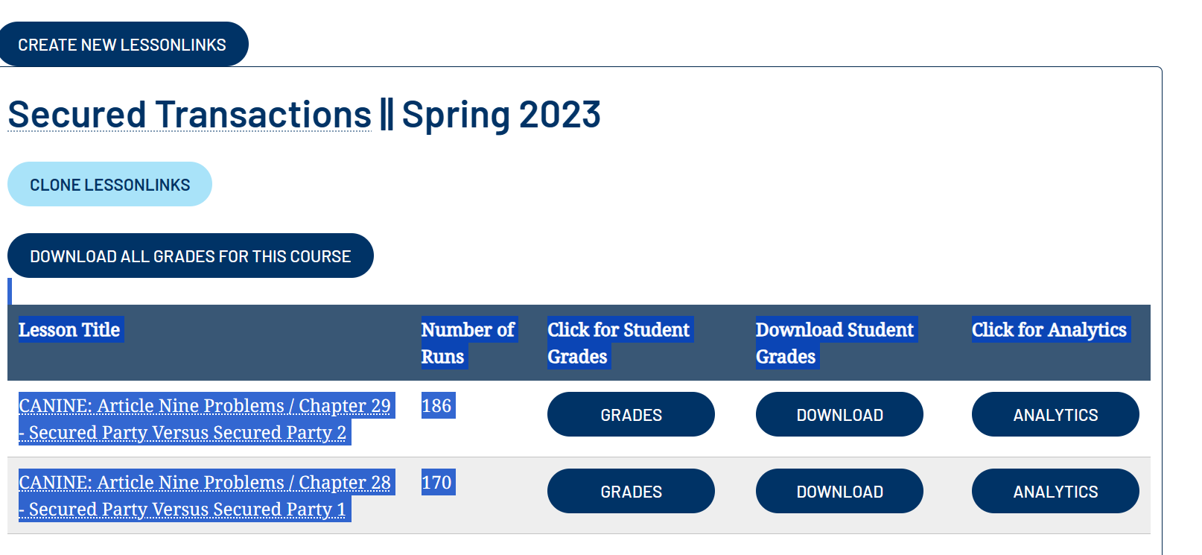
Example 1: A CALI Lessonlink on Secured Transactions: formative assessment and learning

Slide 8
Example 2: What might the data for an essay look like? Create a rubric

Slide 9
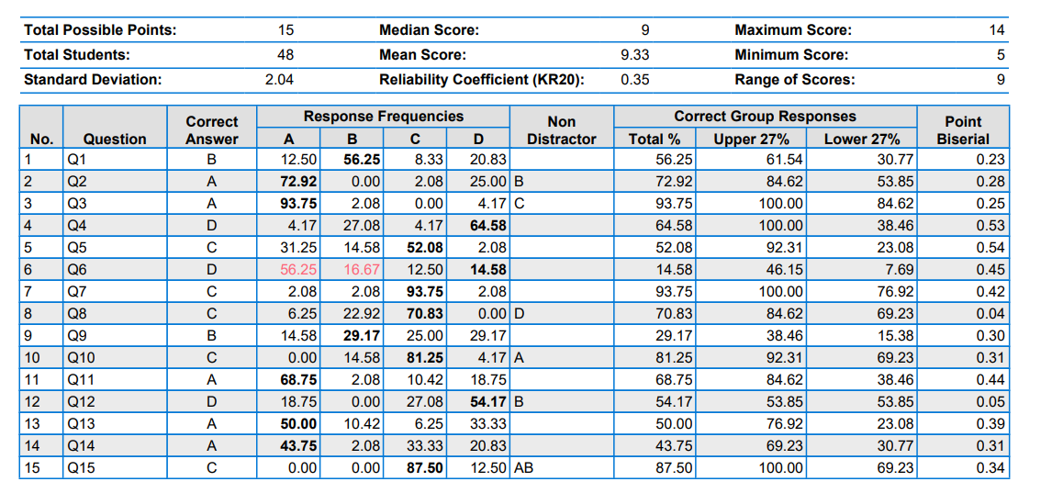
Example 3: A set of multiple-choice questions? Just the numbers here but you can break them down by topic.

Slide 10
Let’s back up… again
Measure: You first need a measurement to collect data; an example is an essay test or tutorial or multiple-choice set; “Charles got 5 out of 10” OR the class average for the assessment was 5 out of 10.
Assessment: Based upon the data collected in the measurement, you can make an assessment; “Charles’ grade is poor” OR the class a whole did poorly
Evaluation: Using data collected from the assessments, you can evaluate and determine a plan/change/needs; “Charles needs to work on these 2 things to improve” OR . . . The class as a whole needs to work on these 2 things to improve . . .

Slide 11
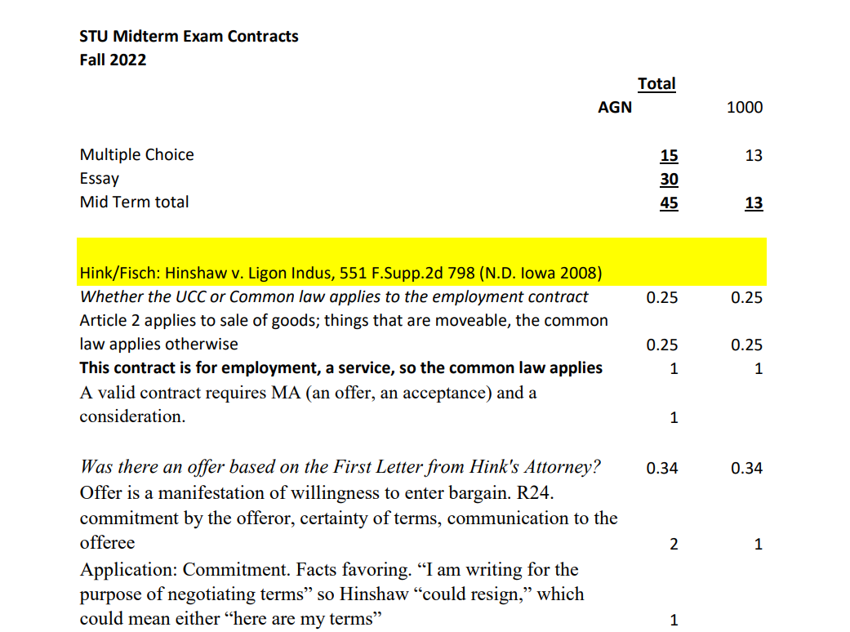
Closing the loop: Providing Student Feedback
Class averages on different questions and portions of the exam/mc v. essay

Slide 12
What can you say about the assessment/course? Closing the loop on your course
What can the students do better next time? As a group?
Do we need to change what we teach or how we teach it?
Was the assessment effective?

Slide 13
Any Questions?

