Slide 1
AALS Workshop for Adjunct Faculty
Session Two: “Conducting Classes”
Presentation One:
David L. Jamison, Distinguished Lecturer,
Duquesne University Thomas R. Kline School of Law

Slide 2
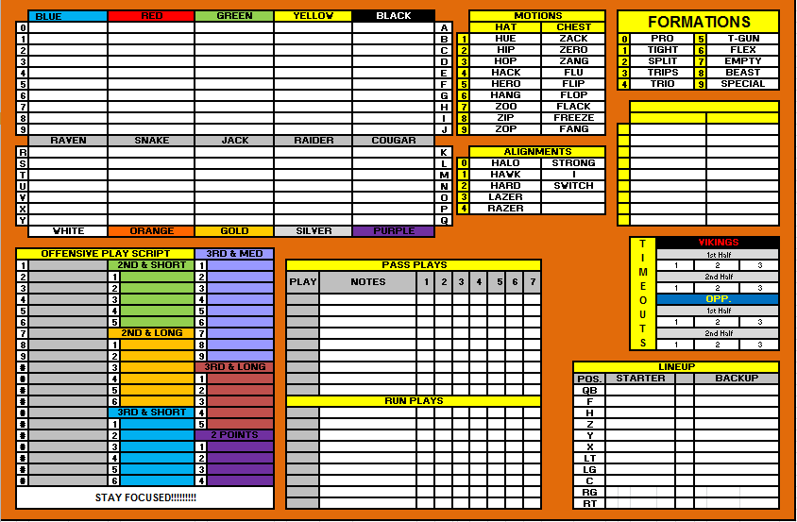
Conducting Classes: Suggestion One
Have A Game Plan . . .

Slide 3
Conducting Classes: One (Cont.)
… But adapt …

Slide 4
Conducting Classes: Two
Remember that you’re an adjunct . . .

Slide 5
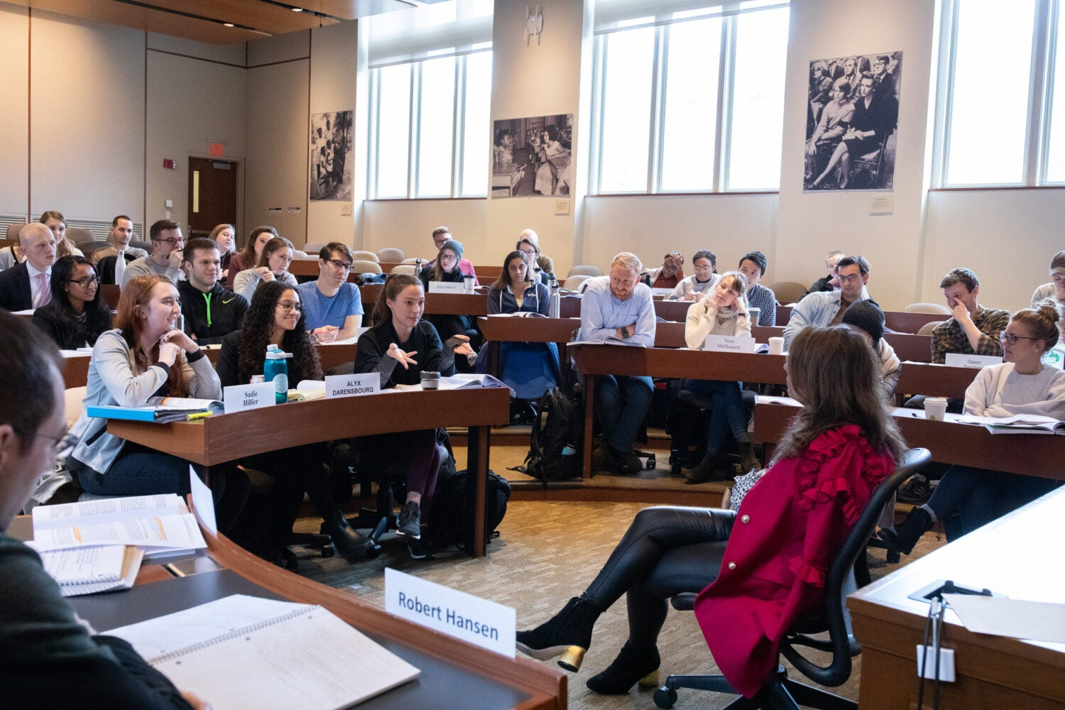
Conducting Classes: Two (cont.)
. . . then forget that you’re an adjunct . . .

Slide 6
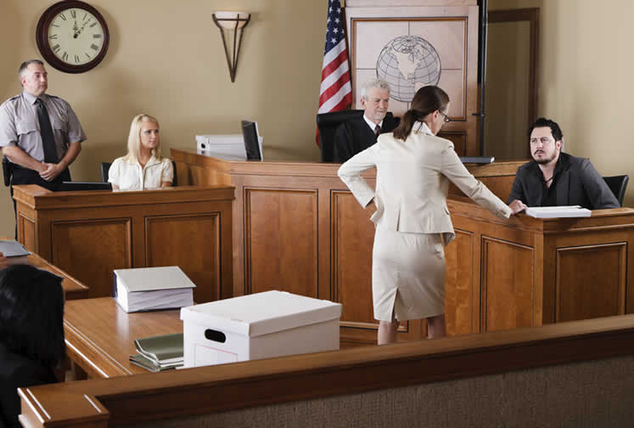
Conducting Classes: Three
Draw on your experience . . .

Slide 7
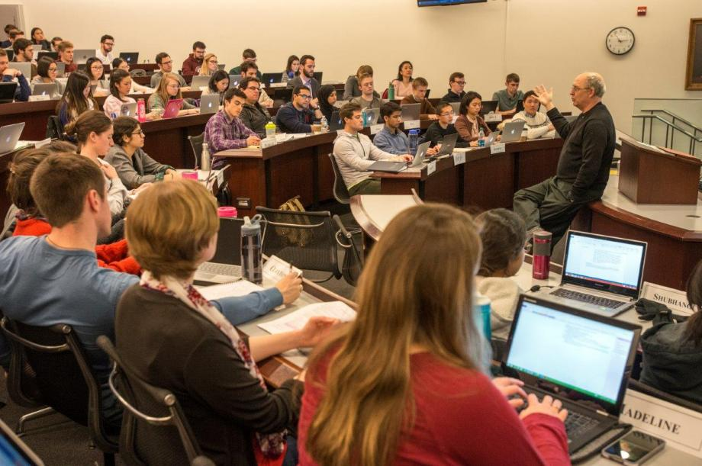
Conducting Classes: Three (Cont.)
. . . but remember the goal . . .

Slide 8
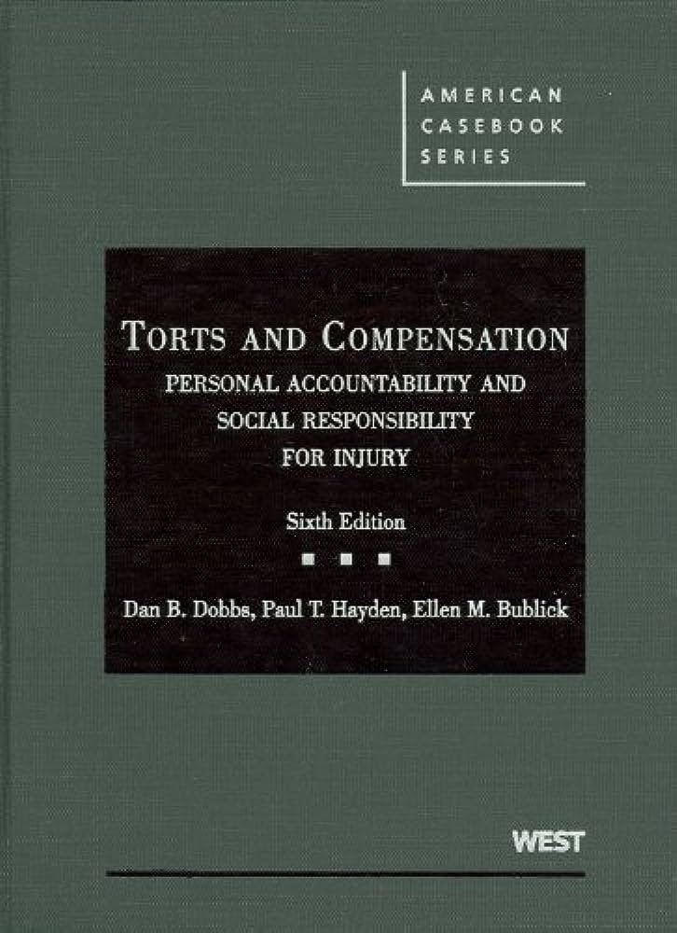
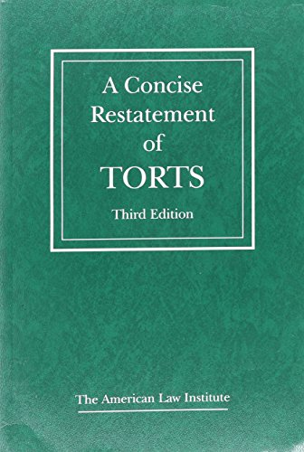
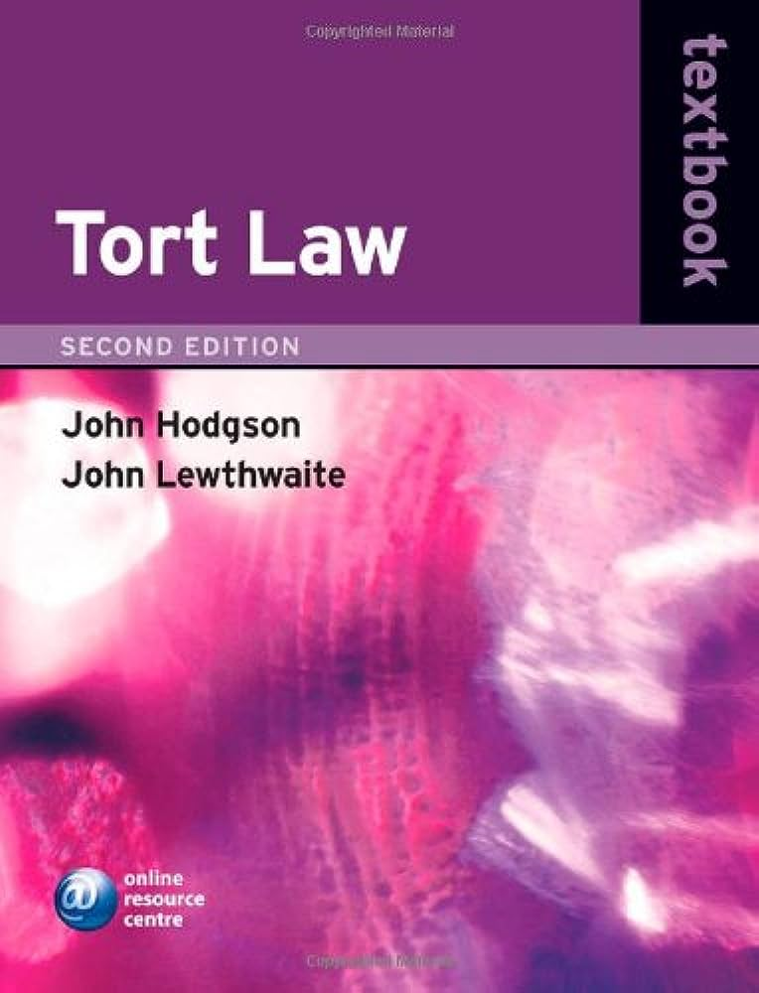
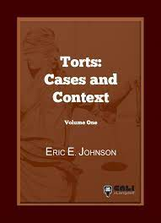
Conducting Classes: Four
You know what to present . . .

Slide 9
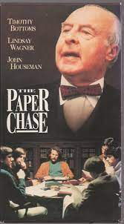
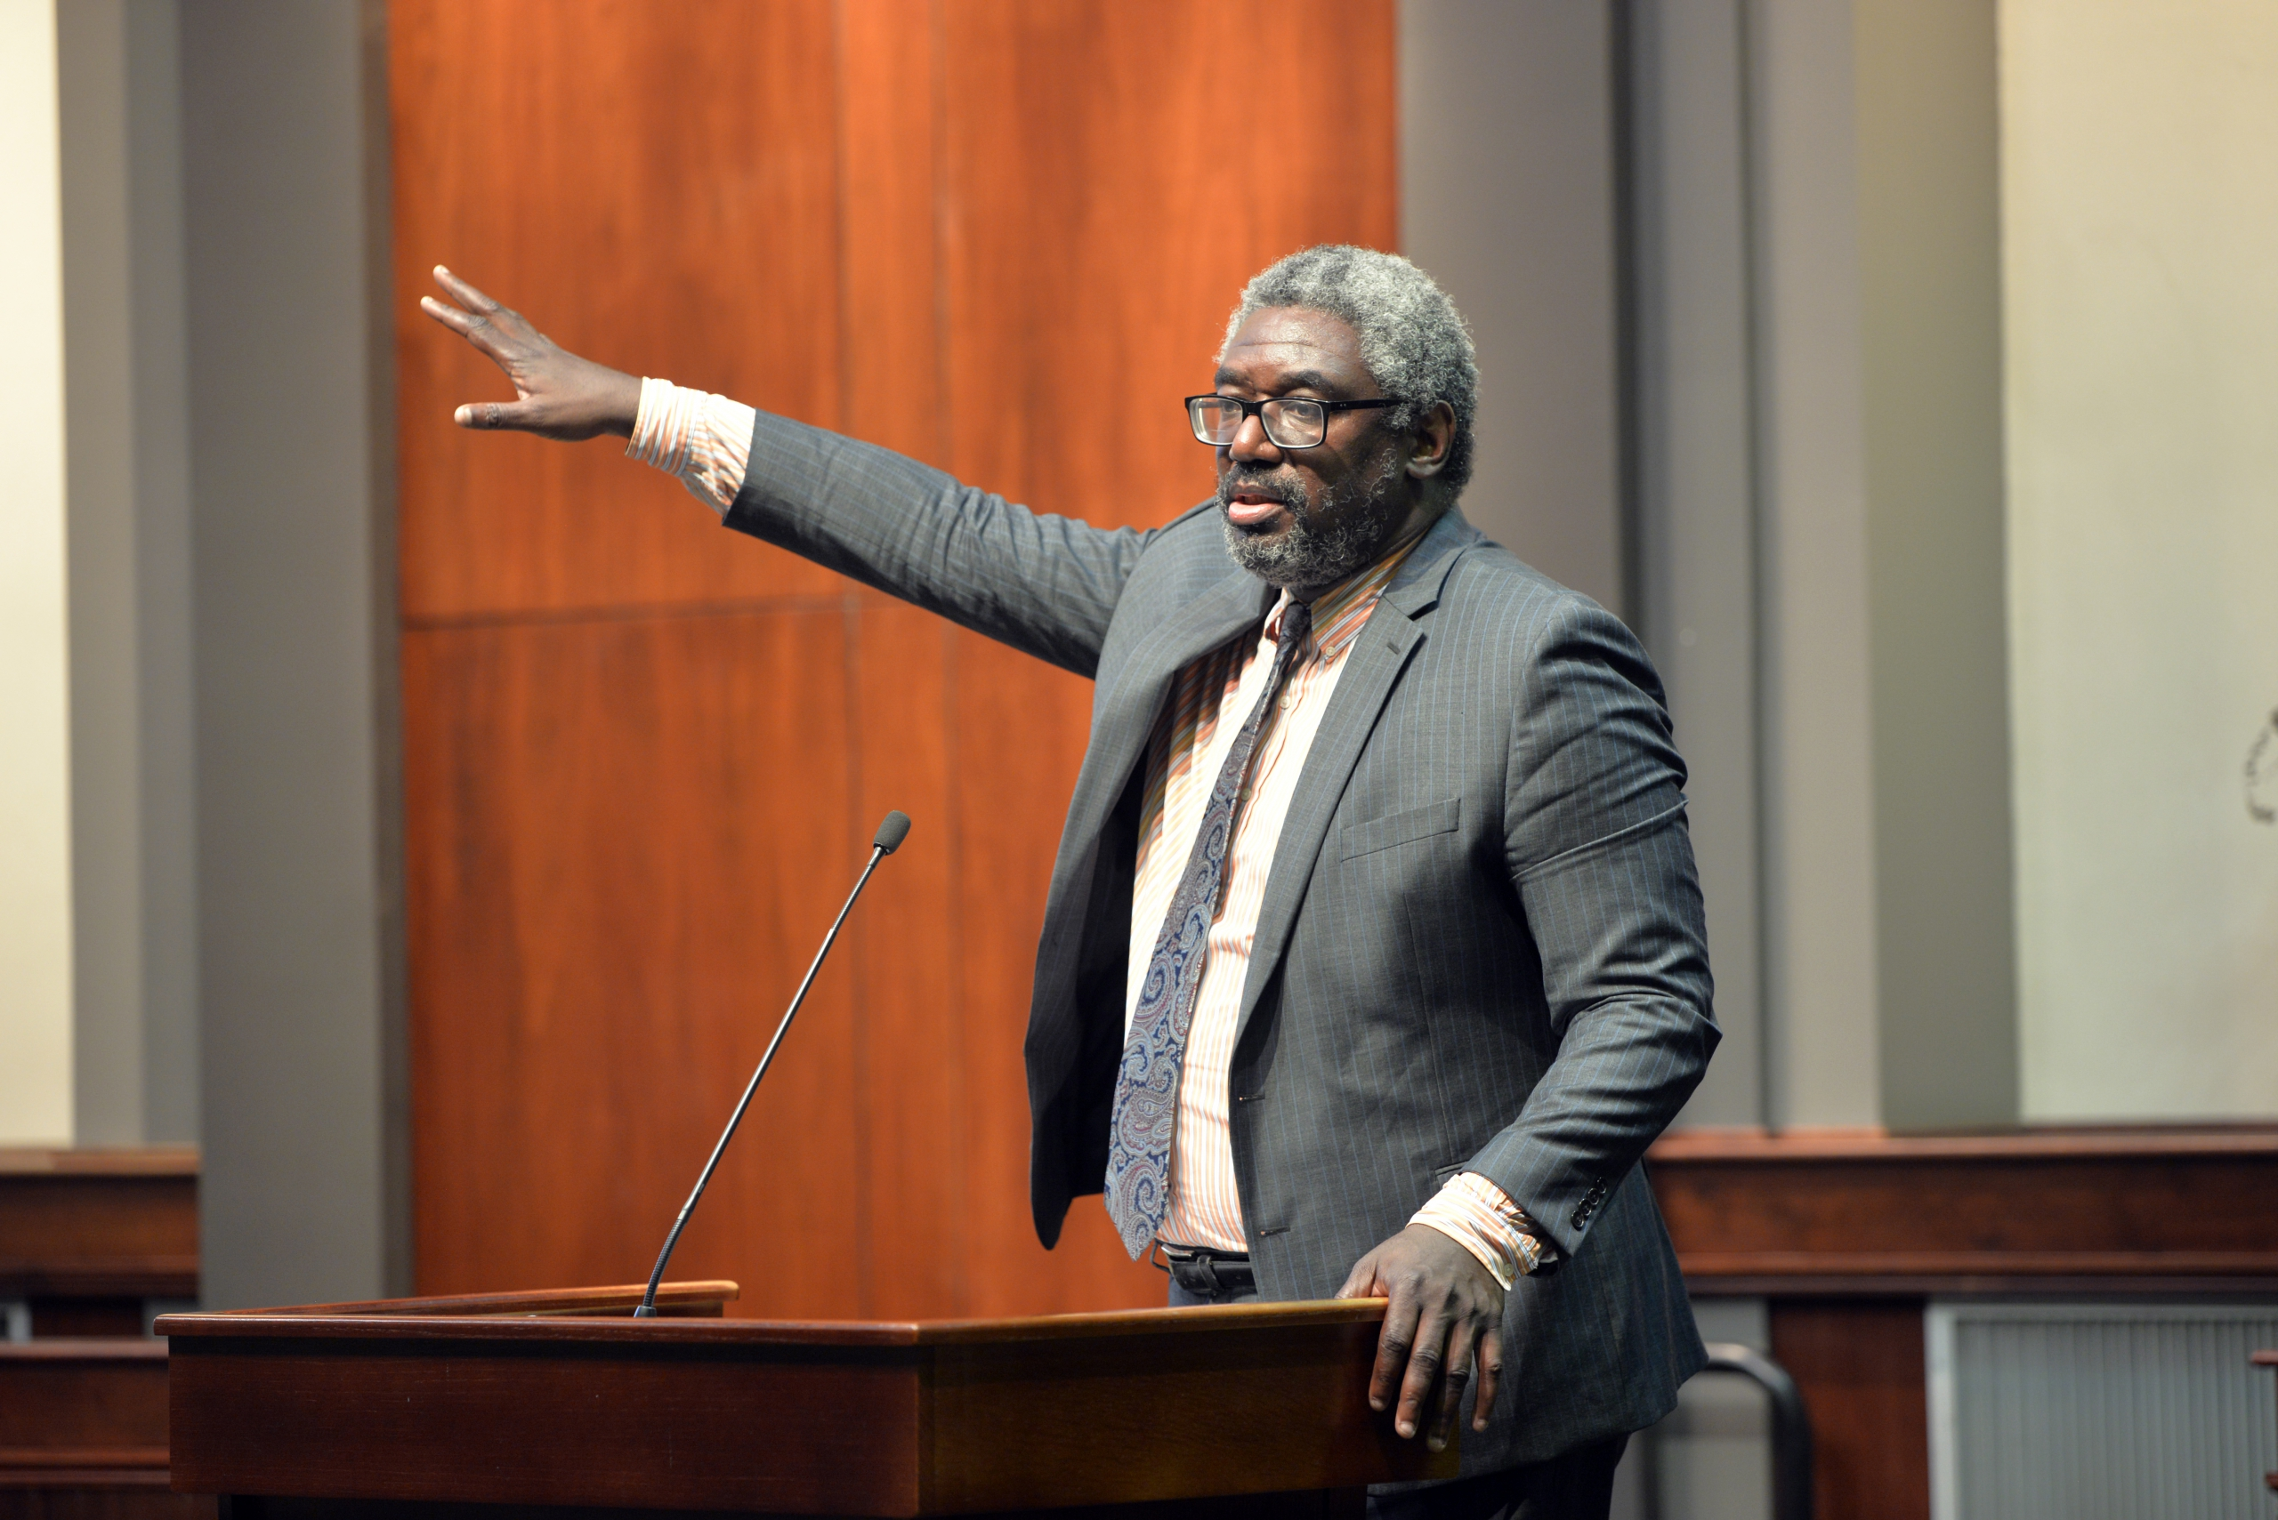
Conducting Classes: Four (Cont.)
. . . but how to present it is today’s biggest challenge . . .

