Slide 1
Welcome and Introduction
Austen parrish | Indiana University Maurer School of Law
Chair, AALS Membership review committee
Association of American Law Schools
Advancing Excellence in Legal Education
Copyright © 2020 Association of American Law Schools. All rights reserved.

Slide 2
Quick Overview
Advancing Excellence in Legal Education
Programs for Faculty
The Membership Review Process
  ABA Accreditation v. AALS Membership Review
  Regulatory Review v. Peer Review
  List of Requirements v. Adherence to Core Values.
Association of American Law Schools
Advancing Excellence in Legal Education
Copyright © 2020 Association of American Law Schools. All rights reserved.

Slide 3
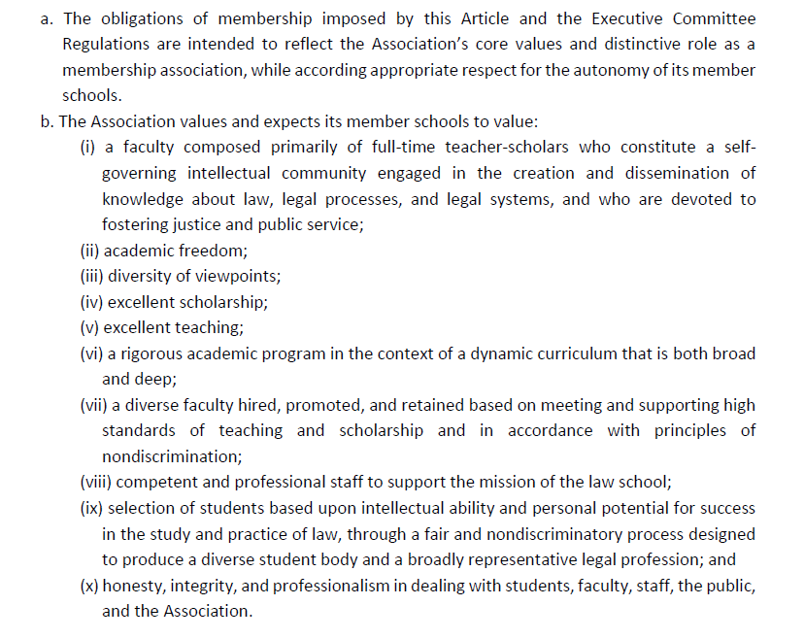
AALS Core Values
AALS Bylaw Article 6. Requirements of Membership
Scholarship and Teaching
Diversity and Nondiscrimination
Self-Governance
Academic Freedom
Honesty and Integrity
Association of American Law Schools
Advancing Excellence in Legal Education
Copyright © 2020 Association of American Law Schools. All rights reserved.

Slide 4
A Renewed Focus
An Emphasis on Peer Review and Mutual Support
Presumption that member schools desire to adhere to core values
Peer Review, including:
    Peer Counsel when member school appears to be struggling.
    Fewer report backs—only if member school is not willing or able to take appropriate steps to correct serious shortcomings involving core values.
    Praise for innovation
Recognition that schools can be different while pursuing core values
Process remains confidential
Association of American Law Schools
Advancing Excellence in Legal Education
Copyright © 2020 Association of American Law Schools. All rights reserved.

Slide 5
Overview of the AALS Process
Judith areen| AALS executive director
Association of American Law Schools
Advancing Excellence in Legal Education
Copyright © 2020 Association of American Law Schools. All rights reserved.

Slide 6
Membership Review Process
Member Schools – reviewed every ten years
  Bylaw 6 standards; Regulations and Policy
Change of Operation
  Significant – major programmatic, locational or institutional change (such as merger, new entity, new degree, new division, new branch, affiliation, closure)
Association of American Law Schools
Advancing Excellence in Legal Education
Copyright © 2020 Association of American Law Schools. All rights reserved.

Slide 7
AALS Membership Review Process
School Visit
  AALS Questionnaire
  ABA Materials
AALS Report
  Sent to member school
  Any response by member school
Membership Review Committee
  Reads AALS Report, AALS Questionnaire, ABA materials, school responses
  Recommendation to Executive Committee
Executive Committee Decides
  Letter to the School
Association of American Law Schools
Advancing Excellence in Legal Education
Copyright © 2020 Association of American Law Schools. All rights reserved.

Slide 8
Membership Review Committee
Who?
  Law school faculty
  Law school deans
What?
  Relies primarily on AALS reporter to be fact finder
When?
  Meets in April and October
Association of American Law Schools
Advancing Excellence in Legal Education
Copyright © 2020 Association of American Law Schools. All rights reserved.

Slide 9
Executive Committee
Who?
  Law school faculty and deans
  Elected by member schools
What?
  Determines compliance with AALS Bylaws and
  Executive Committee Regulations
  Interprets and Implements AALS requirements
When?
  May and November
Association of American Law Schools
Advancing Excellence in Legal Education
Copyright © 2020 Association of American Law Schools. All rights reserved.

Slide 10
Executive Committee Letter to Member School
Peer Advice
  Strengths and achievements; suggestions for improvement
More Information
  Cannot determine compliance with membership requirements
Progress Report
  Concern about compliance with requirements
Sanction
  Material failure to comply with membership requirements
Association of American Law Schools
Advancing Excellence in Legal Education
Copyright © 2020 Association of American Law Schools. All rights reserved.

Slide 11
Support for the AALS Reporter
Barbara Studenmund| aals director of membership review
Association of American Law Schools
Advancing Excellence in Legal Education
Copyright © 2019 Association of American Law Schools. All rights reserved.

Slide 12
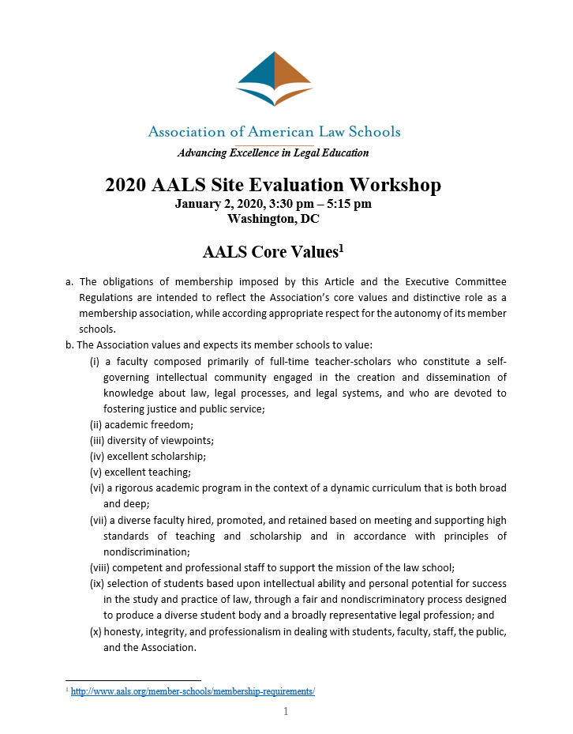
Workshop Handout Contents
AALS Process and Role of the AALS Reporter
Sabbatical Visit Timeline
Reporter Appointment Letter
  Enclosed: Instructions to the AALS Reporter
Classroom Visit Form
Discussion with Dean
AALS Questionnaire
Format of the Report
EC Letter to School
AALS Bylaw and EC Regulations
Association of American Law Schools
Advancing Excellence in Legal Education
Copyright © 2019 Association of American Law Schools. All rights reserved.

Slide 13
AALS Reporter Materials
Dropbox invitation sent via email
Included materials:
  AALS Membership Requirements
  Memo to Dean
  AALS Questionnaire
  Report Format Outline
  Reporter Instruction Memo
  ABA Conduct Memo
  ABA Site Report Template
  Classroom Visit Form
  Confidentiality
Association of American Law Schools
Advancing Excellence in Legal Education
Copyright © 2019 Association of American Law Schools. All rights reserved.

Slide 14
Changes to the AALS Membership Review Process
AALS Questionnaire
  Draws information from the ABA Site Evaluation Questionnaire
  Also Collects Info re Online Distance Education Information
Communications with AALS Reporters
  “Know Before You Go” emails
  Reporter Survey
Annual Report sent to Member Schools and Reporters
Association of American Law Schools
Advancing Excellence in Legal Education
Copyright © 2019 Association of American Law Schools. All rights reserved.

Slide 15
The AALS Questionnaire and Finalizing the AALS Report
Cara McQuitty | AALS Membership Review Coordinator
Association of American Law Schools
Advancing Excellence in Legal Education
Copyright © 2020 Association of American Law Schools. All rights reserved.

Slide 16
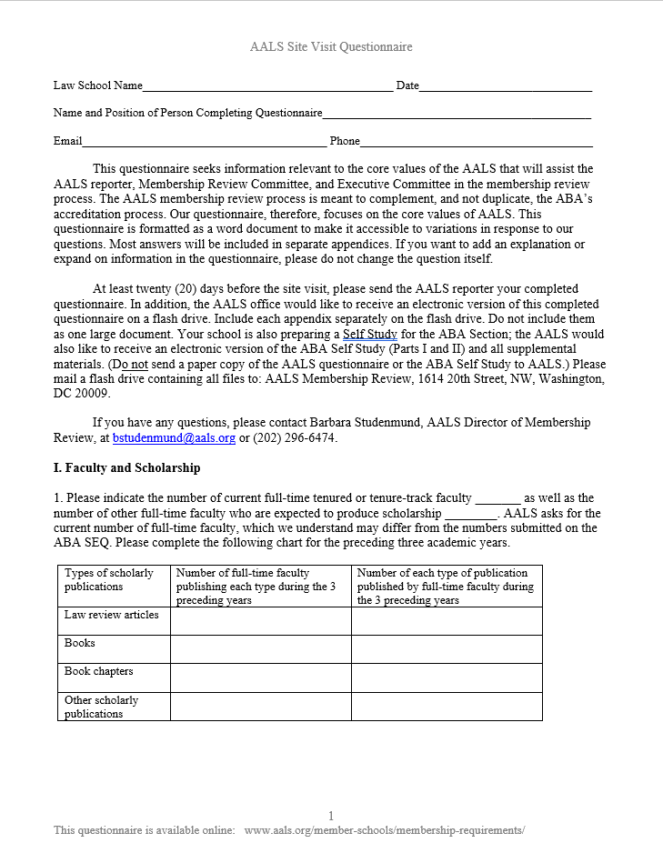
The AALS Questionnaire
Faculty and Scholarship
Teaching
  “Course Hours Summary” and alternatives
Improvements Since the Last Site Visit
  New emphasis on positive changes
Nondiscrimination and Diversity
  AALS Bylaw 6-3b updated in January 2016
  Addition of ABA 509 report
Faculty Profile
Association of American Law Schools
Advancing Excellence in Legal Education
Copyright © 2020 Association of American Law Schools. All rights reserved.

Slide 17
AALS Questionnaire for 2019-2020
Information from the ABA Site Evaluation Questionnaire
Supplemental information:
  Teaching quality and effectiveness
  Scholarly productivity
Replacement information:
  Faculty diversity efforts
  Online and distance education
Information we continue to ask for:
  “Course Hours Summary” charts
  509 Standard Information Reports
Association of American Law Schools
Advancing Excellence in Legal Education
Copyright © 2020 Association of American Law Schools. All rights reserved.

Slide 18
Wrap Up: AALS Staff Review
AALS Staff and the Membership Review Consultant reviews AALS report for:
  Completeness
  Consistent data
  Facts
Ensures that report:
  Does not indicate AALS compliance
  Does not inappropriately identify faculty
Association of American Law Schools
Advancing Excellence in Legal Education
Copyright © 2020 Association of American Law Schools. All rights reserved.

Slide 19
Wrap Up: Committee Review
AALS Membership Review and Executive Committees review materials for each school:
  AALS Report
  AALS Questionnaire
  ABA Report
  Dean’s comments on ABA and AALS Reports
Membership Review Committee makes recommendations to the Executive Committee
  Executive Committee sends final action letter to the school
  AALS Reporter will receive a copy of the final action letter
Association of American Law Schools
Advancing Excellence in Legal Education
Copyright © 2020 Association of American Law Schools. All rights reserved.

Slide 20
The AALS Reporter
Barbara j. cox | California western school of law
AALS Membership Review consultant
Association of American Law Schools
Advancing Excellence in Legal Education
Copyright © 2020 Association of American Law Schools. All rights reserved.

Slide 21
What have I gotten myself into?
Association of American Law Schools
Advancing Excellence in Legal Education
Copyright © 2020 Association of American Law Schools. All rights reserved.

Slide 22
The AALS Reporter 101
Represents the AALS
Independent of ABA/different focus
  Faculty Governance
  Faculty Scholarship
  Faculty and Student Diversity
  Nondiscrimination
Fact-finder
You’re it
Association of American Law Schools
Advancing Excellence in Legal Education
Copyright © 2020 Association of American Law Schools. All rights reserved.

Slide 23
The AALS Reporter
Preparing for the visit
The Visit
Writing the Report
Association of American Law Schools
Advancing Excellence in Legal Education
Copyright © 2020 Association of American Law Schools. All rights reserved.

Slide 24
Preparing for the Visit
Coordinate with key people
  Team chair
  Team members (class/office visits)
  The dean*
  On-site point persons
  Faculty chairs, staff
Association of American Law Schools
Advancing Excellence in Legal Education
Copyright © 2020 Association of American Law Schools. All rights reserved.

Slide 25
Preparing for the Visit
Review key documents
  AALS Site Questionnaire & Prior Report
  ABA documents: Site Evaluation Questionnaire
  and Self Assessment
  The School’s website
Association of American Law Schools
Advancing Excellence in Legal Education
Copyright © 2020 Association of American Law Schools. All rights reserved.

Slide 26
Preparing for the Visit
Review suggested format of the AALS Report
Follow suggested AALS Format for the Report
When surveyed, Reporters are split on whether to write a draft before the visit (and confirm data during visit) or wait until after the visit. Either way, the focus is to be thorough and accurate.
Association of American Law Schools
Advancing Excellence in Legal Education
Copyright © 2020 Association of American Law Schools. All rights reserved.

Slide 27
Preparing for the Visit
Meet alone with Dean
  By phone before the visit
  In person early in the visit
Communicate the AALS role
What is the School doing right?
Association of American Law Schools
Advancing Excellence in Legal Education
Copyright © 2020 Association of American Law Schools. All rights reserved.

Slide 28
The Visit
First meeting with the team
At the school
  The dean and president (in and out)
  Meet with key people
  Class and office visits (team effort)
  Due Diligence (trust but verify)
Fill in the blanks
Association of American Law Schools
Advancing Excellence in Legal Education
Copyright © 2020 Association of American Law Schools. All rights reserved.

Slide 29
Writing the Report
Make sure all the needed information is included
But limit your report to 7-10 pages single-spaced
Ask chair for team members’ drafts once received
Incorporate ABA Report by reference
Conform final ABA draft to your draft
Be factual; avoid using adjectives
No judgments or conclusions
No names
Polish/edit
Association of American Law Schools
Advancing Excellence in Legal Education
Copyright © 2020 Association of American Law Schools. All rights reserved.

Slide 30
Submit Your Report to the AALS Office
Expect to hear from me with any questions or suggested changes
Please respond to my email as soon as possible with your comments
Finalize the report
Association of American Law Schools
Advancing Excellence in Legal Education
Copyright © 2020 Association of American Law Schools. All rights reserved.

Slide 31
It’s done!
Association of American Law Schools
Advancing Excellence in Legal Education
Copyright © 2020 Association of American Law Schools. All rights reserved.

Slide 32

Overview of the ABA Process
William Adams
ABA Section of Legal Education Deputy Managing Director

Slide 33
Planning for the Visit at the School
Sabbatical Review of Fully Approved School Every Ten Years
Self Study
-Site Evaluation Questionnaire (SEQ)
No more data entry
-Self-Assessment
-Respond to Standard 204 (b)

Slide 34
The Site Visit Process
Appointment of Site Team Chair
New dashboard
Appointment of Other Site Team Members
-Librarian
-Clinician
-Judge/Practitioner
-Academic
-Univ. Admin.
-AALS Representative
-Chair coordinates
Team Member Assignments
Organization of Visit

Slide 35
-Materials
-Preparation for the Visit
-SEQ
-Self Assessment
New
Dashboard
Site Report Template
Site Visit
-Team Meetings
-Entrance Meeting
-Interviews with Faculty, Administrators, Staff
-Class Visits
-Meeting(s) with Students
-Exit Interview

Slide 36
Post-Visit Preparation of Site Report
Site Report Template
Office Review
Review of Site Report and Response by School

Slide 37
Evaluation of Site Team
-by Dean
-by Chair
-by Team Members
-by Report Reviewer
-by Council Monitor
Consideration of Site Report by Council/Decision Letter
-RFI
-11(a)(2)
-11(a)(3)

Slide 38
Report Back by School on Any RFI’s, 11(b)’s
11(a)(4)
Rule 13
Hearing
“School Remains on List of Approved Law Schools”
Rule 15
Sanction

